Slide 1
RiverRun Gardens
Community Outreach Meeting
July 18th, 2018
Newburyport City Hall
60 Pleasant St
Newburyport, MA 01950
Notes:
Good Evening – Thank you for taking time out of your night to be with us as I represent my company RiverRun Gardens, LLC

Slide 2
Mission Statement
RiverRun Gardens is a small family run operation that will offer a superior brand of cannabis achieved through organic horticultural practices.
We will provide excellent employment compensation and benefits to our team members.
Our organization aims to be good citizens by offering a percentage of our profits to aid various causes.

Slide 3
Purpose of RiverRun Gardens
Marijuana Cultivation business pursuant Cannabis Control Commission regulations 935 CMR 500.000
Tier I Cultivation (Maximum 5,000 Sq. Ft.)
Cultivate and Wholesale product to other licensed businesses
There will be NO RETAIL SALES or Public allowed at facility

Slide 4
Positive Impact to Community
RiverRun Gardens will positively impact Newburyport by donating over a quarter of a million dollars

Slide 5
RiverRun Gardens will not be a nuisance to the city of Newburyport, its Citizens, businesses and abutters

Slide 6
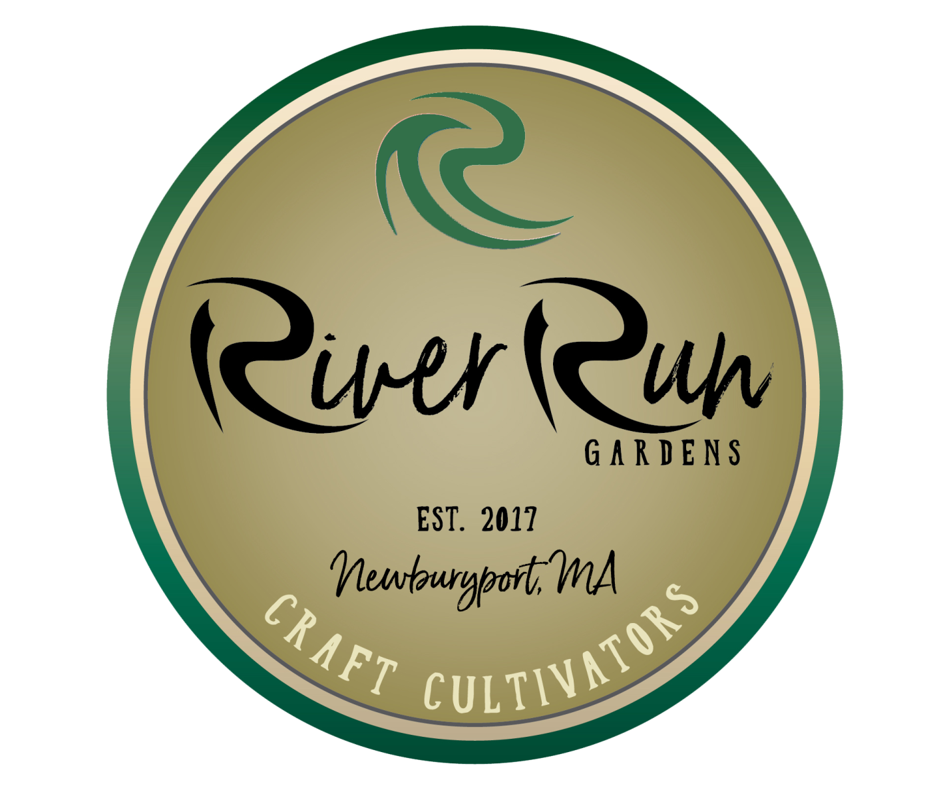
Meet The Team

Slide 7
Who Is RiverRun Gardens
Family owned small business started by father and son
3 employees, will be offering additional jobs to local citizens
Focused on medicinal benefits and education of cannabis

Slide 8
Edward X. DeSousa (Big Ed) Manager
Owner RiverRun Gardens
Started business in Newburyport 28 years ago
Licensed Import & Export legal matters
Experience in distribution and logistics centers

Slide 9
Edward M. DeSousa Operations
Owner RiverRun Gardens
20 years information technology
Experience in Financial, Consulting, Automotive & non-profit sectors
Cannabis Medical patient

Slide 10
Jim Blanchette Master Grower
Degrees in Plant Biology & Horticulture
Over 15 years experience operating family business: Blanchette Gardens
Studied Wisley Horticultural and Walt Disney Horticulture programs

Slide 11
Bob Peach Security Consultant
REPMS is a group of technically proficient professionals from all segments of the security industry: Distribution, Corporate End-user IT help desk, Project management, Systems Integrators and Product design
Bob has designed security systems for State and Federal law enforcement. He also has designed systems for casinos and financial institutions

Slide 12
Location

Slide 13
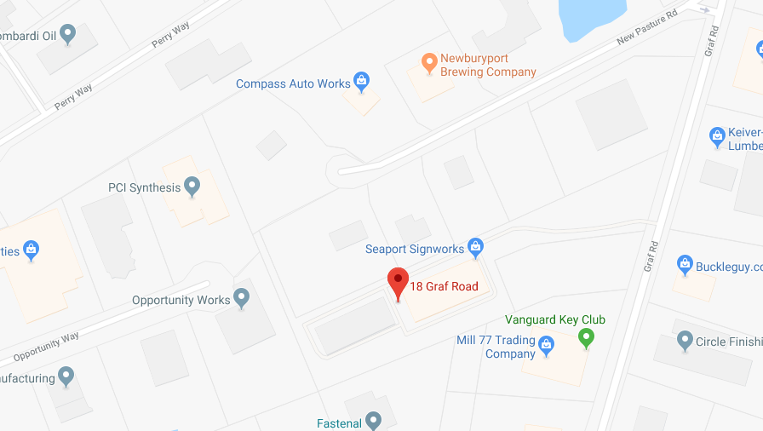
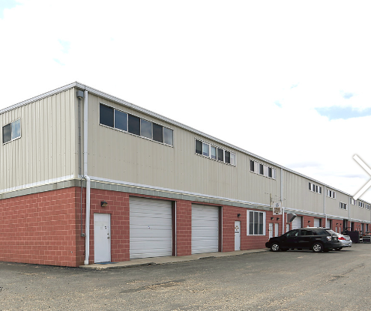
Location
RiverRun Gardens has obtained a lease in Newburyport’s Industrial Park at 18 Graf Rd, Units 24 and 25
Owner of property: Rick Boudrow
District: Marijuana Overlay District (V-G)
Total Sq. Ft. of cultivation 3,830ft

Slide 14
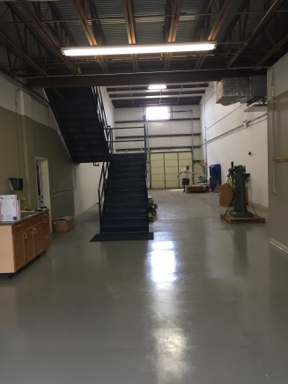
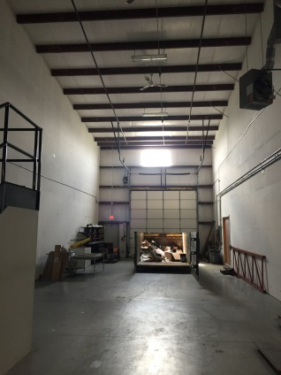
Existing Structure
2 Bays, 98 x 24 - Units 24 & 25
Total 5,244 Sq. Ft.

Slide 15
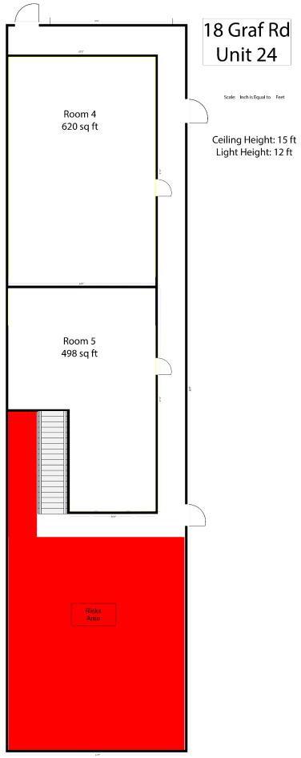
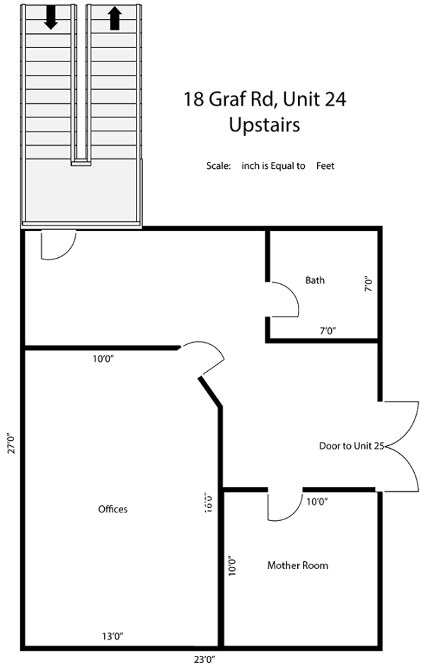
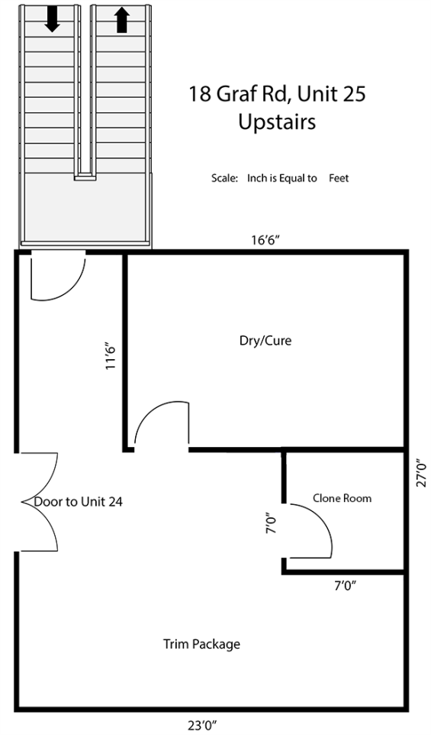
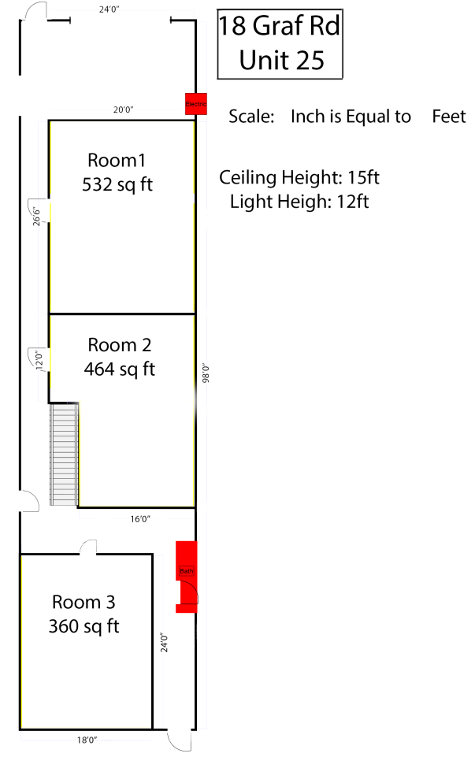
Planned Upgrades
Unit 25
Unit 24

Slide 16
Inspections
RiverRun Gardens will comply with all Municipal and Statutory Inspection requests

Slide 17
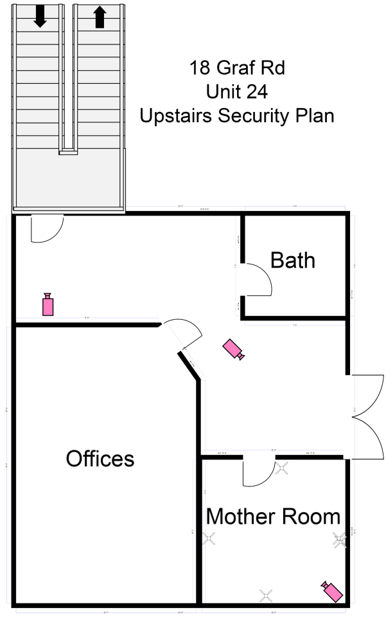
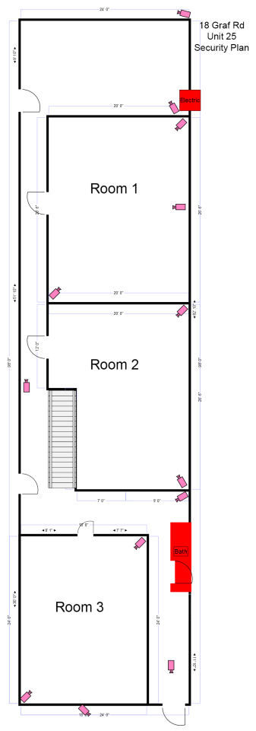
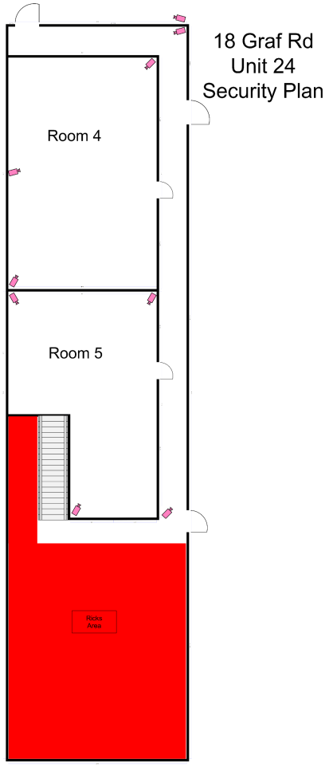
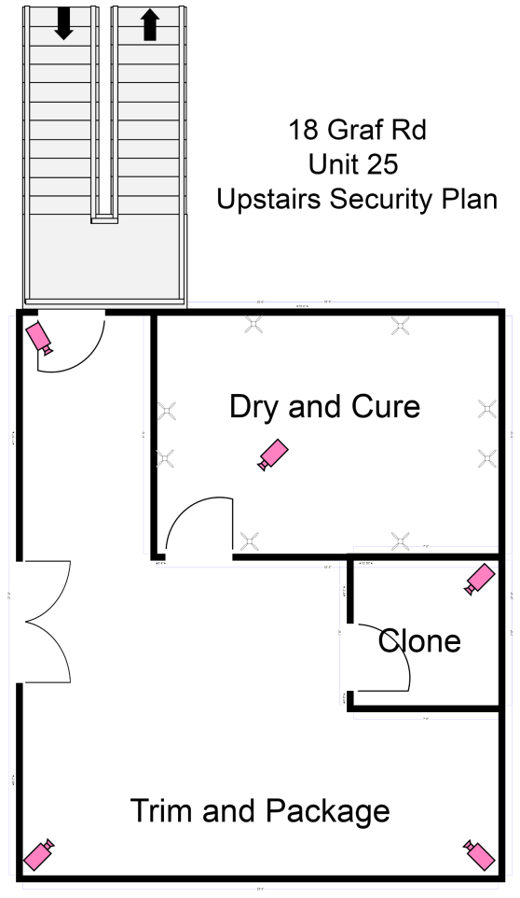
Security
RiverRun Gardens will exceed all security standards including two separate alarm systems
Over 28 cameras, biometric/digital access controls, Video and Sound recording storage

Slide 18
Prevention of Diversion
Systems
Inventory will be locked to prevent unauthorized access.
Access to the inventory will be restricted to individuals authorized by the RiverRun Gardens
Use analytics software to perform control substances audits (e.g., Flourish).
Establish a procedure to ensure all cannabis is stored away by the end of the shift.
Establish a procedure to ensure waste is properly secured
Implement audits
Audit invoices to ensure that each invoice is received in RiverRun’s tracking system.
Audit delivery transactions to ensure that all cannabis pulled from the main area to be restocked in units are accounted for
Promote education and awareness

Slide 19
Questions?

