Slide 1
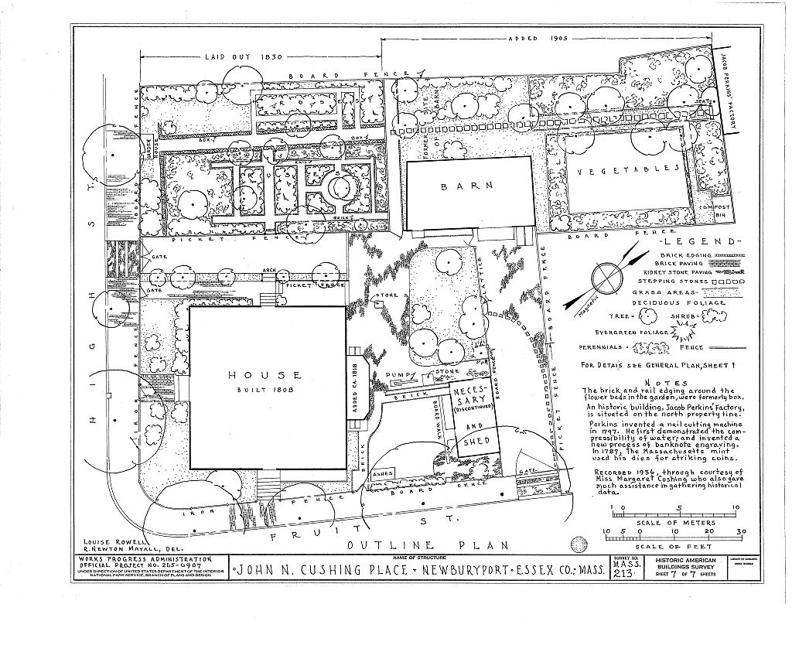
Museum of Old Newbury Phase 3 Landscape Restoration & Rehabilitation

Slide 2
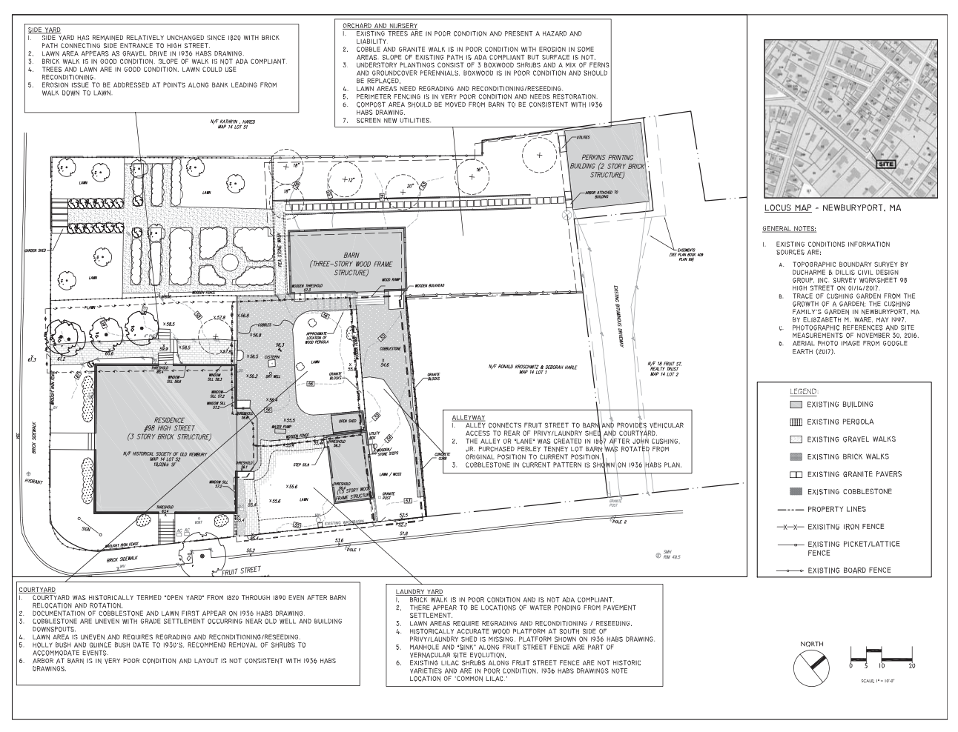
Landscape Elements Treatment Plan

Slide 3
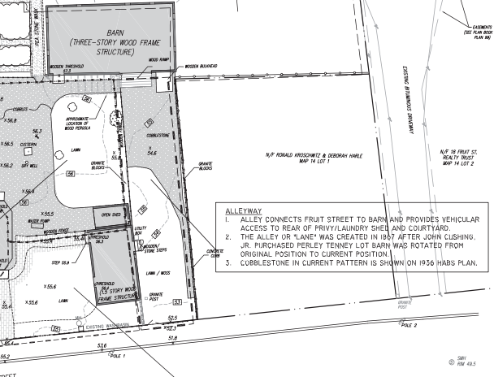
Treatment plan for Carriage Drive

Slide 4
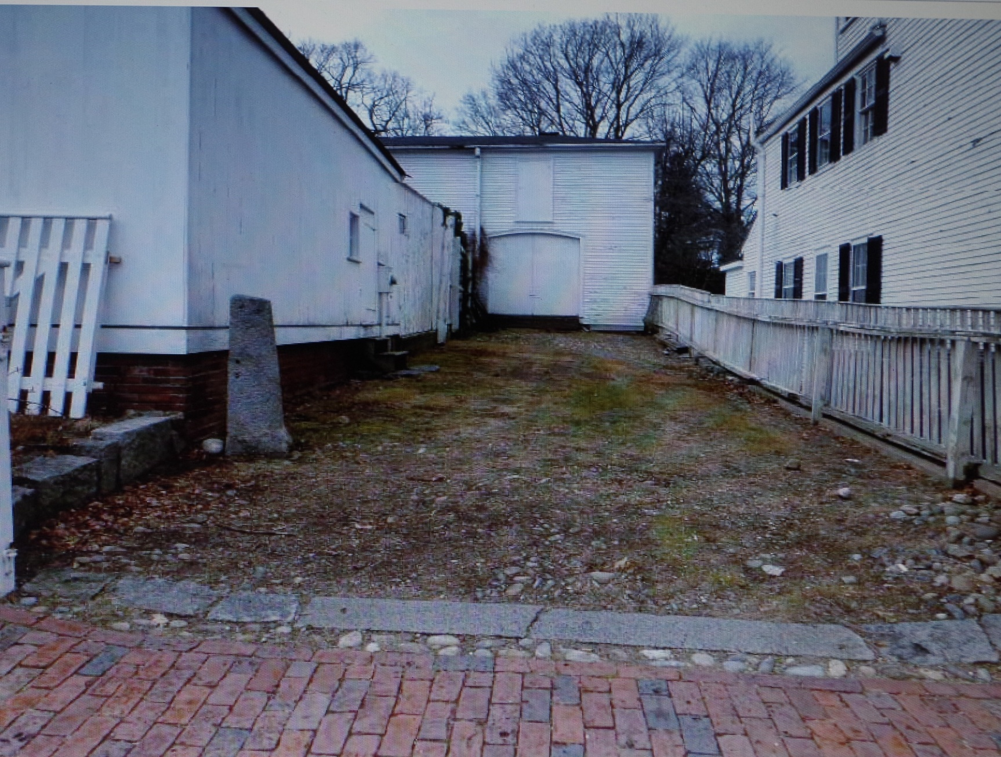
Northwest view from Fruit Street

Slide 5
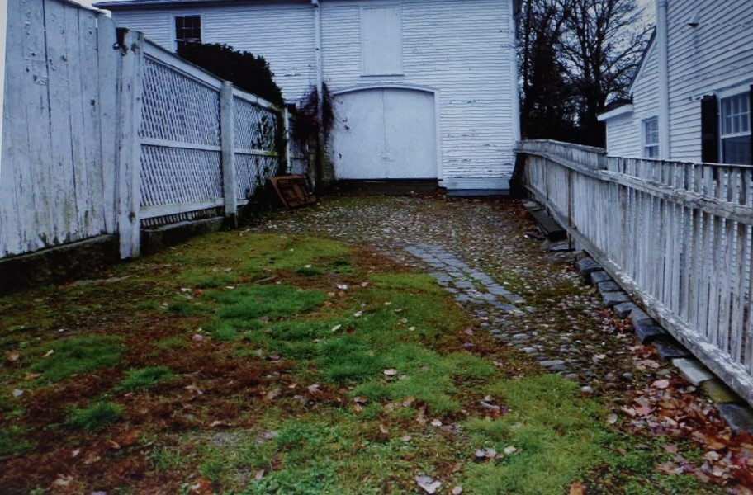
Northwest view of carriage drive to Barn

Slide 6
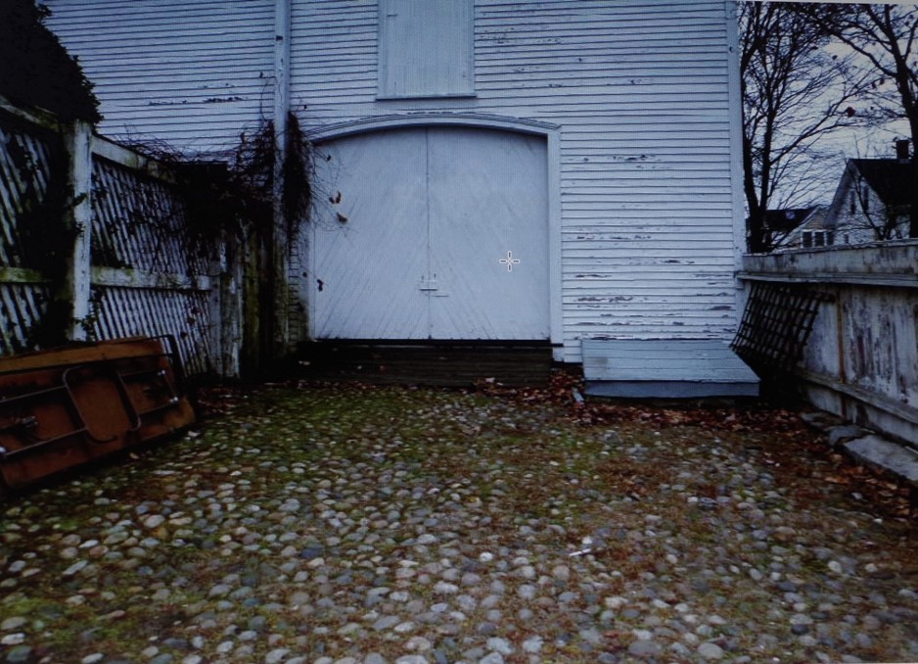
Carriage Barn threshold and bulkhead

Slide 7
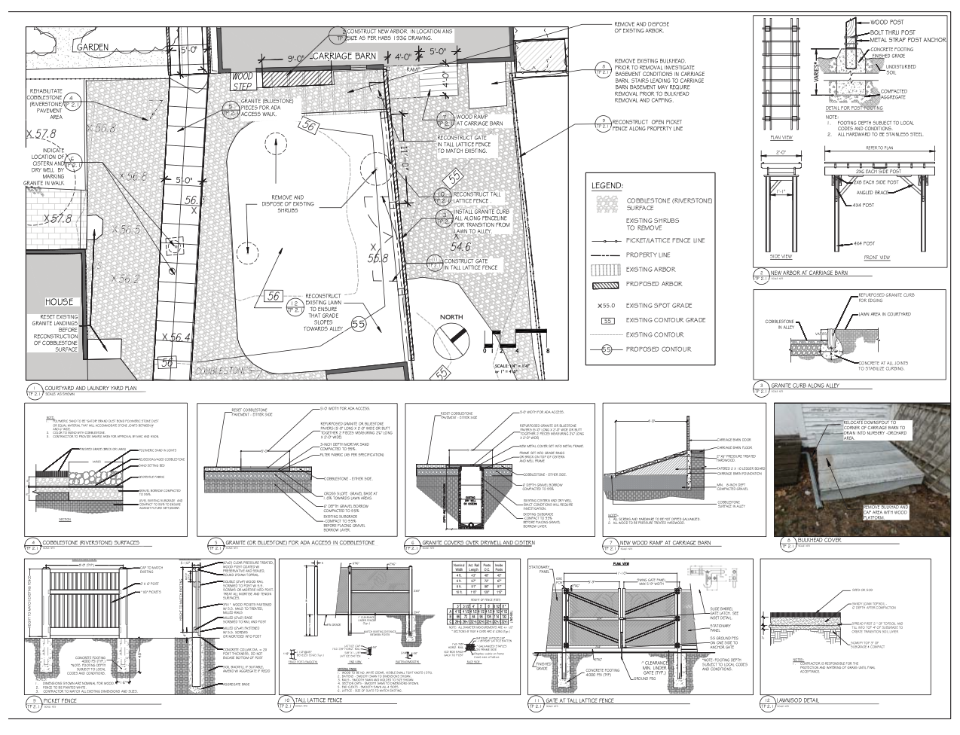
Treatment Plan for Bulkhead

Slide 8
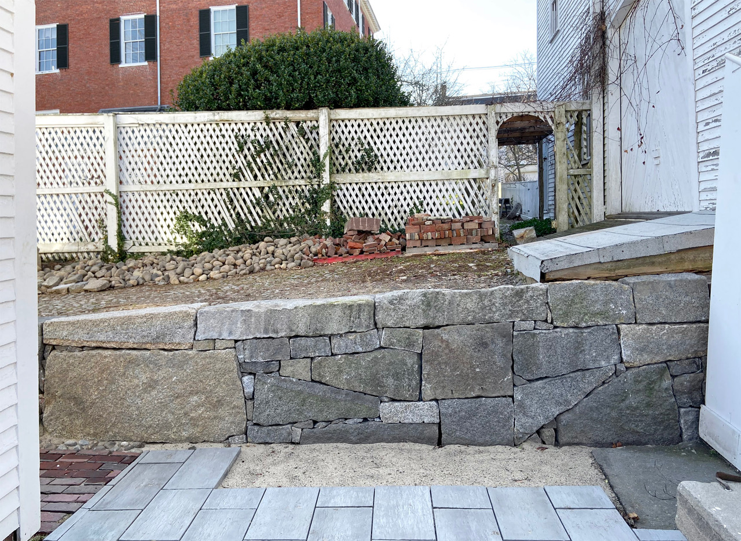

Slide 9
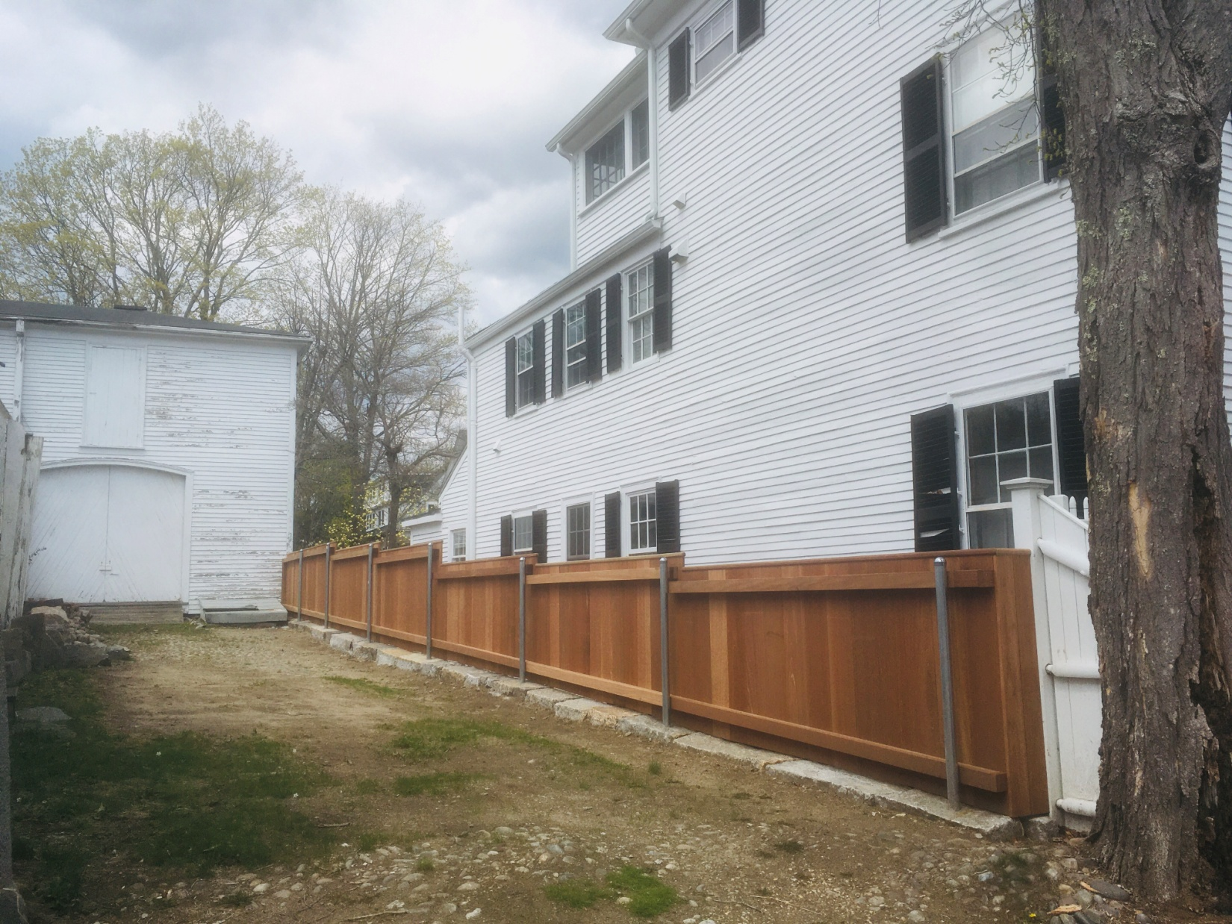
Property line fence

Slide 10
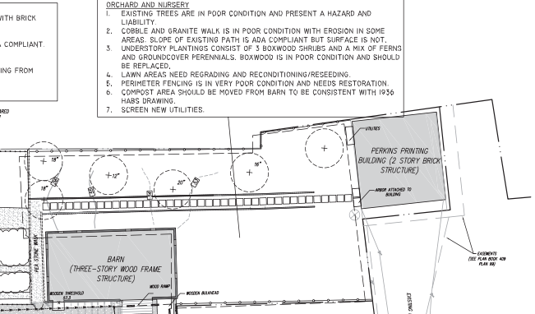
Orchard and Nursery Treatment Plan

Slide 11
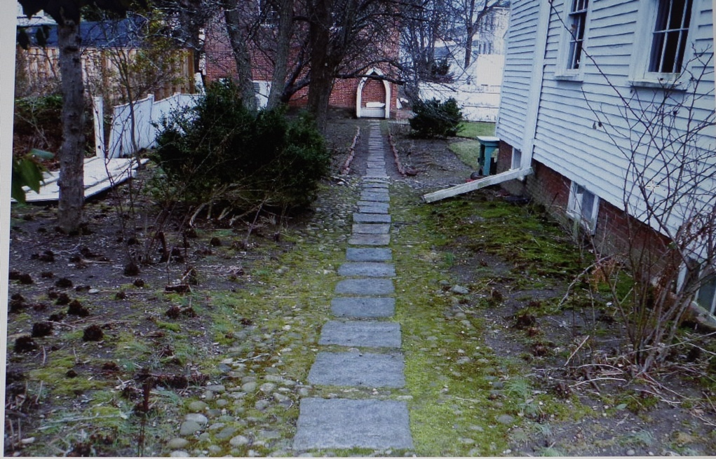
Northeast View Orchard Path to Perkins Mint

Slide 12
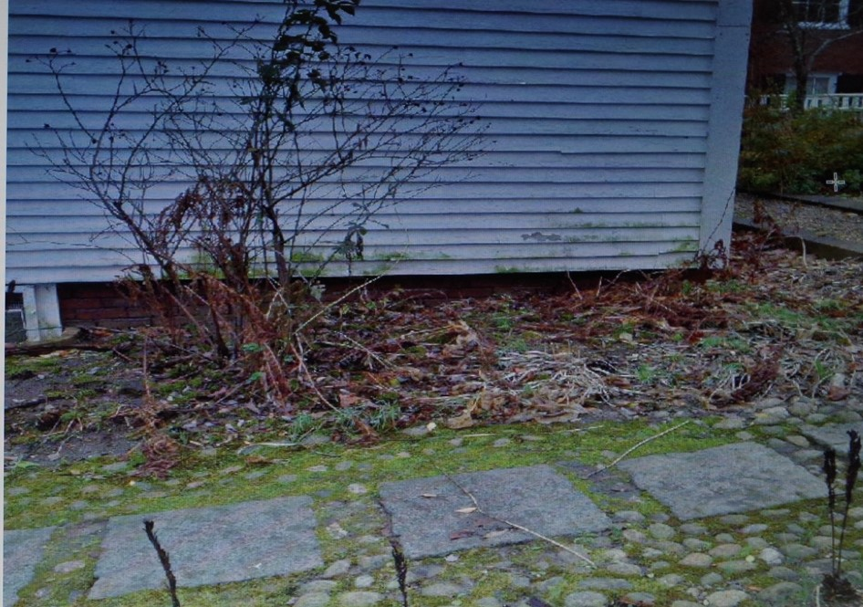
Detail of Orchard Path

Slide 13
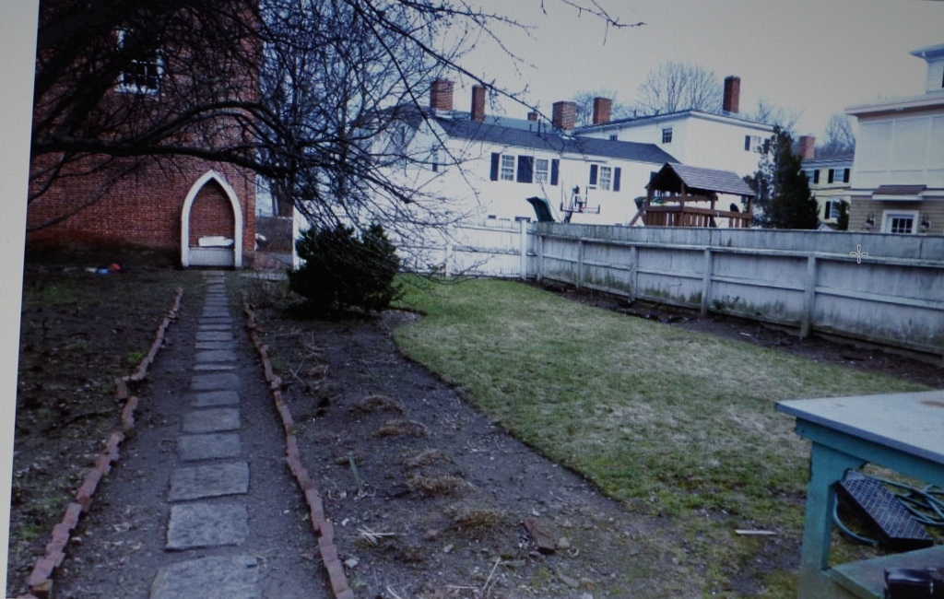
Orchard Path and Nursery Garden

Slide 14
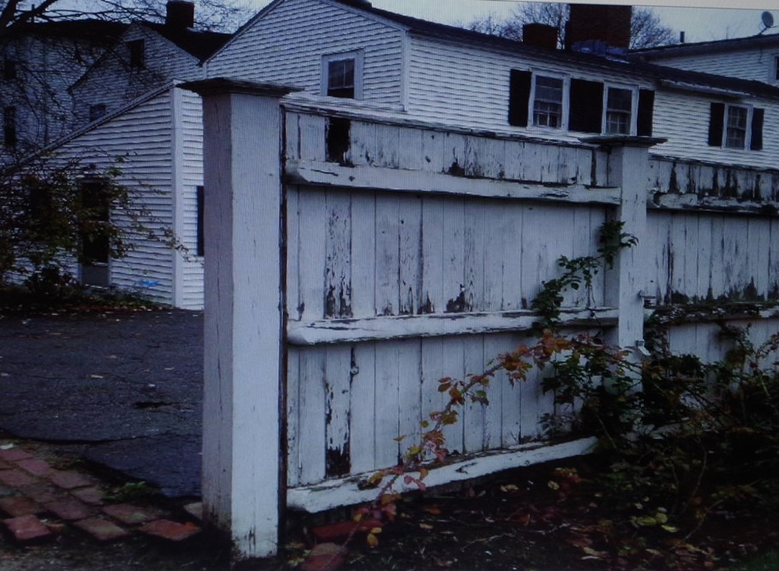
Perimeter fence nursery garden

Slide 15
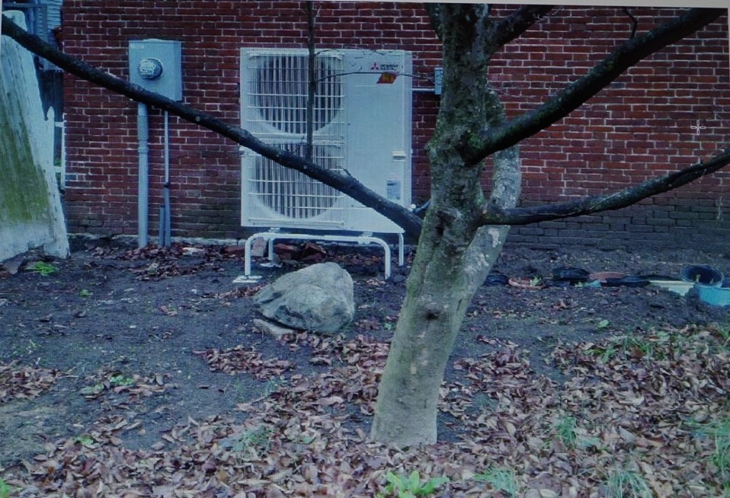
Split pump system Perkins Mint

