Slide 1
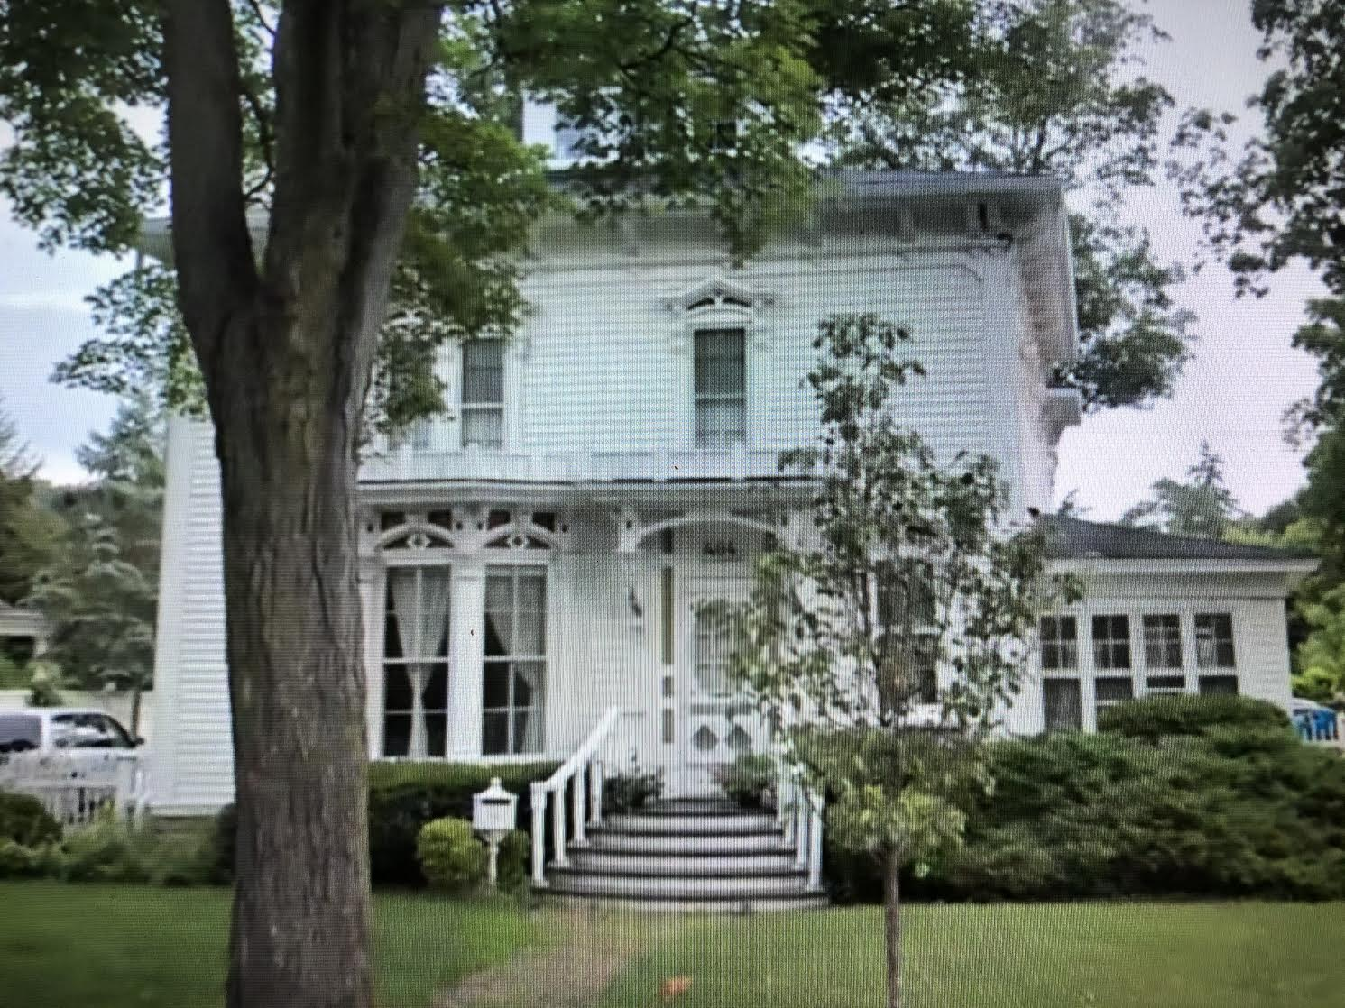
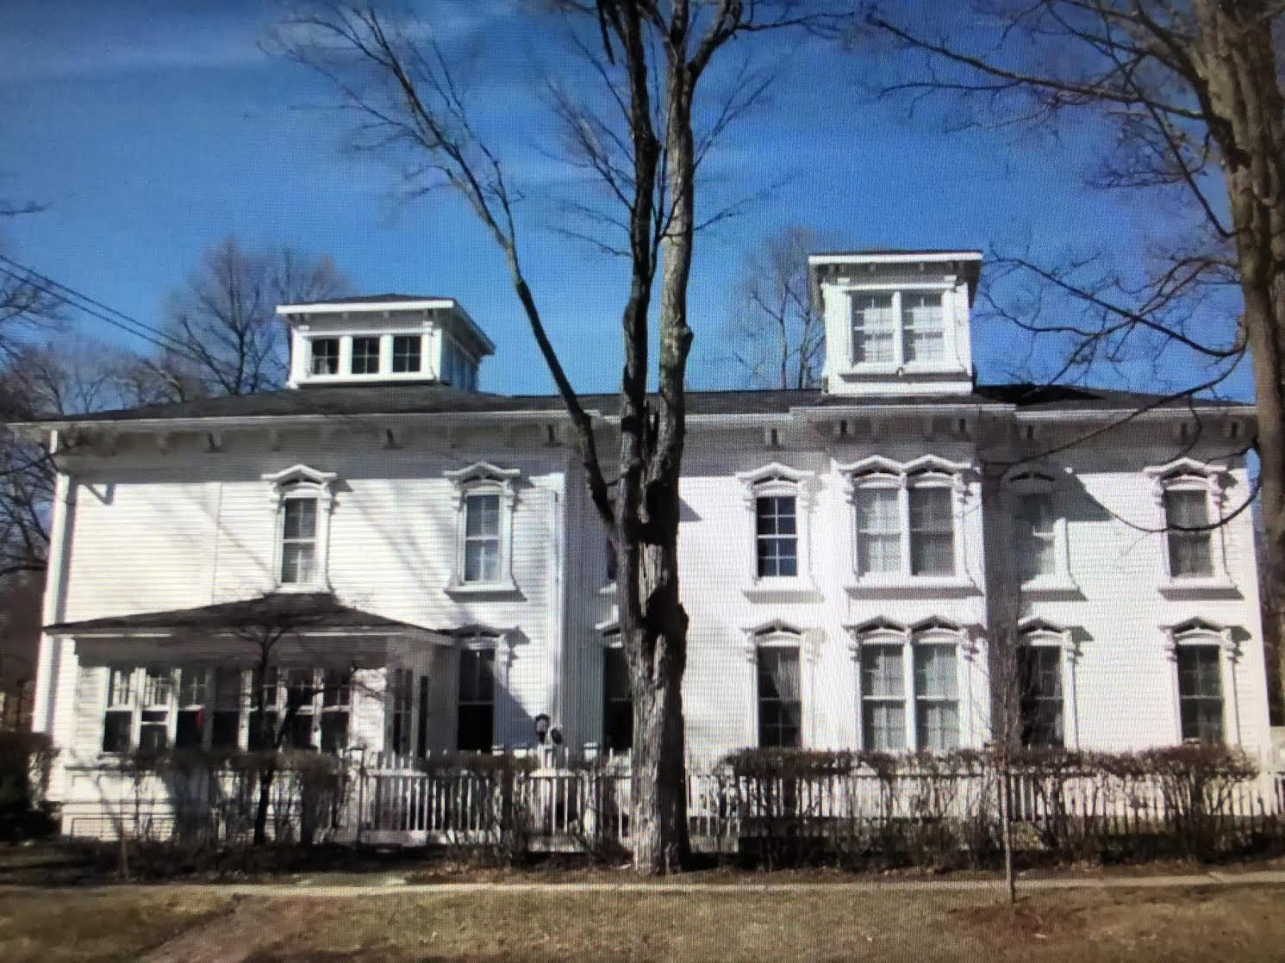
Classic Photo Album

Slide 2
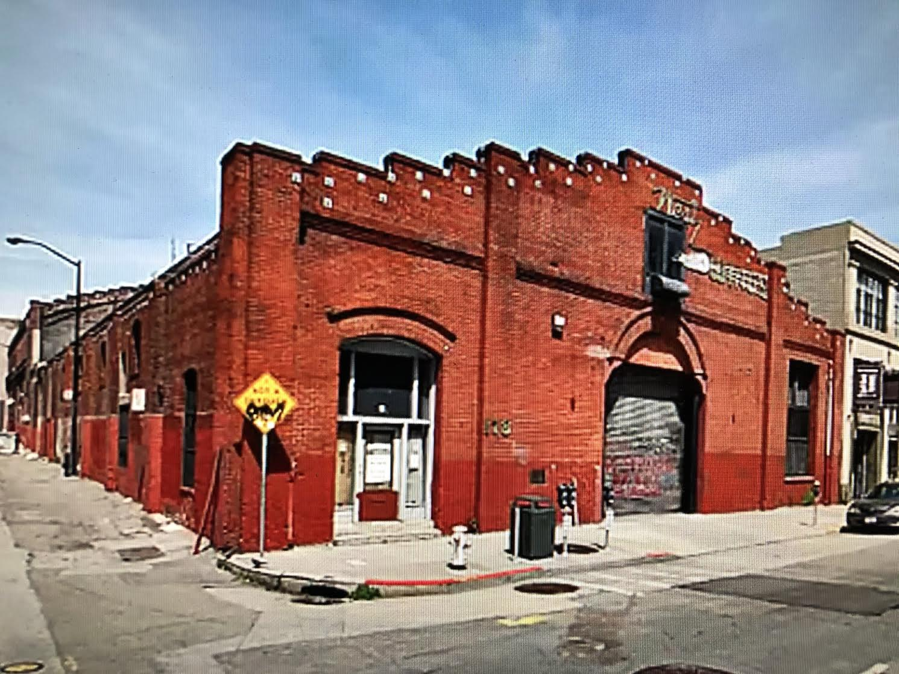
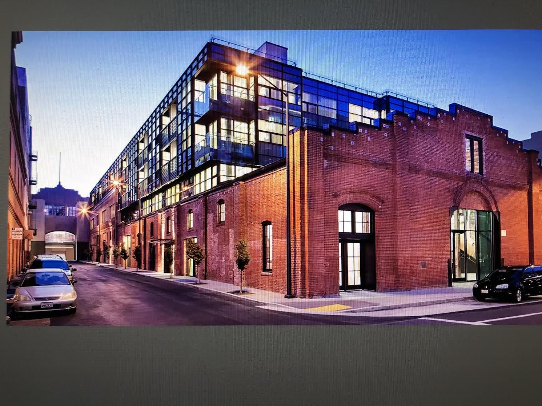
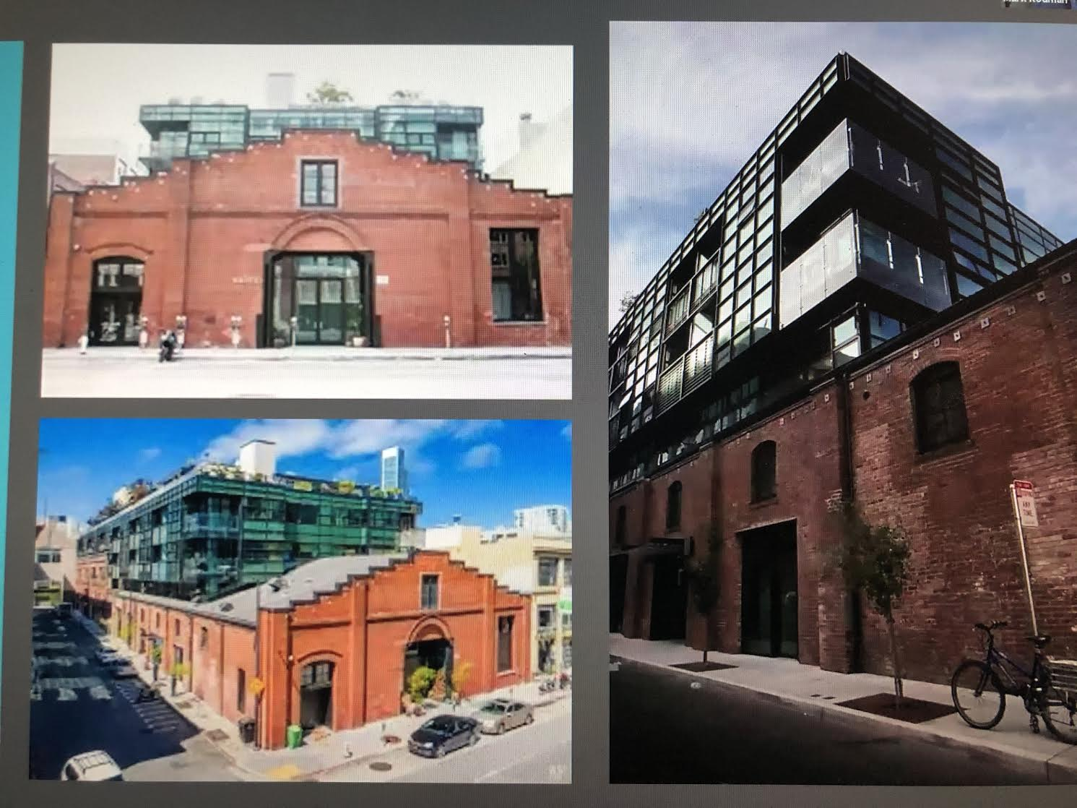

Slide 4
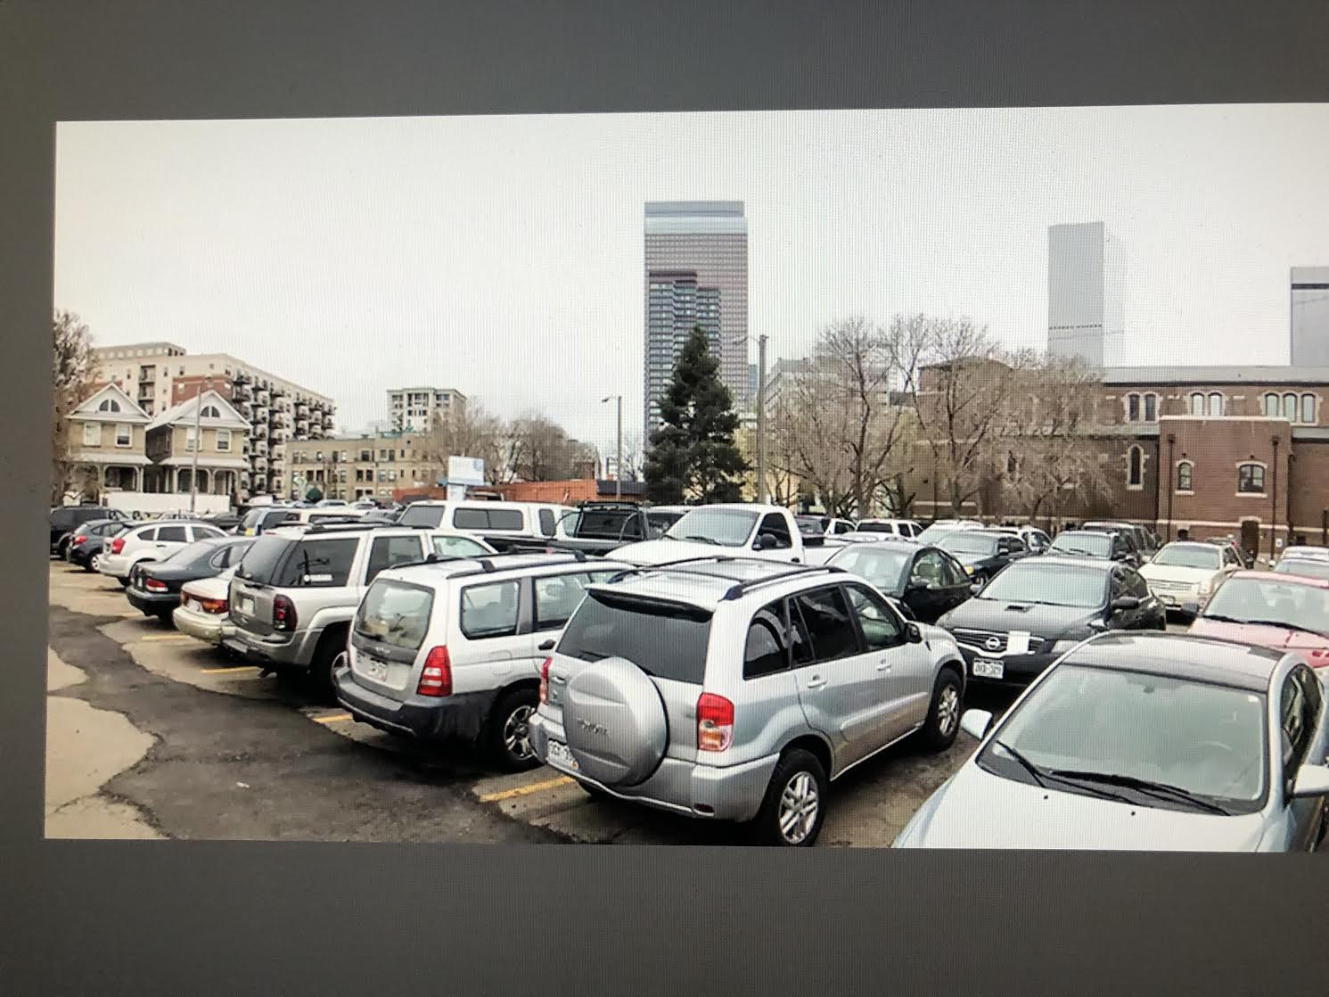
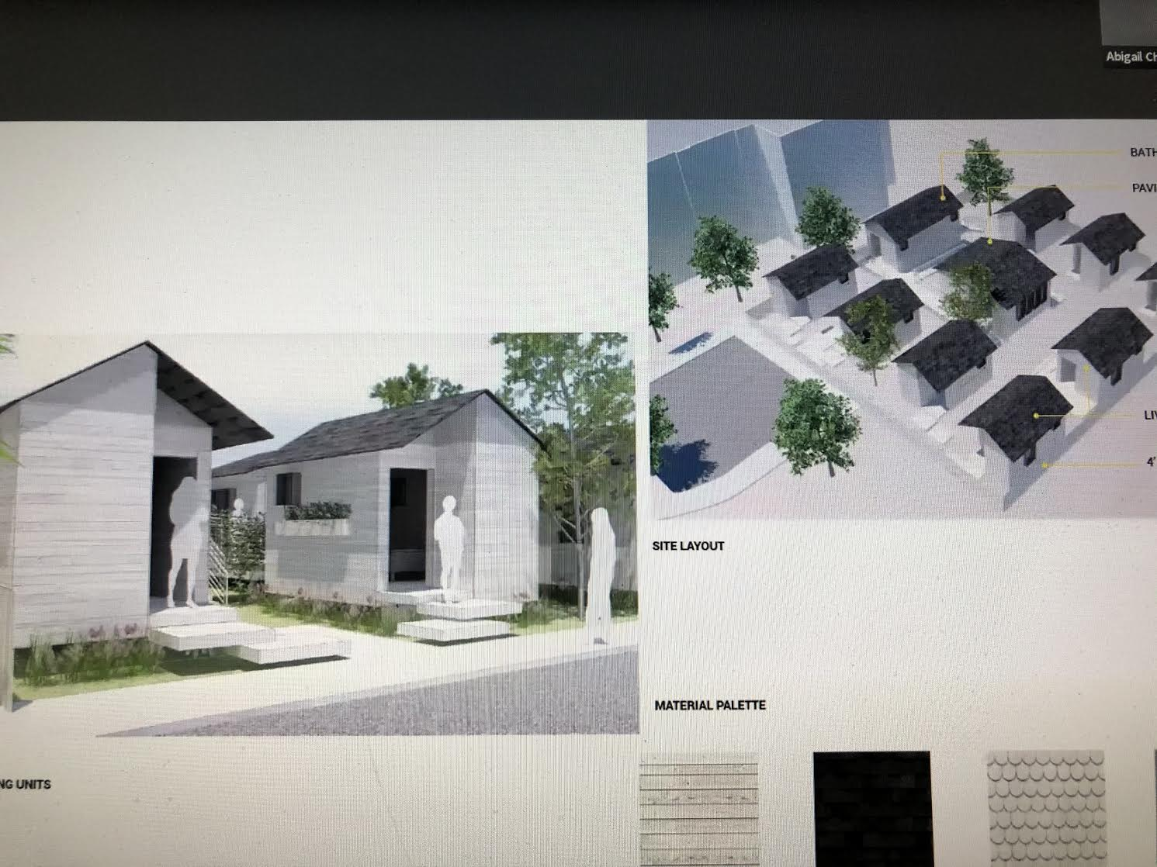
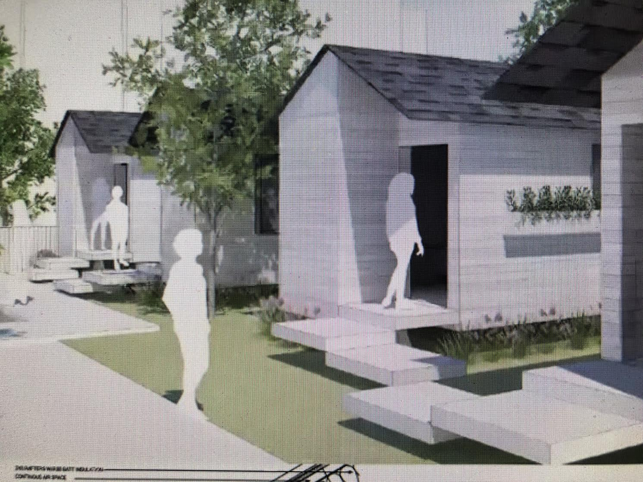

Slide 5
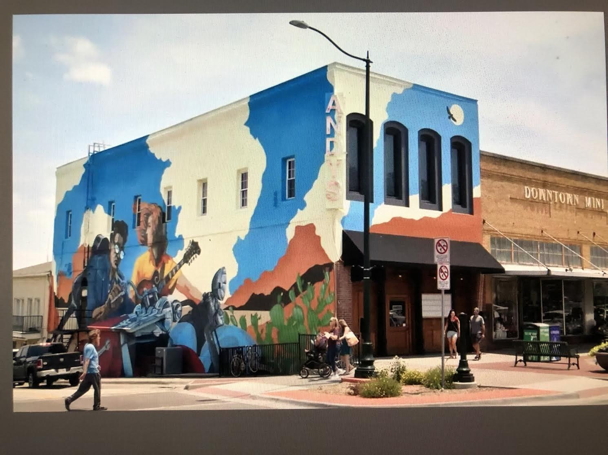

Slide 6
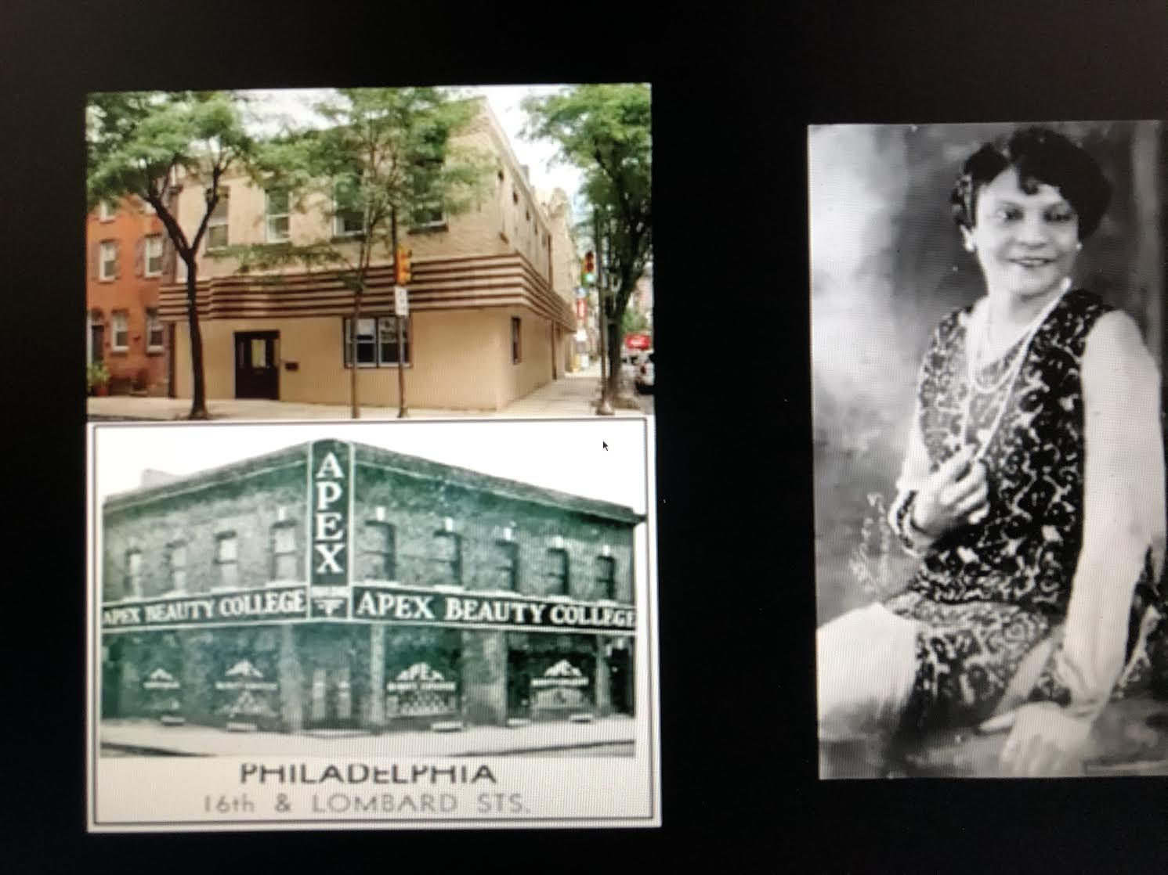

Slide 7
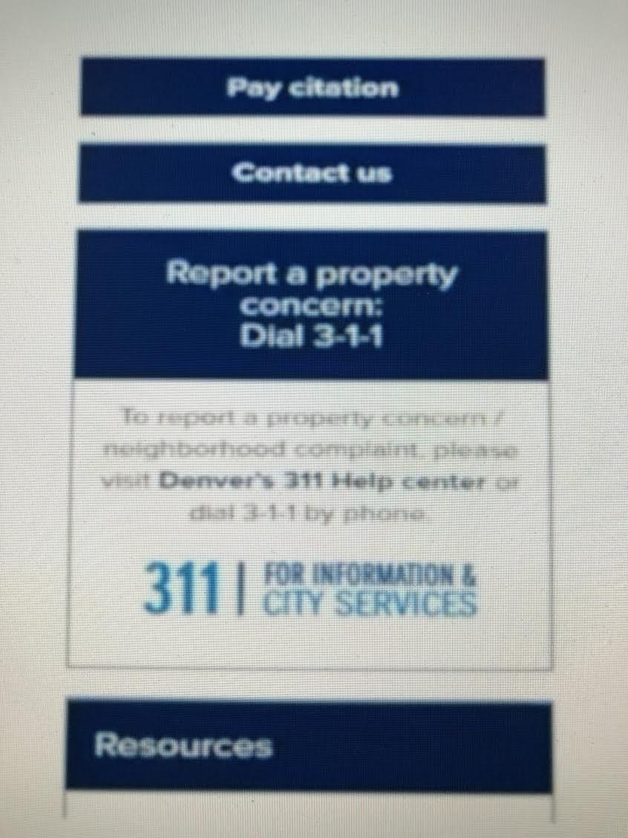
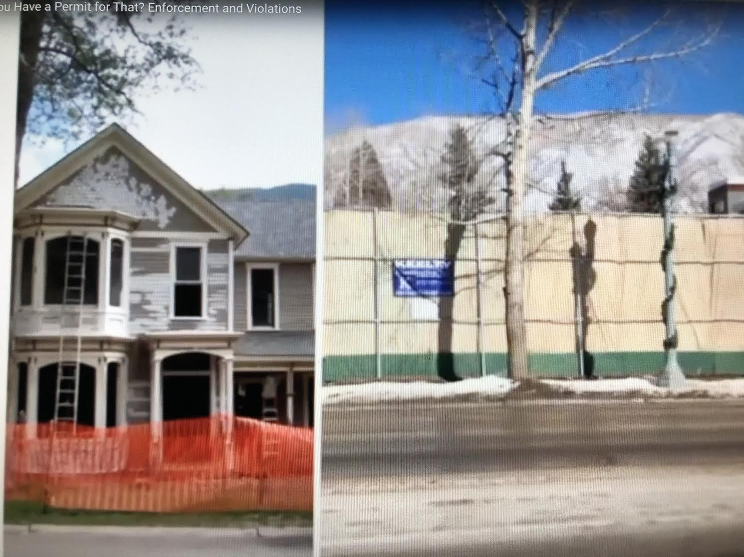

Slide 15
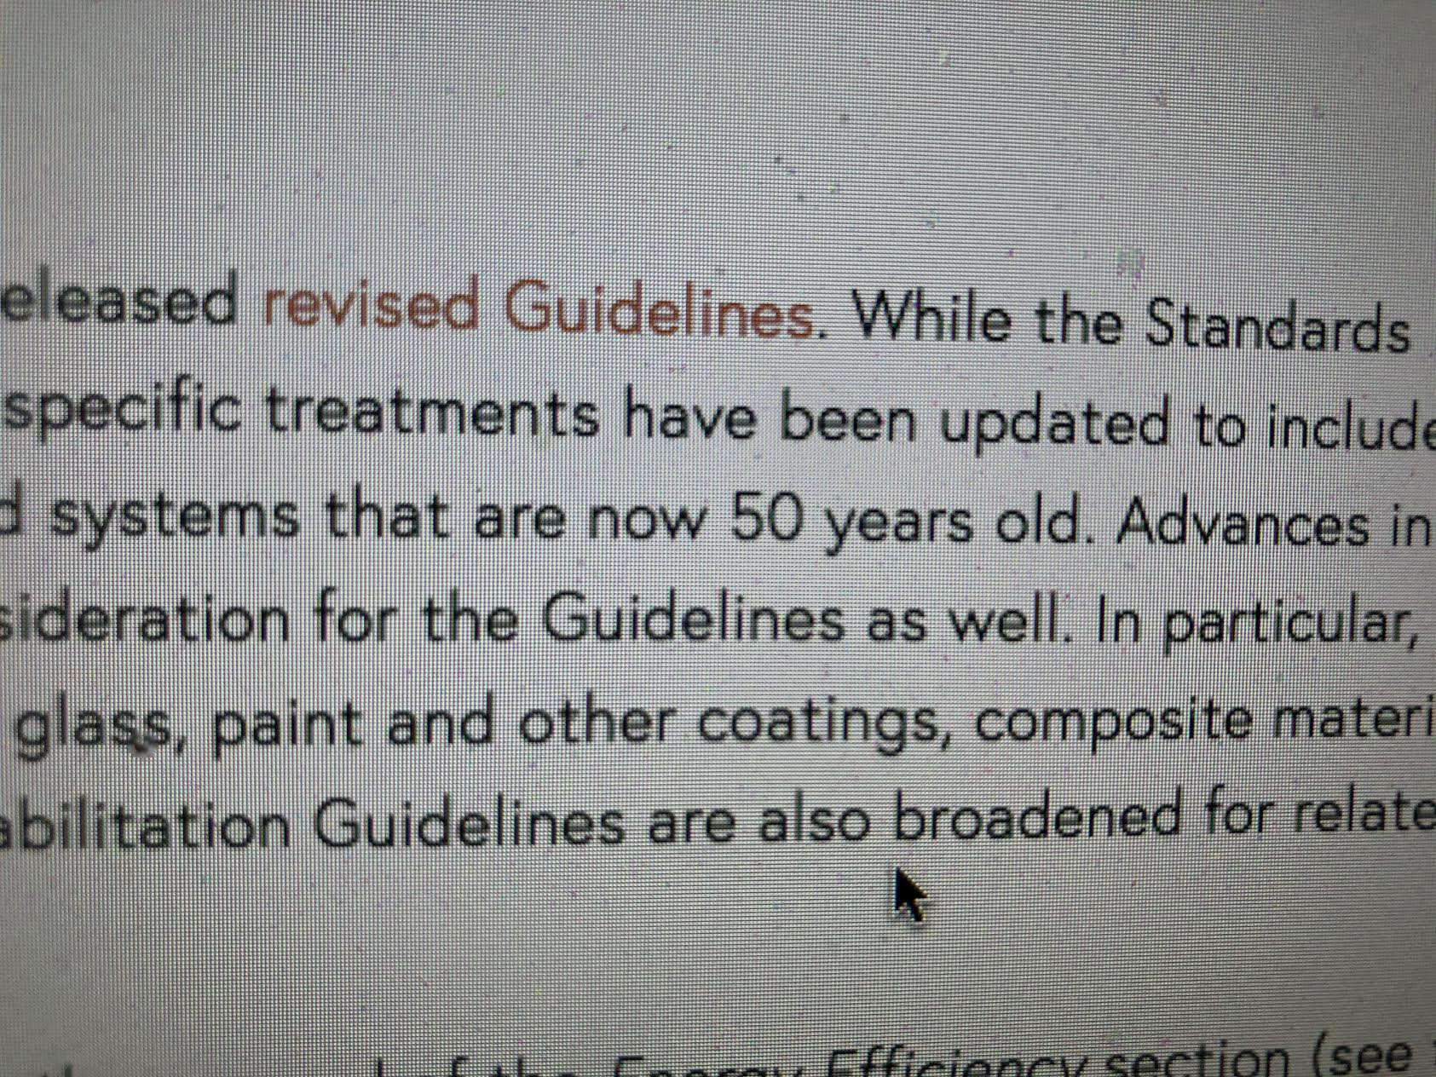

Slide 17
This photo album contains sample pages to get you started.
To add your own pages, click the Home tab, and then click New Slide.

Slide 18
Choose a Layout
…then click the placeholders to add your own pictures and captions.

Slide 19
Click a picture, and then click the Format Picture tab to create your own frames and make picture corrections such as adjusting contrast and brightness or cropping the picture for just the right look.

Slide 20
Picture Styles give you great looking “frames” in a single click.

