Slide 1
Institution for Savings
Concept Study
May 18, 2020

Slide 2
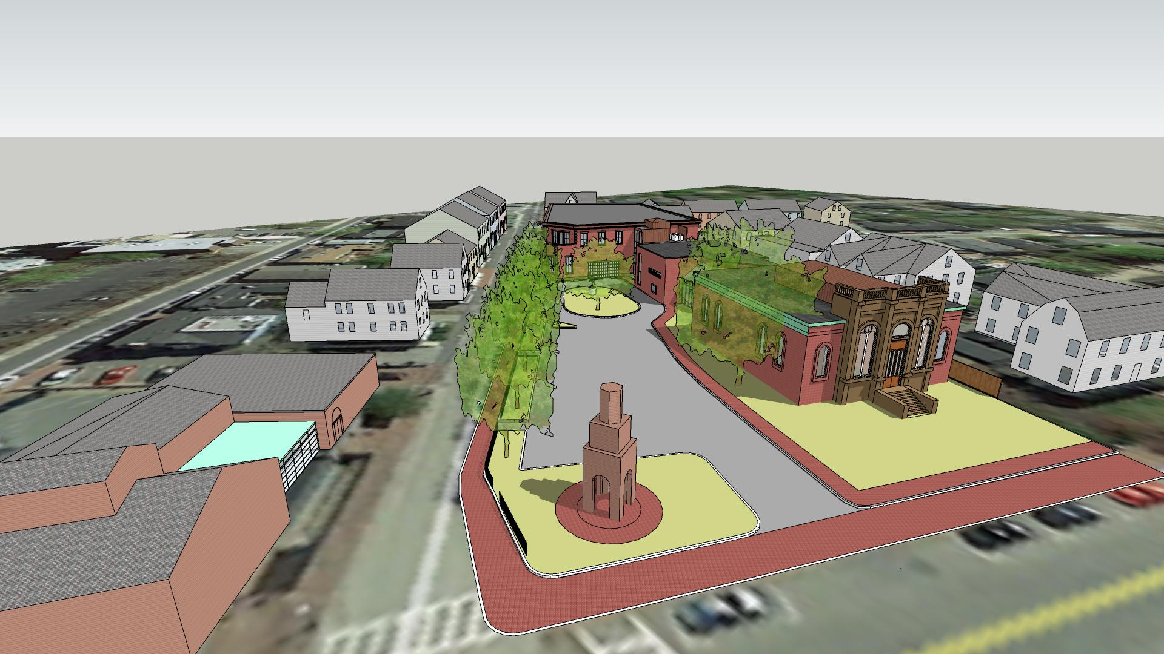
Landscaping not finalized

Slide 3
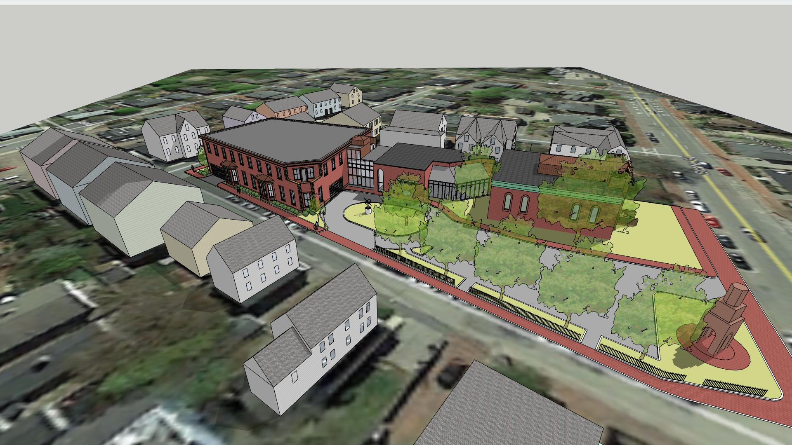
Landscaping not finalized

Slide 4
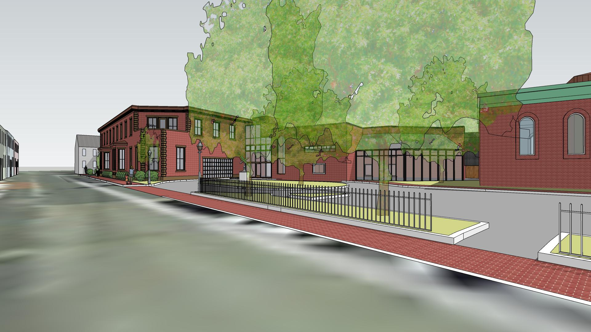
Landscaping not finalized

Slide 5
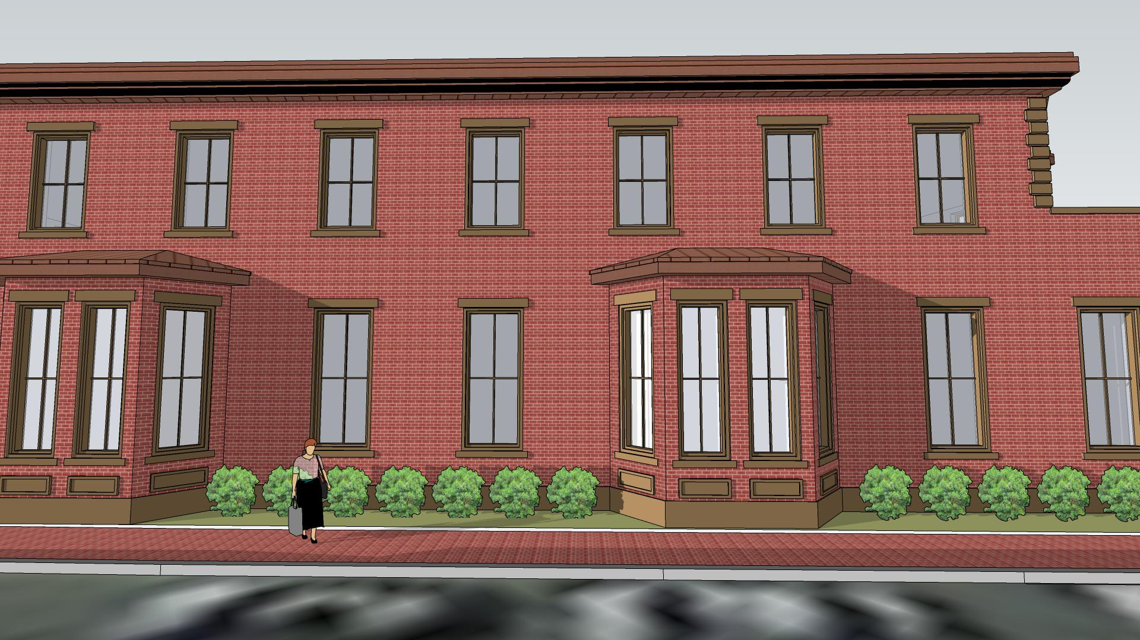
Landscaping not finalized

Slide 6
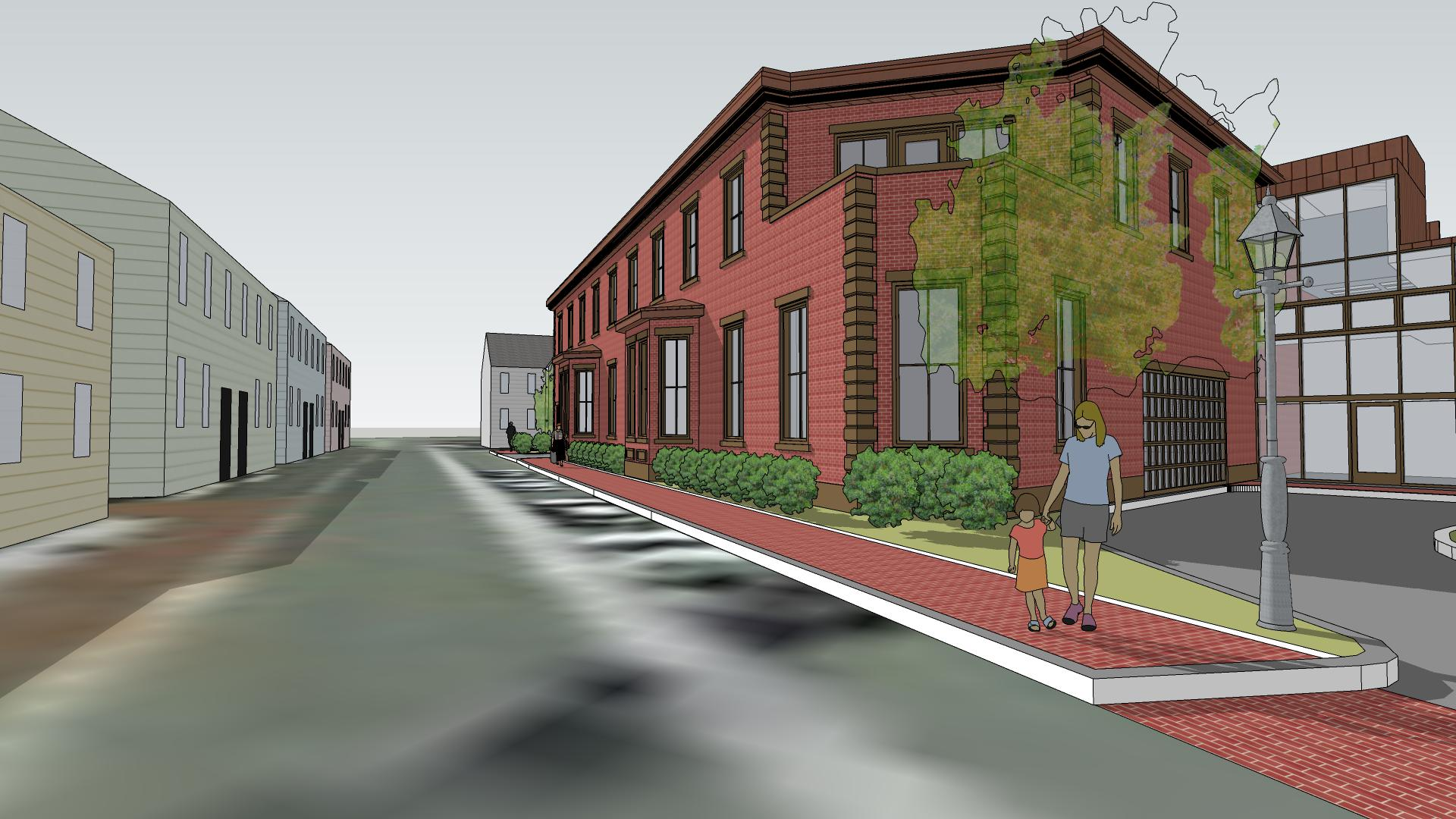
Landscaping not finalized

Slide 7
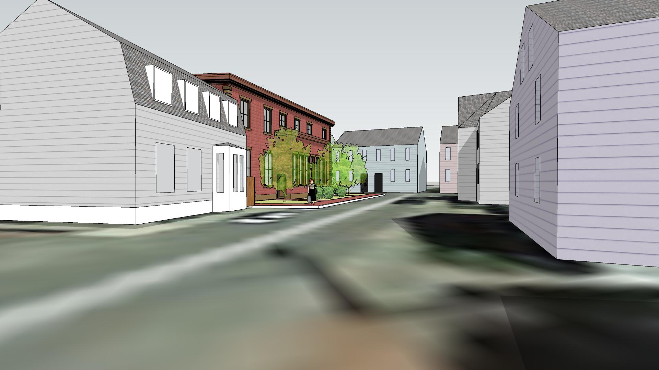
Landscaping not finalized

Slide 8
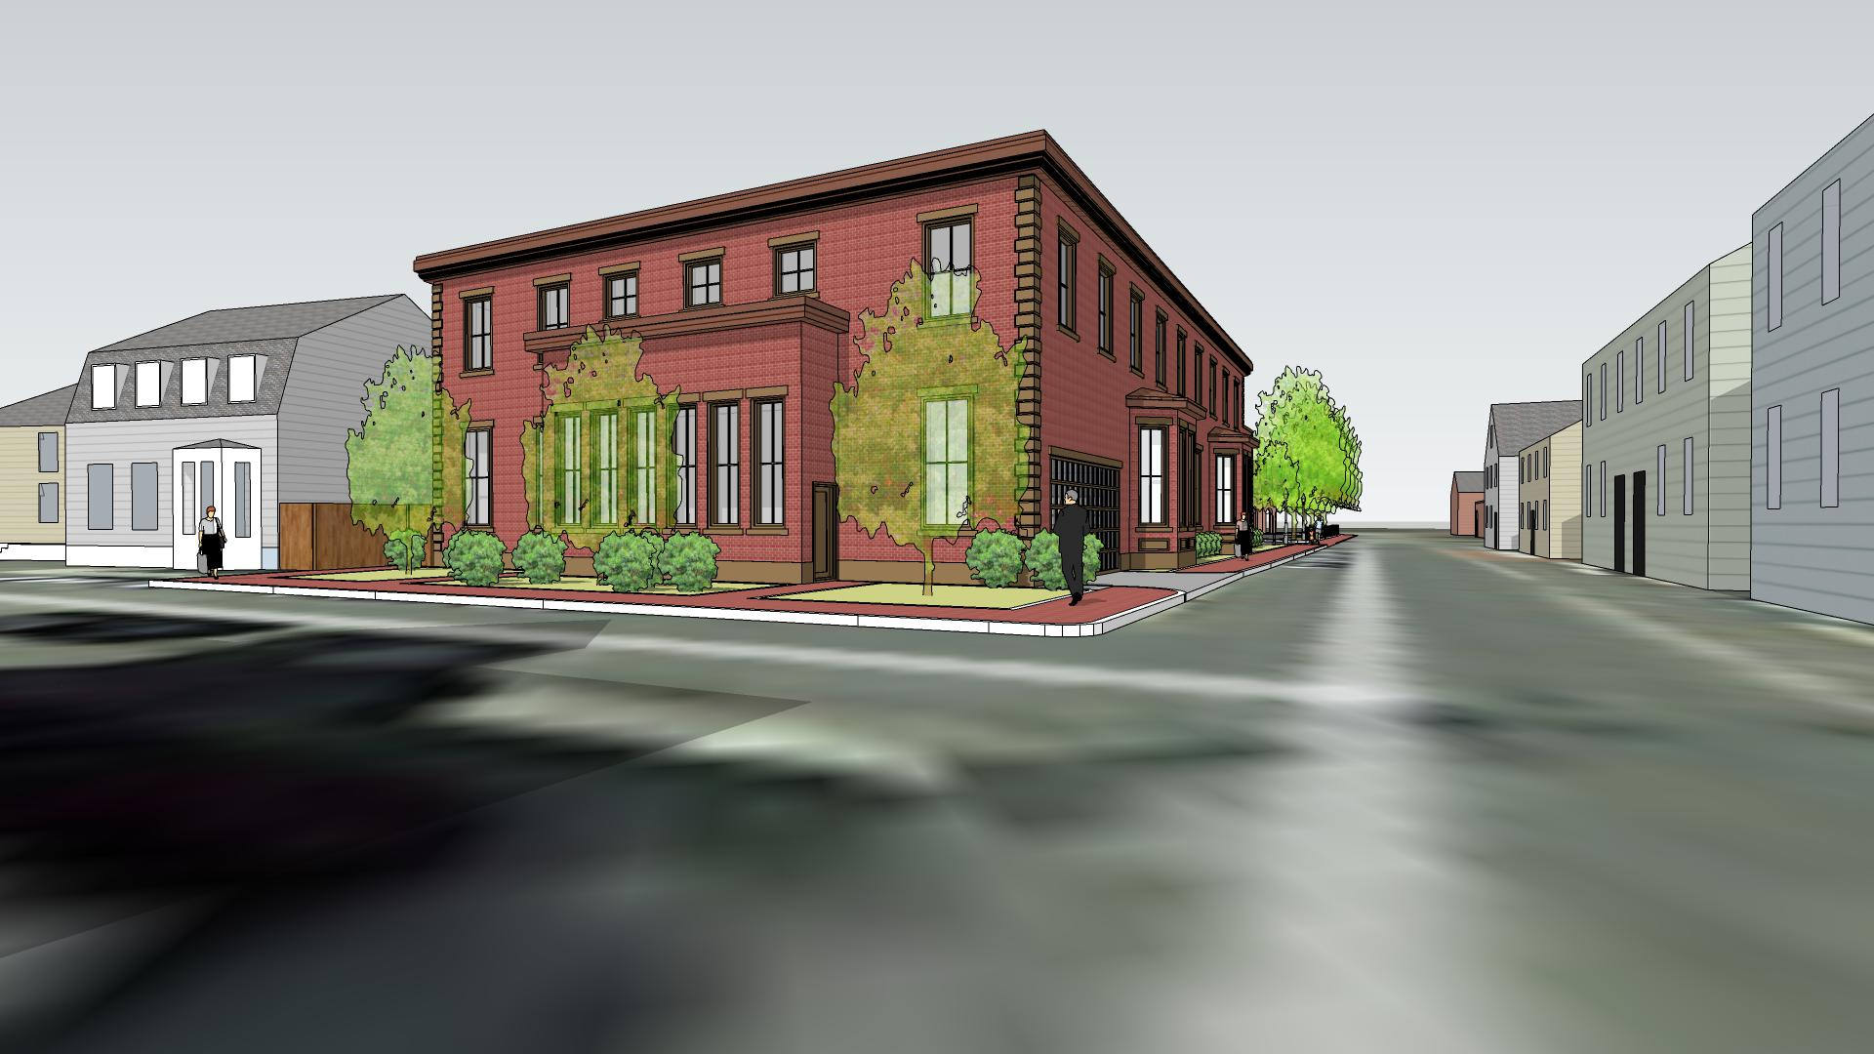
Landscaping not finalized

