Slide 1
37 Reservation Terrace
4,285 square foot lot on Plum Island
Preexisting nonconforming for lot area, setbacks, FAR, and lot coverage
Seeking a Special Permit for Non-Conformities
Proposal is to construct first- and second-floor additions to a single-family residence for total added living space of 210 square feet
No additional bedrooms proposed; currently a 3-bedroom home and will remain 3-bedroom
Received approval from the Historical Commission on April 9th

Slide 8
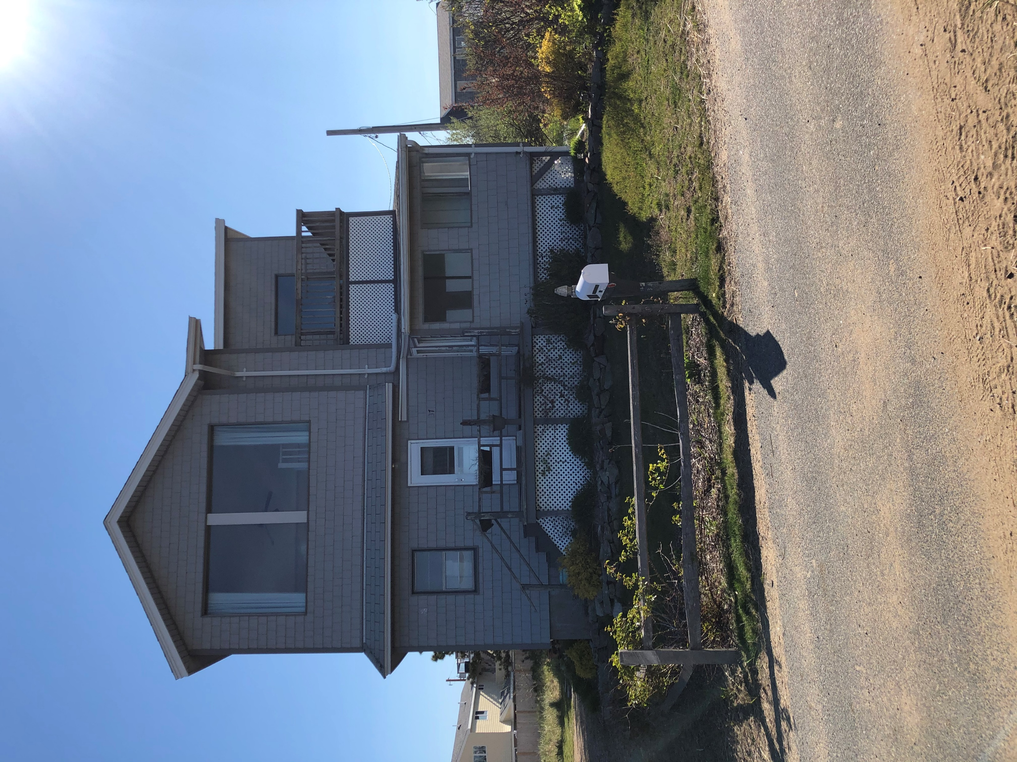
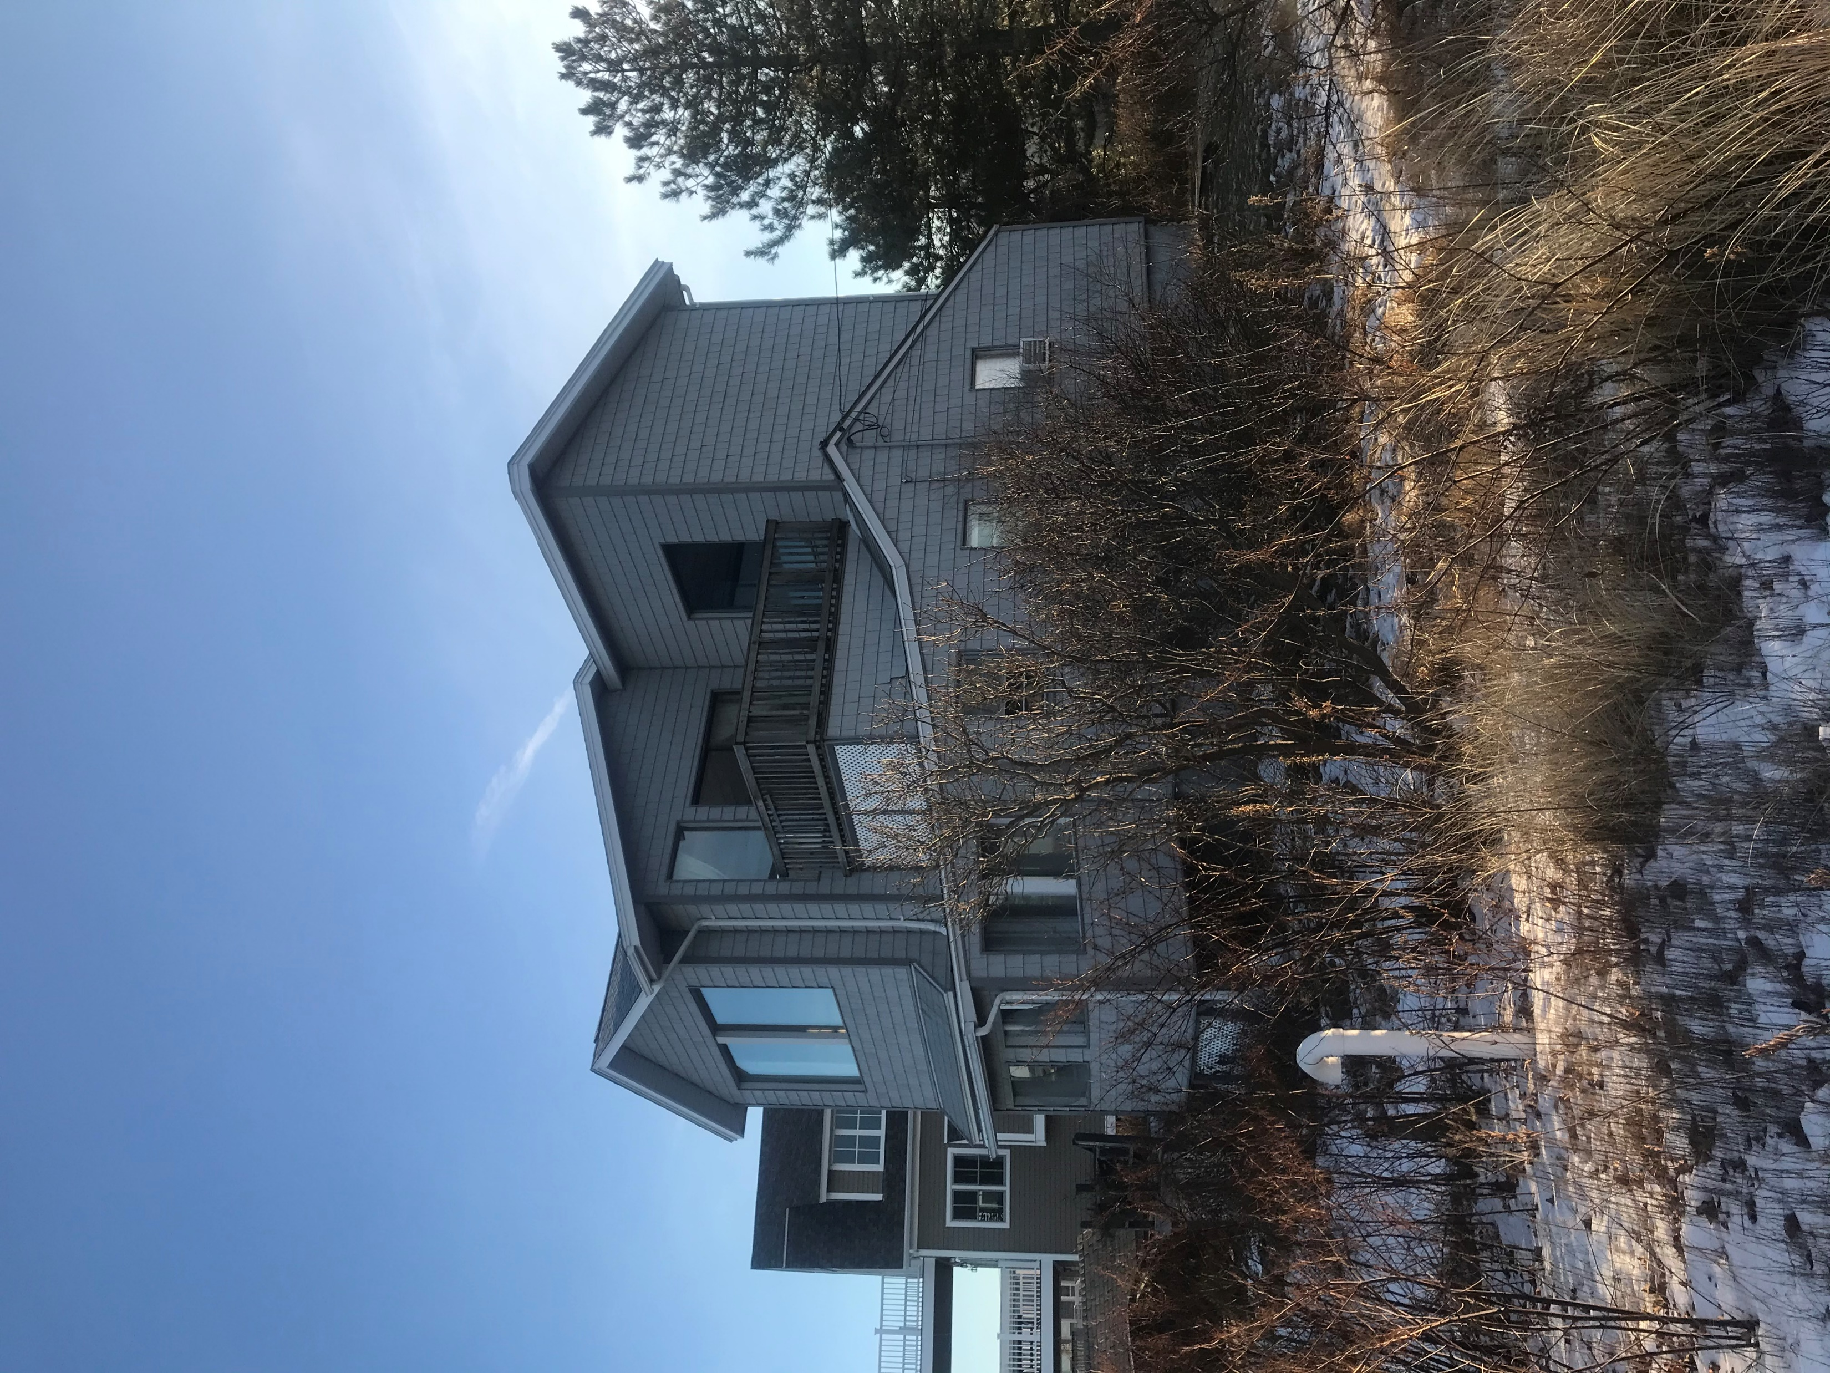
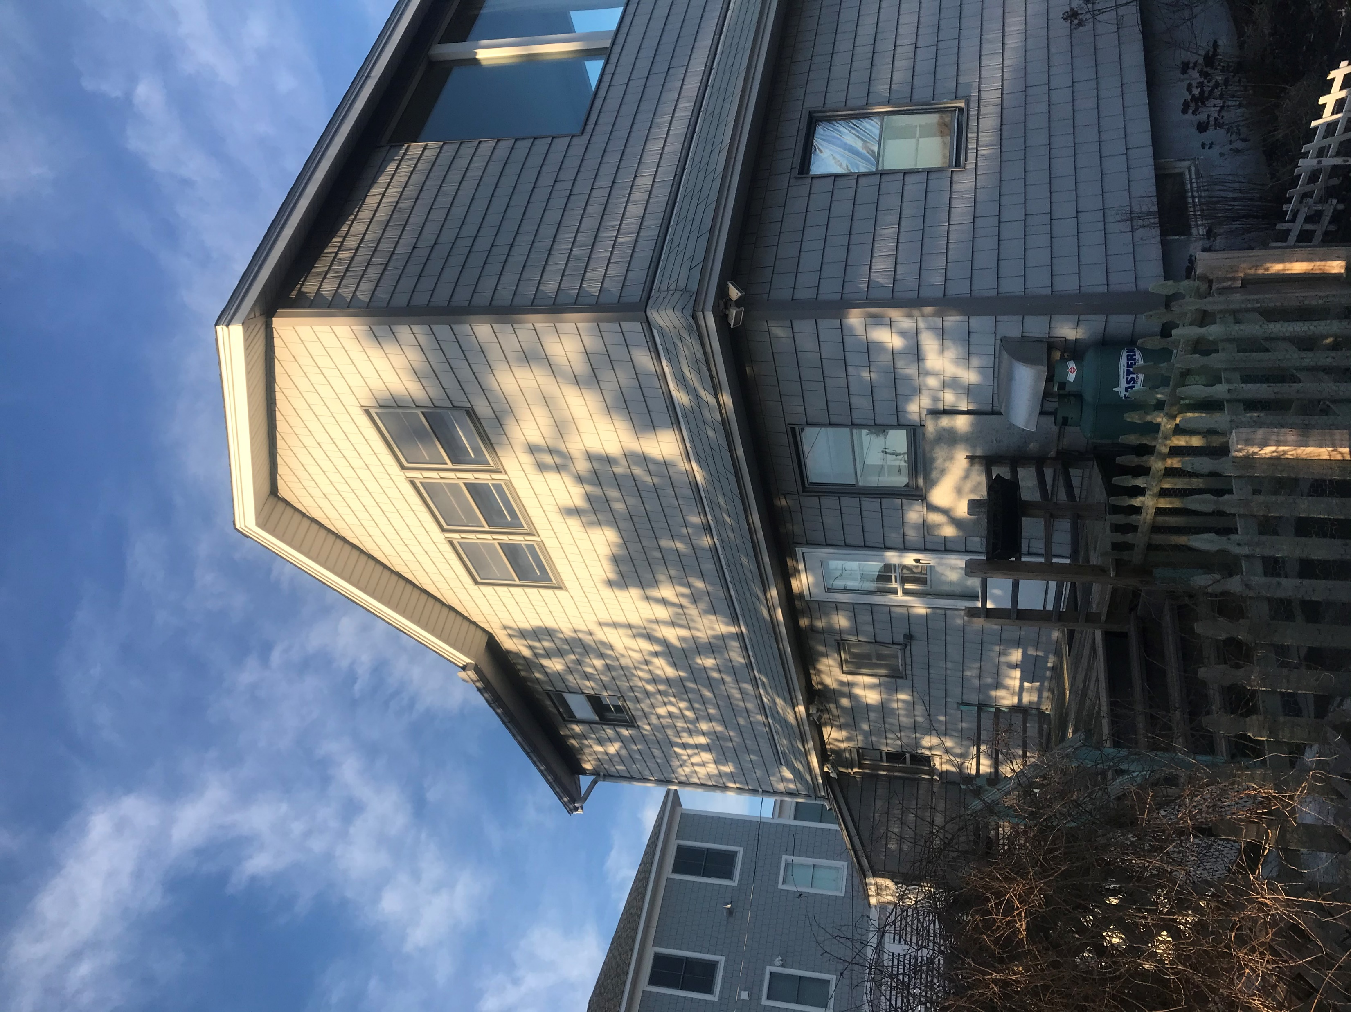
37 Reservation Terrace

Slide 9
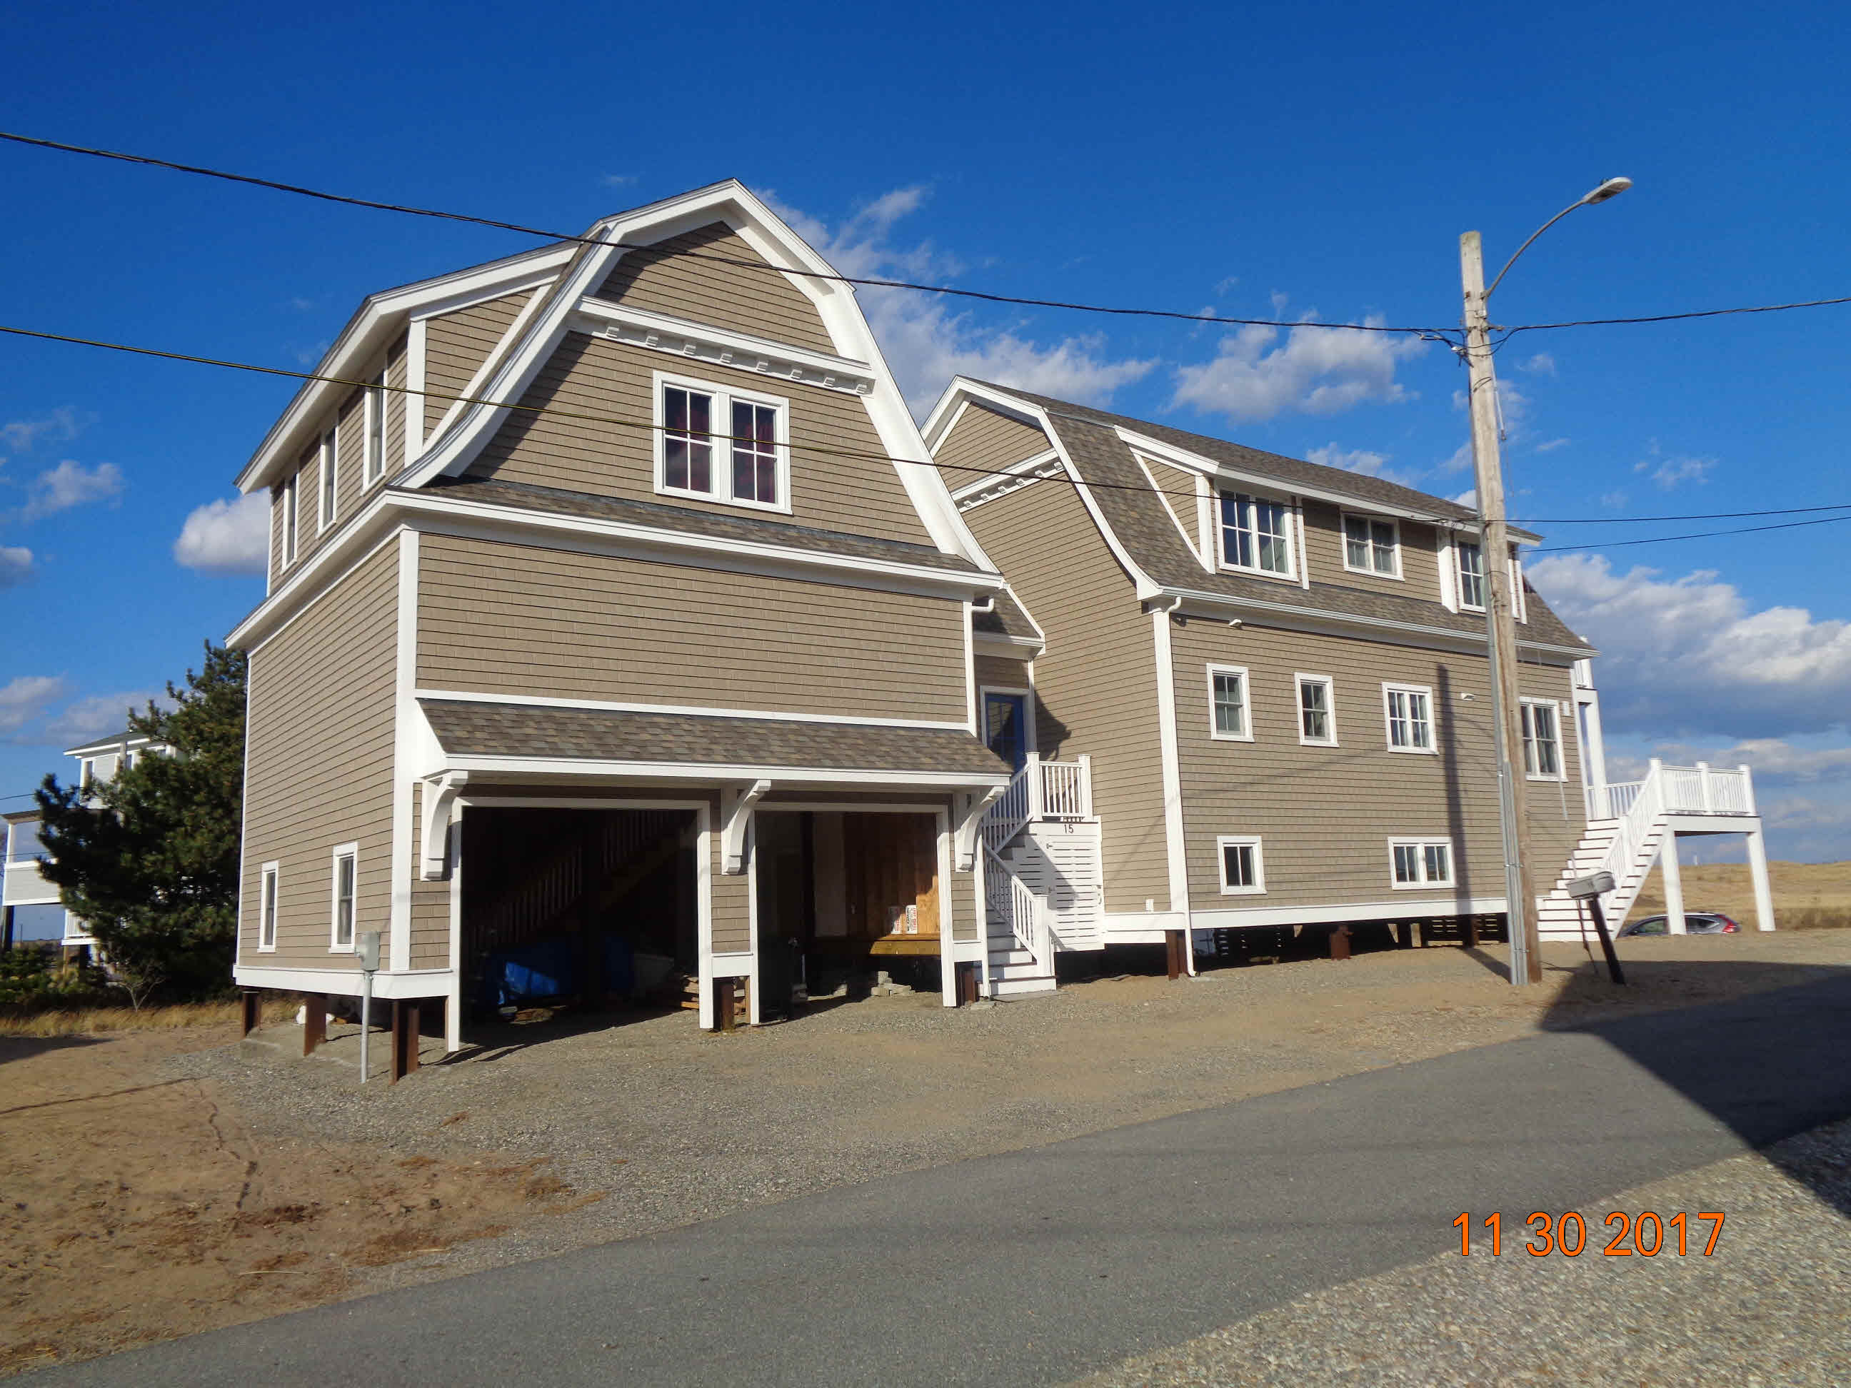
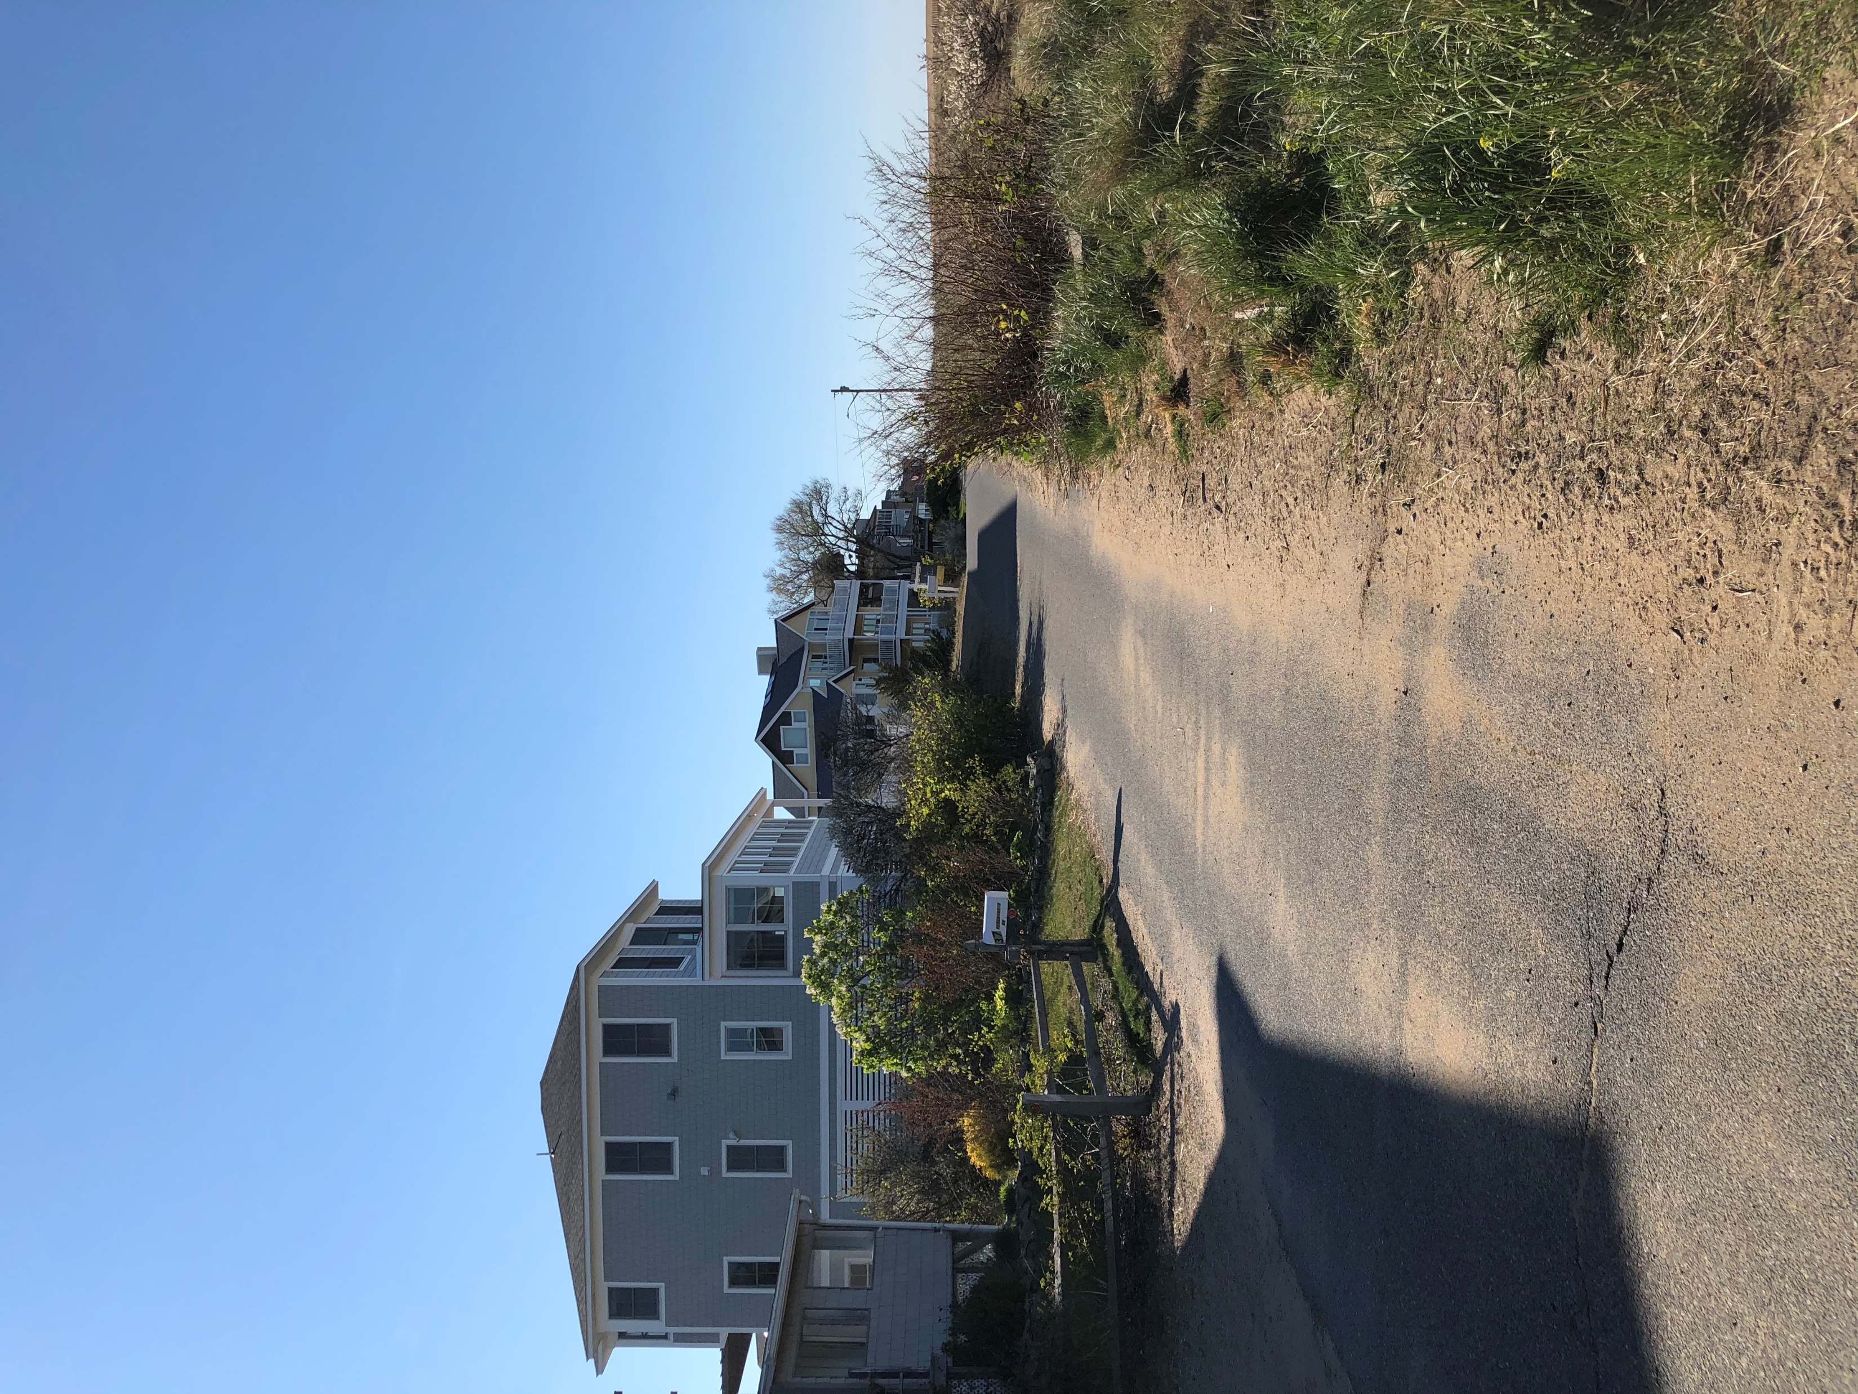
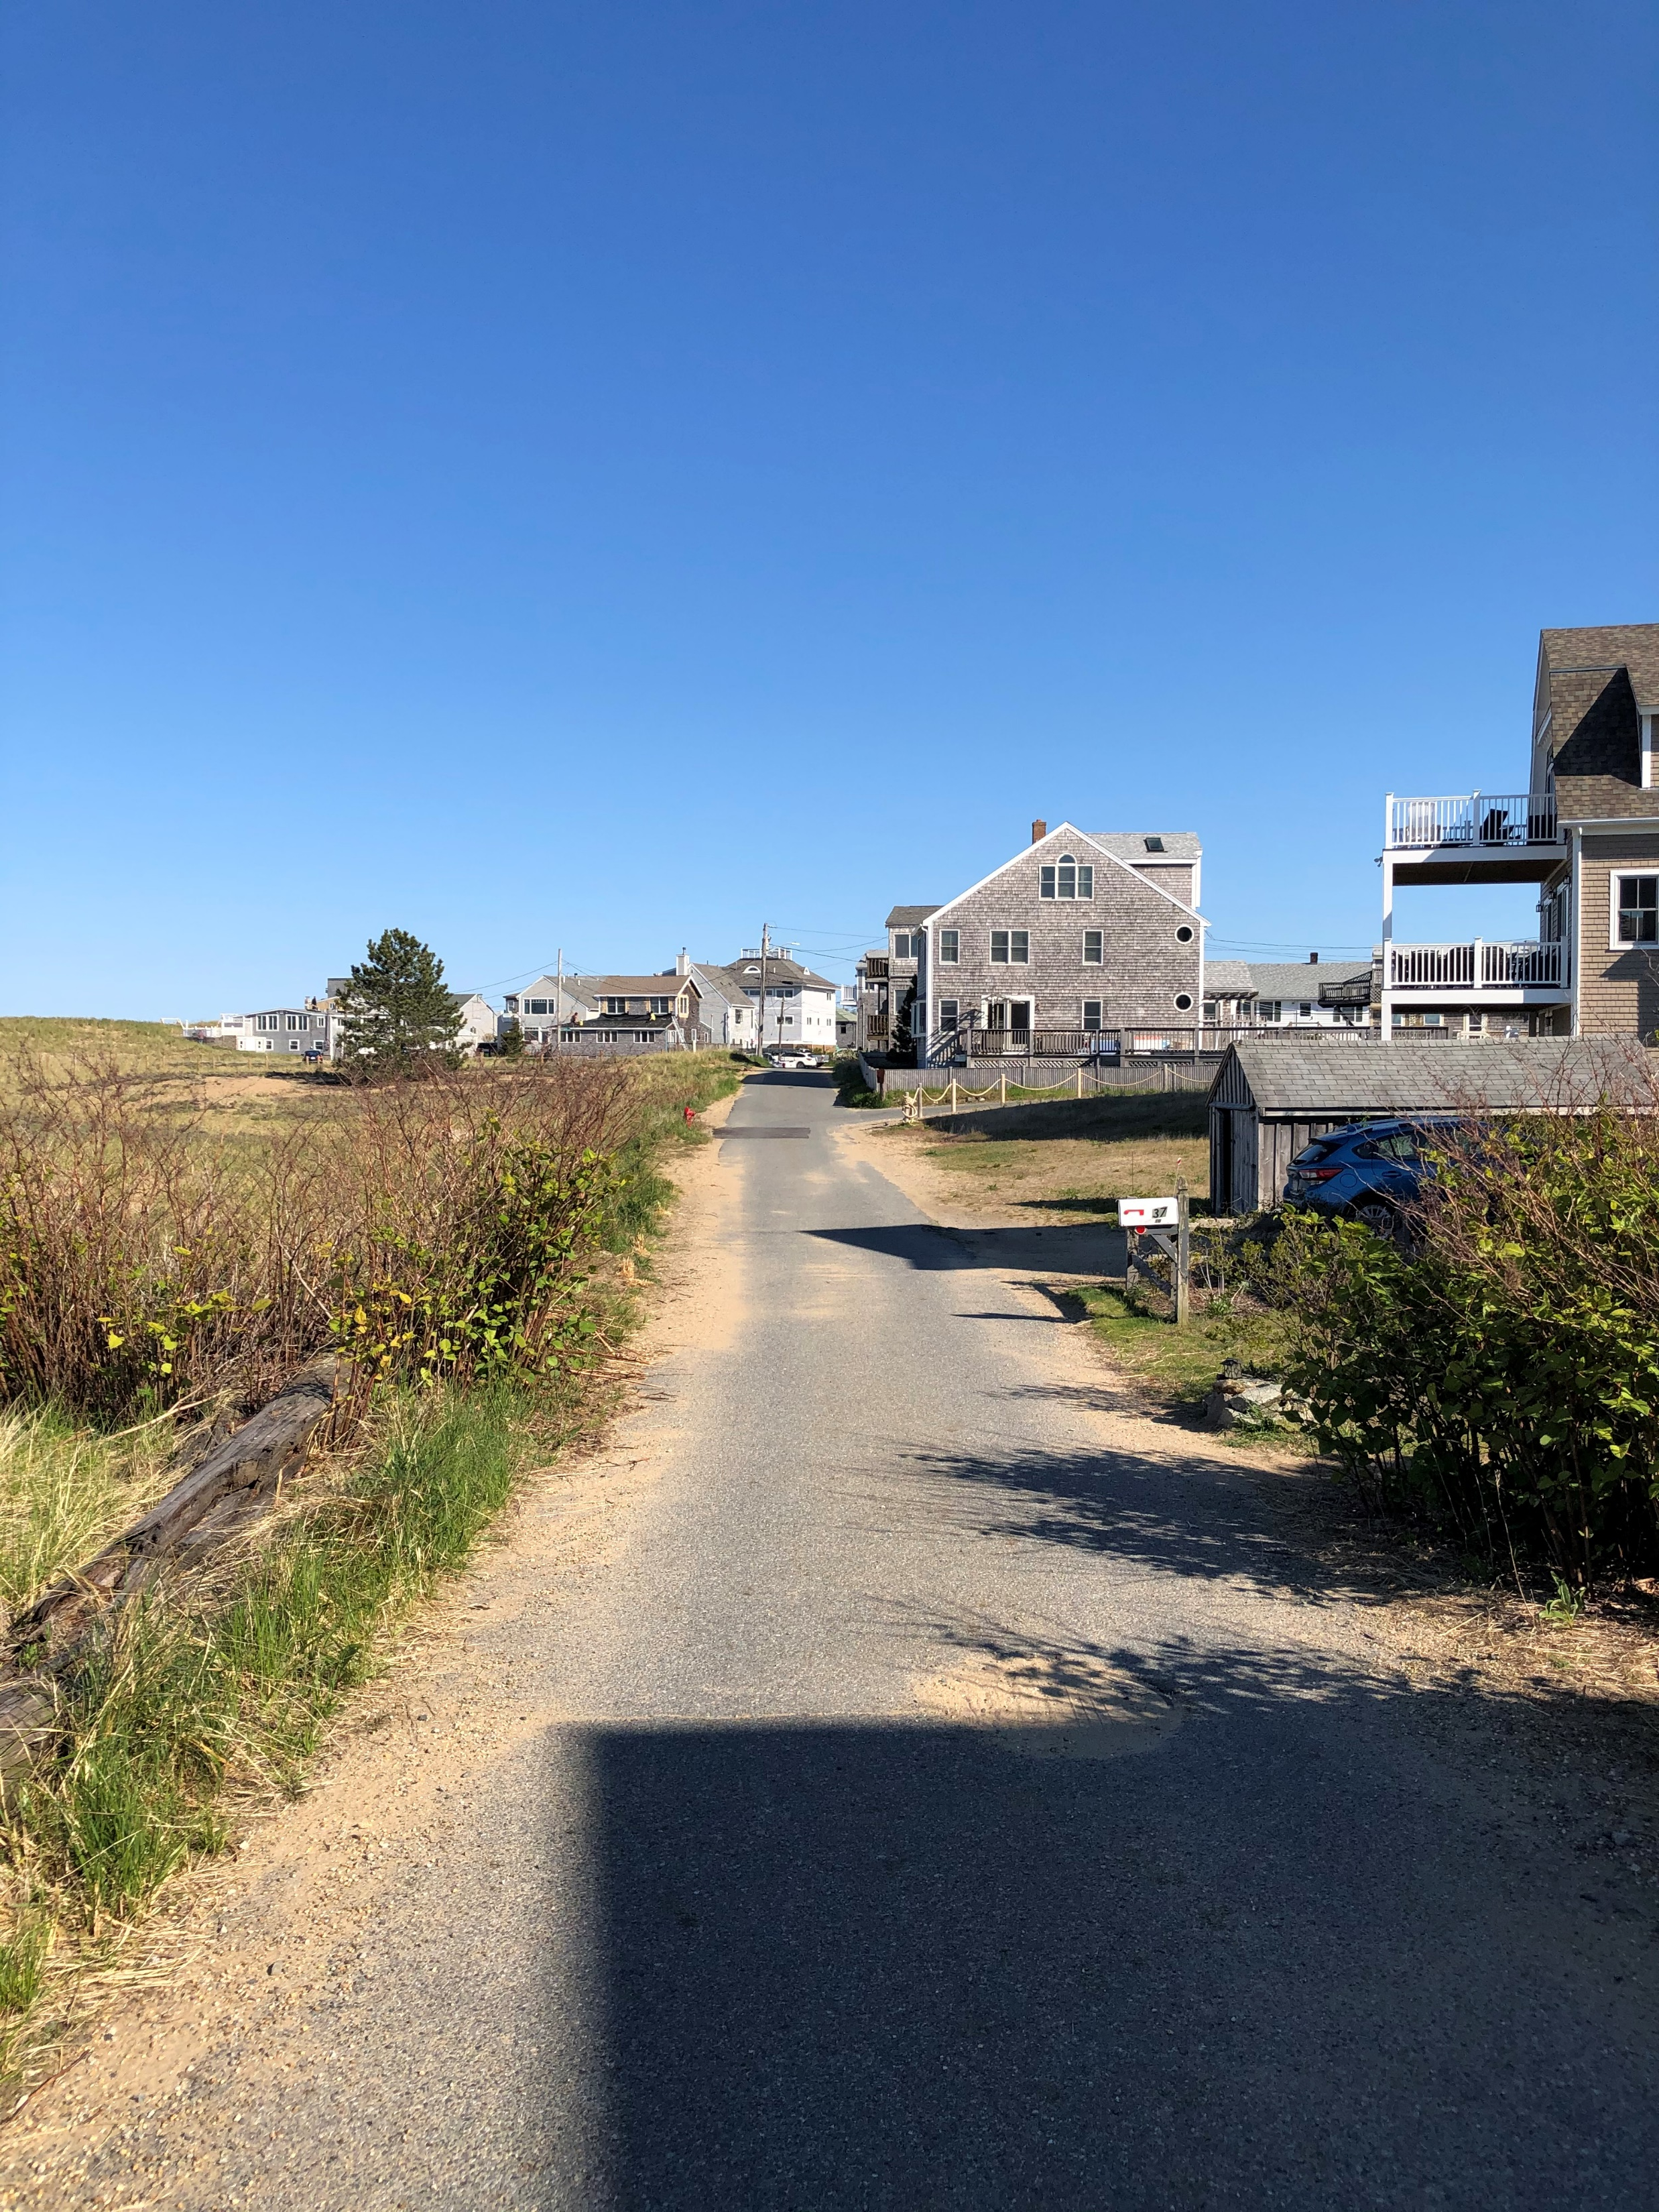
Neighboring Homes
39 Reservation Terrace
15 63rd Street
20 63rd Street

Slide 10
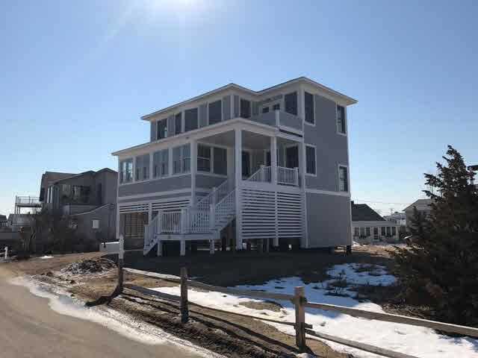
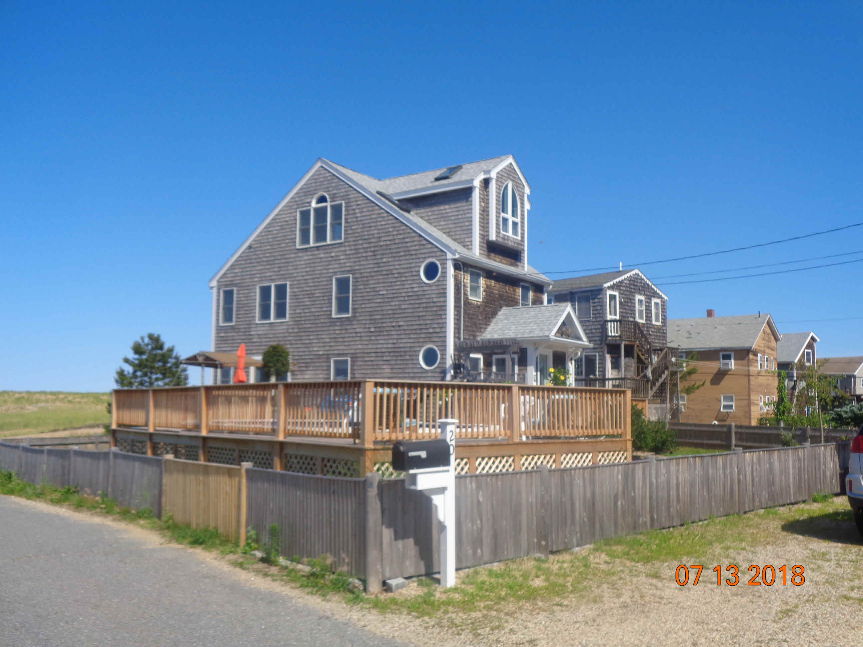
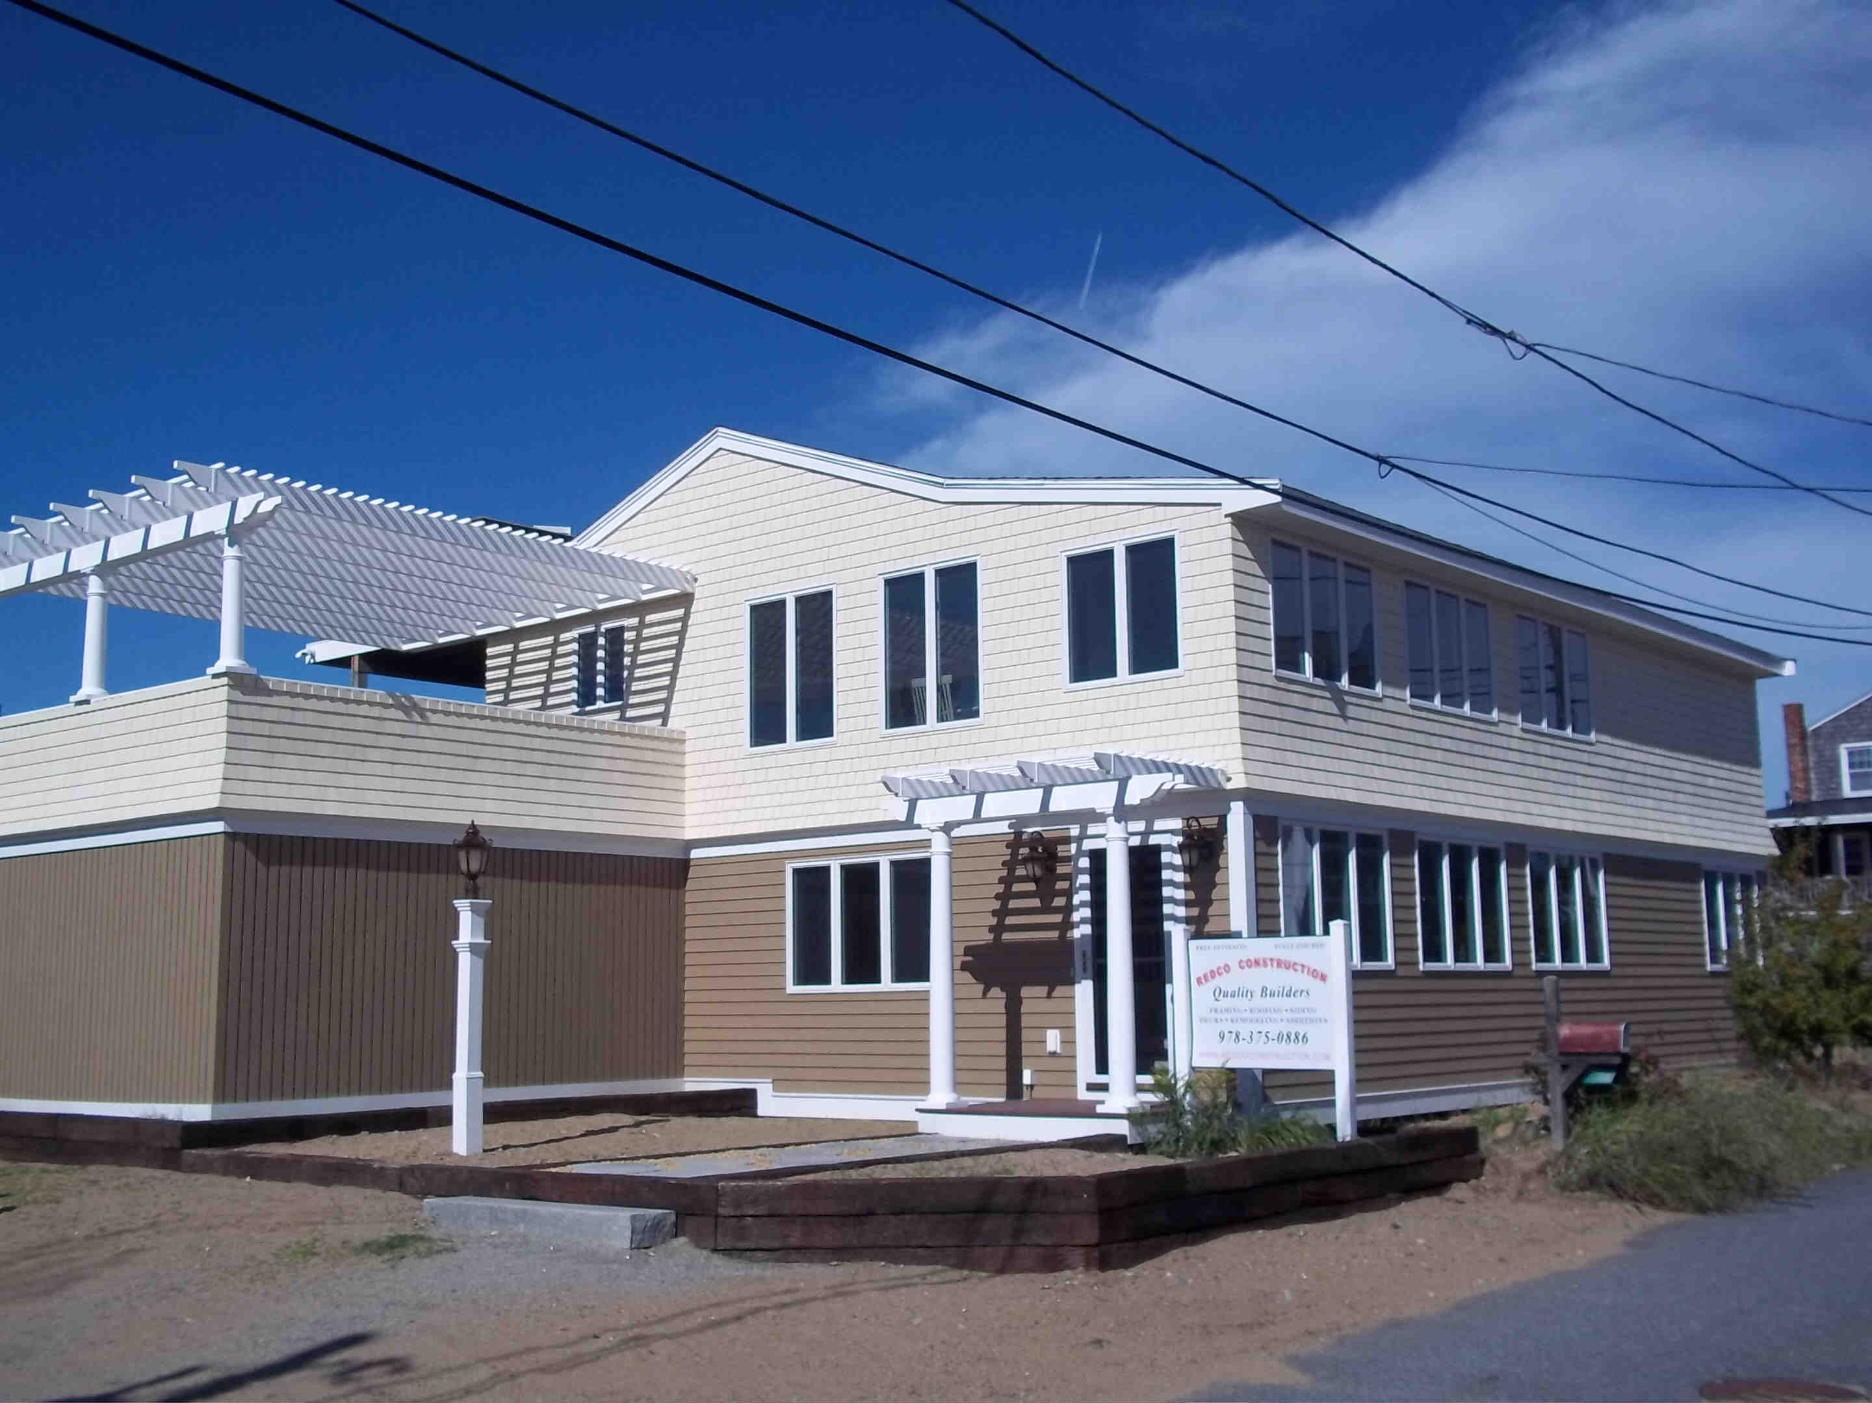
Neighboring Homes
39 Reservation Terrace
20 63rd Street
11 63rd Street

