Slide 1
35 Oakland Street
6,989 sq. ft. lot in the R2 district and DCOD
Pre-existing, nonconforming two-family use
Pre-existing, nonconforming lot area and frontage
Proposal to construct 2.5 story addition to rear of the existing residence by a common wall connector to relocate one unit from the existing residence to the new addition
DCOD does not apply as less than 25% of the exterior walls will be demolished (20.4%)

Slide 8
Neighborhood

Slide 9
Nonconforming Neighborhood
Minimum required lot size for single family in R2: 10,000 square feet
Minimum required lot size for two family in R2: 15,000 square feet
Address | Lot Size in Sq. Ft. | Use
1 Walnut (corner of Oakland) | 6,500 | Single Family
16 Oakland | 5,780 | Single Family
18 Oakland | 5,400 | Single Family
22 Oakland | 4,190 | Single Family
24 Oakland | 1,830 | Single Family
26 Oakland | 6,530 | Single Family
29 Oakland | 5,650 | Single Family
31 Oakland | 3,380 | Single Family
33 Oakland | 3,620 | Single Family
37 Oakland | 3,520 | Single Family
39 Oakland | 6,825 | Single Family
46 Monroe Street (corner of Oakland) | 7,675 | Single Family
 | Average: 5,075
14 Oakland | 3,410 | Two Family
15 Oakland | 7,130 | Two Family
19 Oakland | 8,870 | Two-Family
21-23 Oakland | 4,620 | Two Family
28 Oakland | 10,220 | Two-Family
30 Oakland | 7,760 | Two-Family
32 Oakland | 10,088 | Two Family
35 Oakland | 6,989 | Two Family
 | Average: 7,386
20 Oakland | 10,809 | Three-Family

Slide 10
Neighborhood Lot Coverages
Maximum allowable lot coverage in the R2: 25%
Address | Lot Size in Sq. Ft. | Use | Lot Coverage
14 Oakland | 3,410 | Two Family | 28.5%
15 Oakland | 7,130 | Two Family | 34.4%
19 Oakland | 8,870 | Two-Family | 13.0%
21-23 Oakland | 4,620 | Two Family | 28.4%
28 Oakland | 10,220 | Two-Family | 16.5%
30 Oakland | 7,760 | Two-Family | 17.0%
32 Oakland | 10,088 | Two Family | 15.7%
35 Oakland | 6,989 | Two Family | Proposed: 23.1%
 | Average: 7,386 |  | Current Average: 21.9%

Slide 11
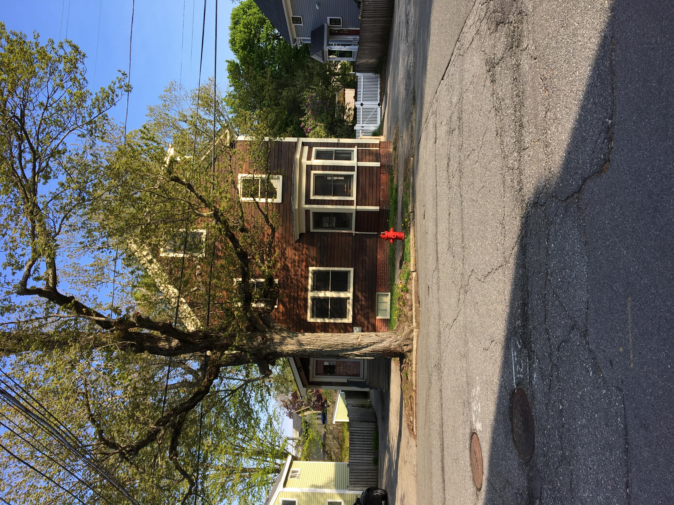
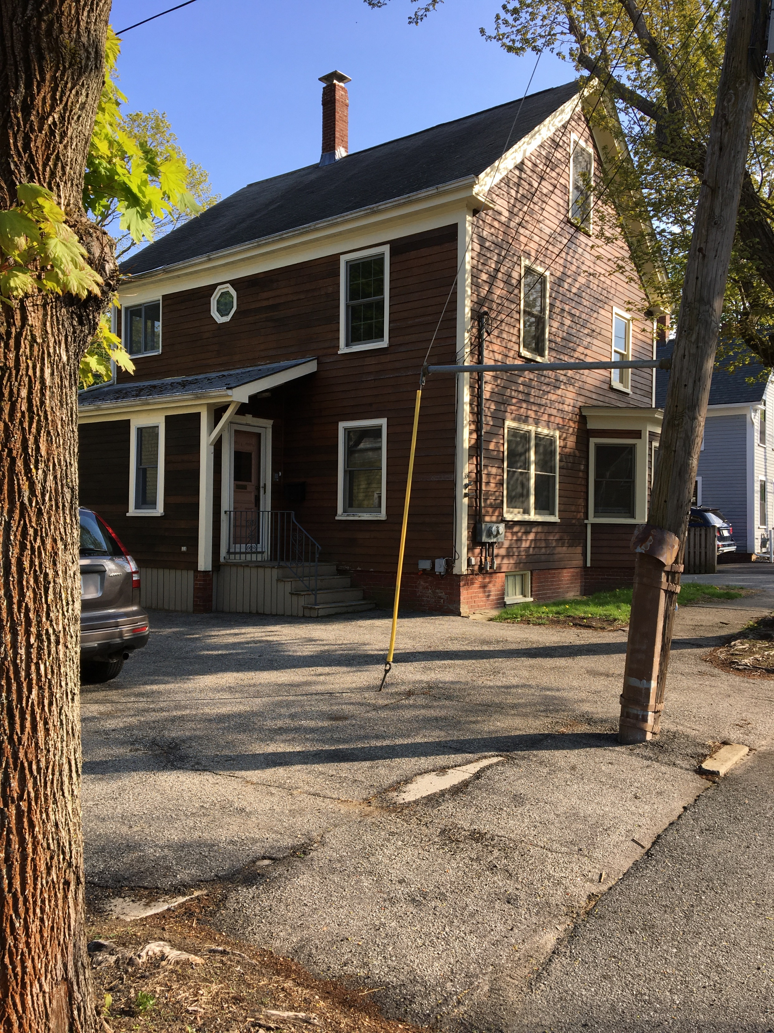
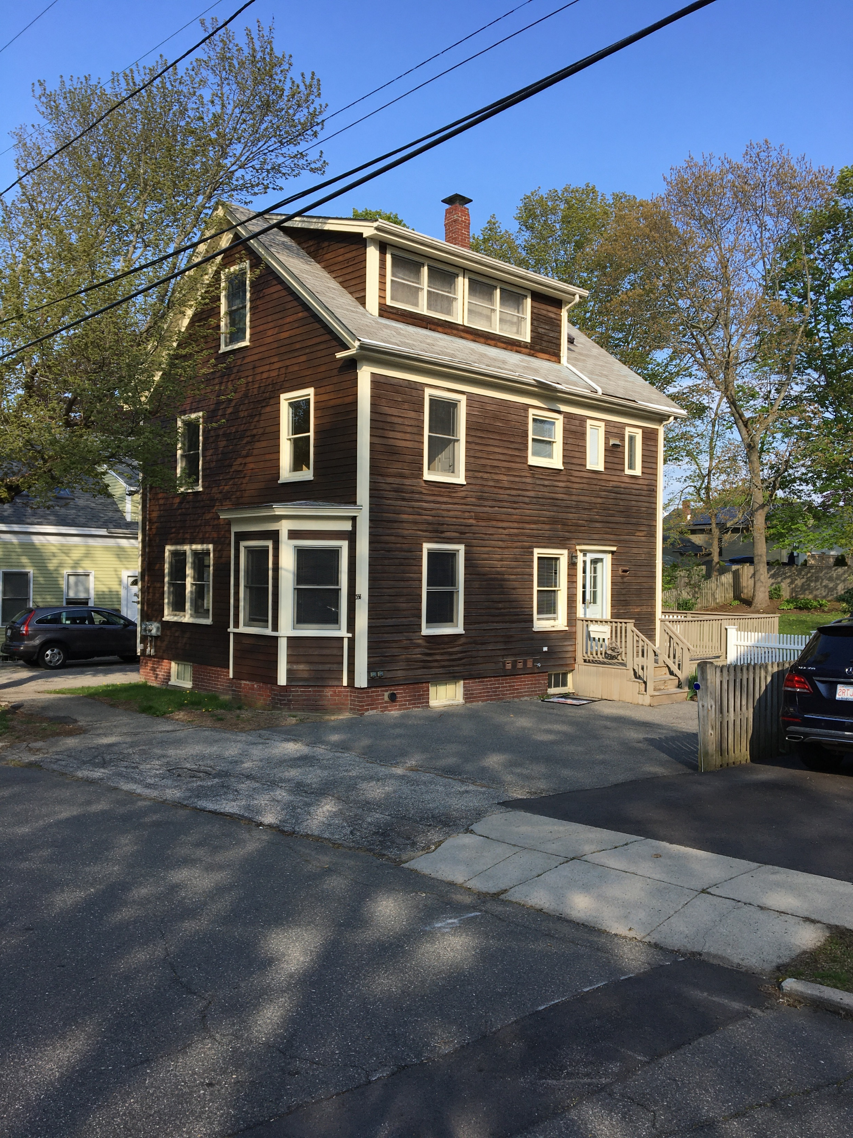
35 Oakland Street

Slide 12
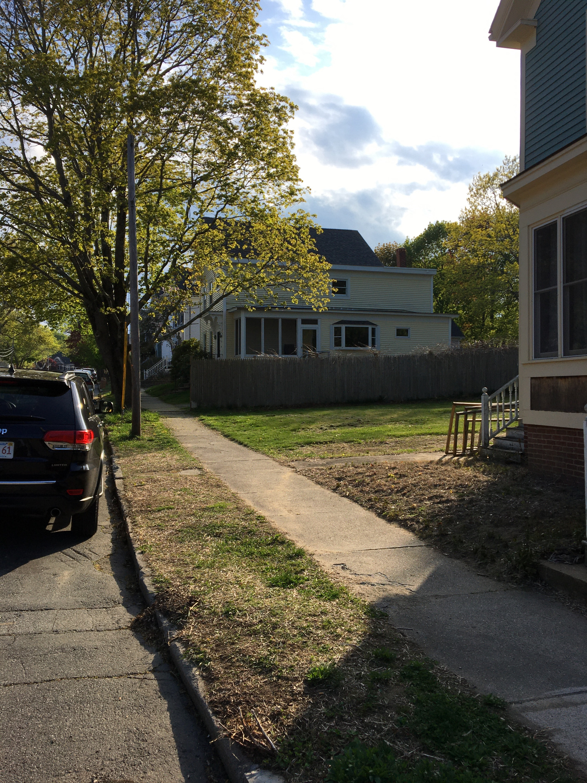
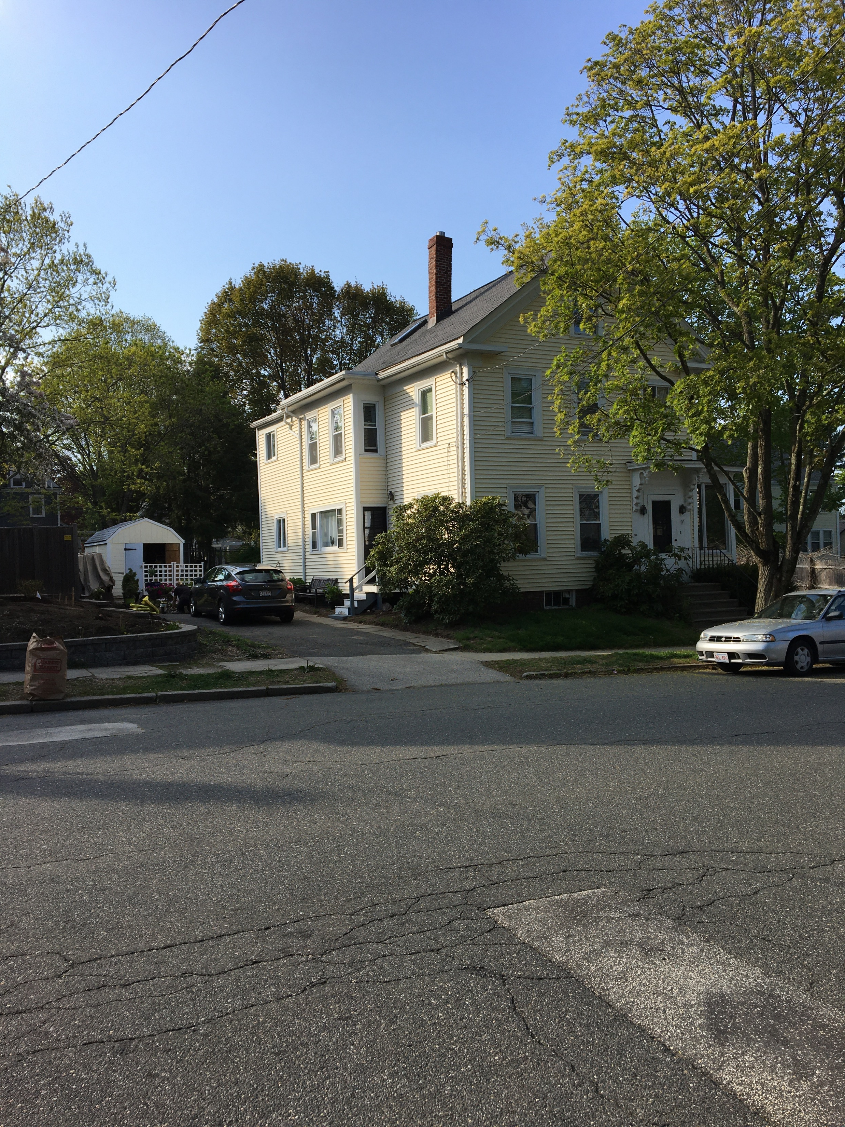
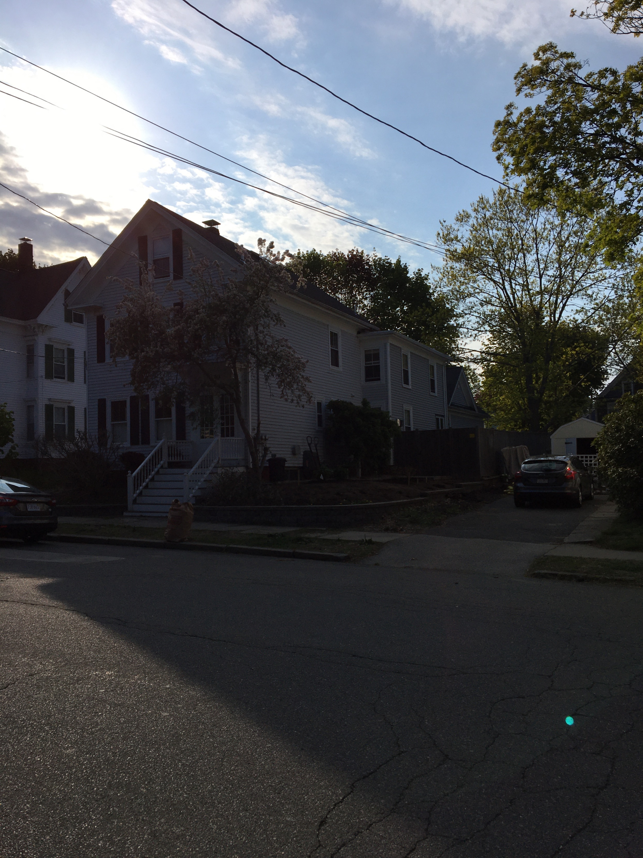
Other Homes

