Slide 1
Special Permit for Non-Conformities
Jane B. Holaday, 8 Peters Rd

Slide 2
The Project:
To add an additional garage bay of dimensions 20' 10" x 24' 10" on pre-existing nonconforming lot.
The Non-Conformity:
Front setback requirement for Zone R1 is 30’.
The existing structure has a setback of 18.9’
The proposed structure does not impact the front setback, it remains at 18.9’

Slide 3
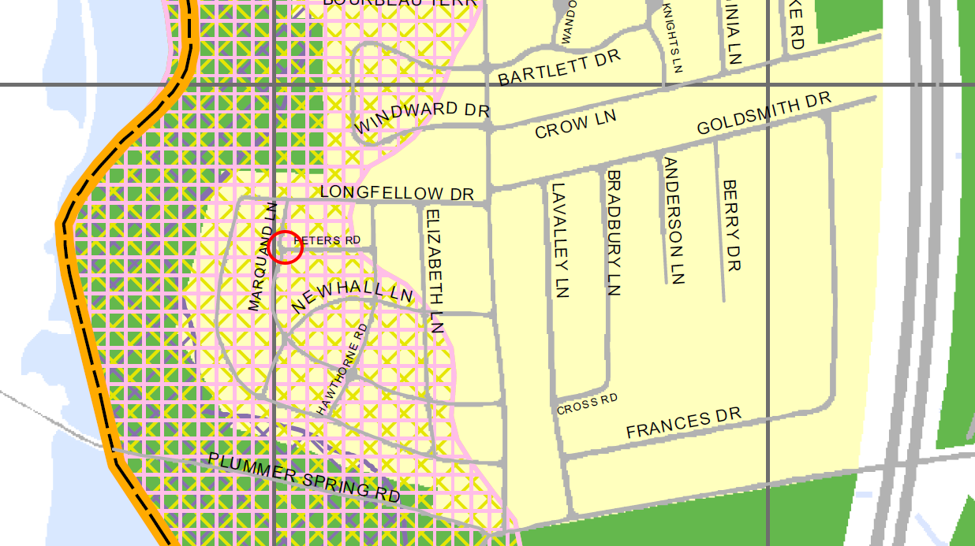
Peters Rd is located between Turkey Hill Rd and the Artichoke Reservoir
TOWNZONE Zone R2 Water Resource Protection District Zones B & C

Slide 4
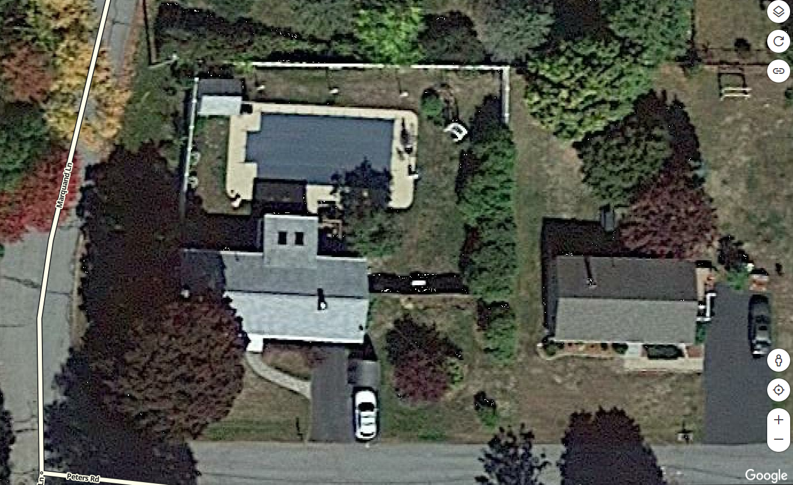

Slide 5
We have spoken to Joanne Doane at 6 Peters Rd., and she supports our desire to expand our garage. She is the only abutter as 8 Peters Rd. is a corner lot.

Slide 6
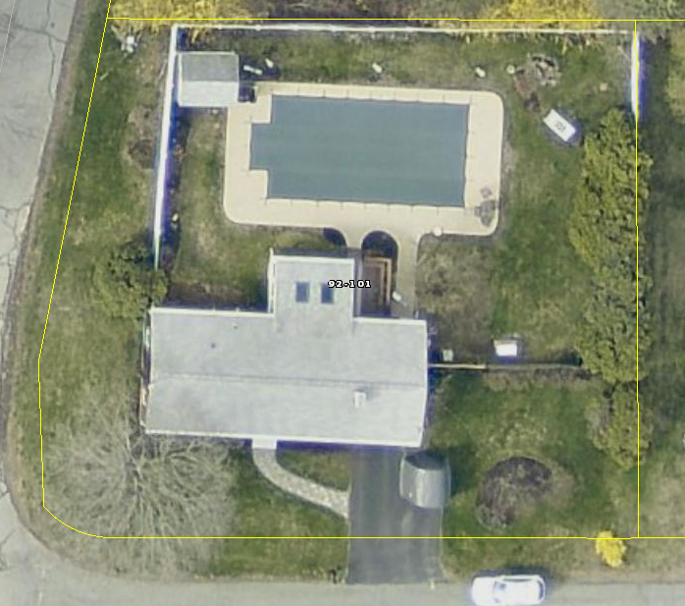

Slide 7
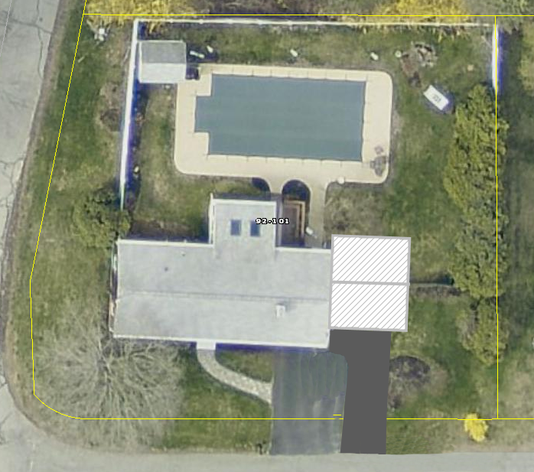

Slide 9
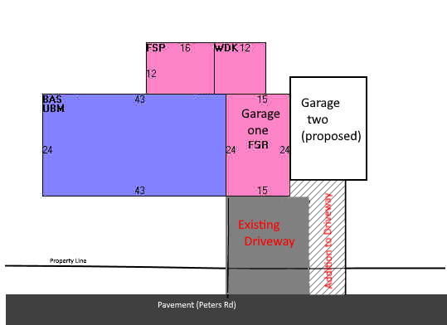

Slide 10
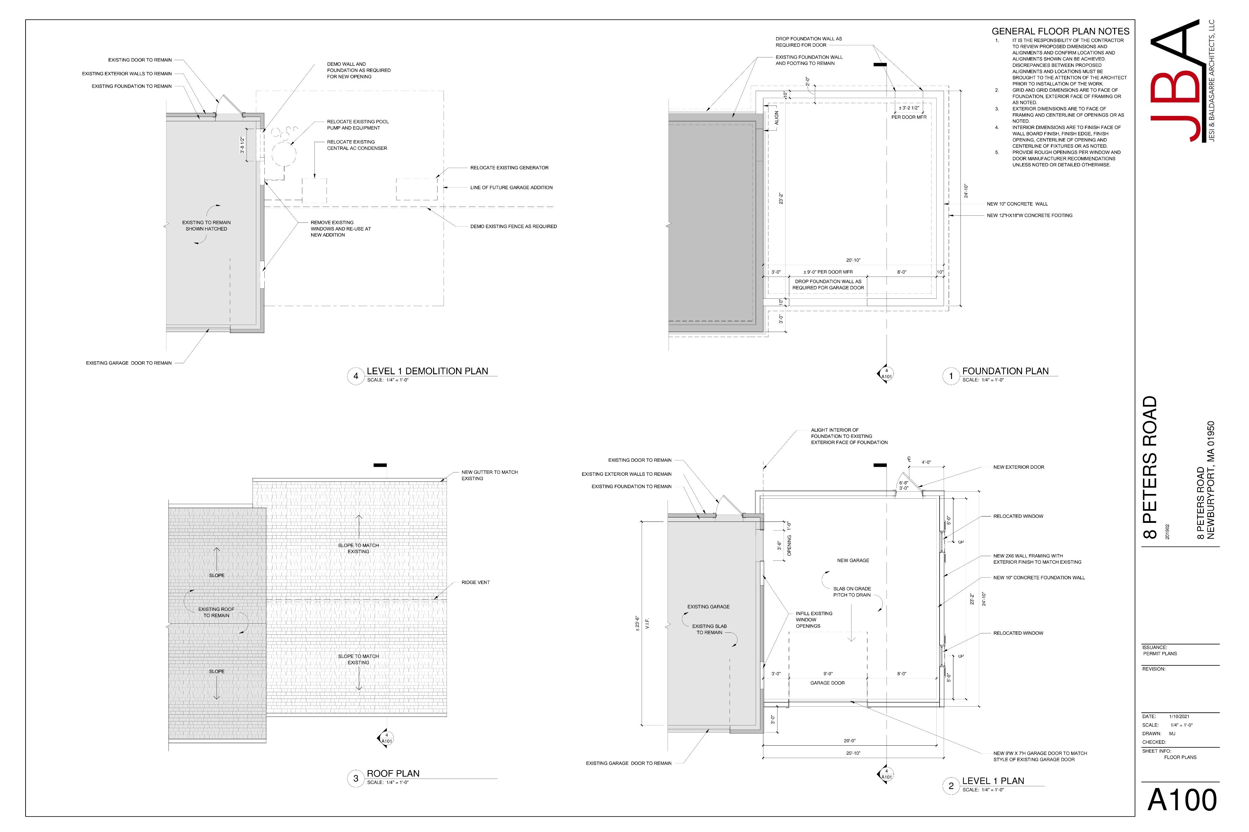

Slide 11
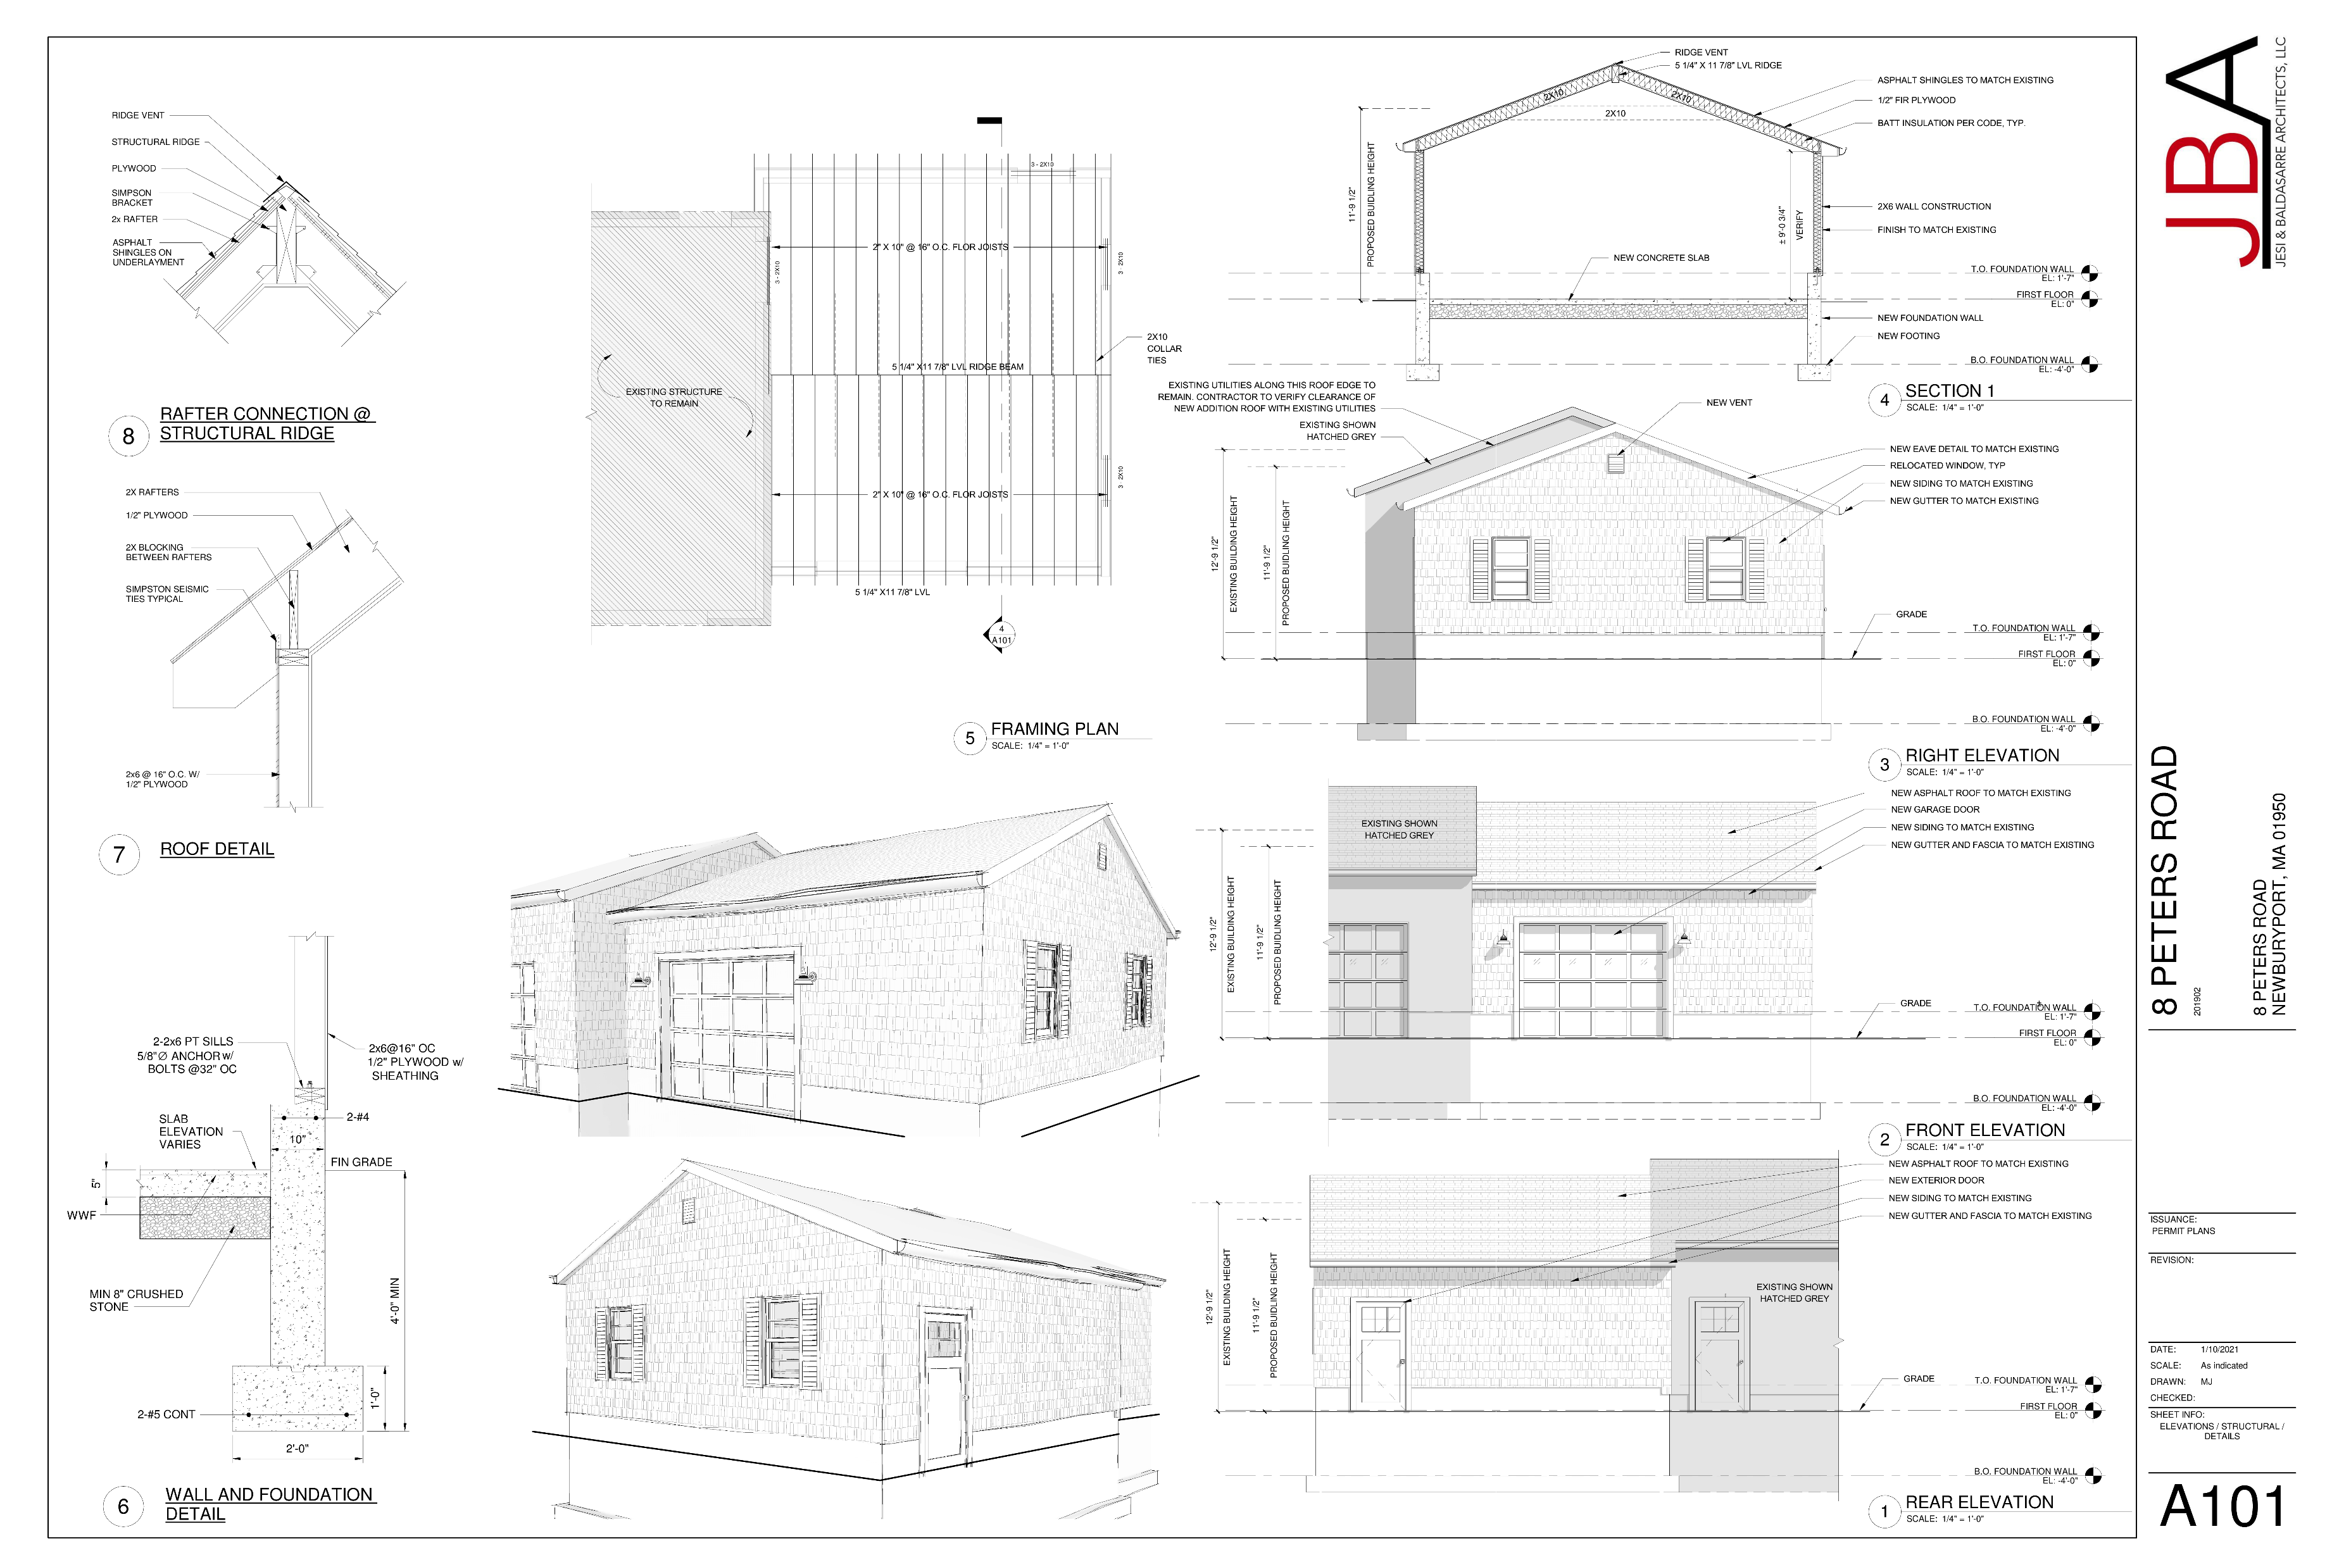

Slide 12
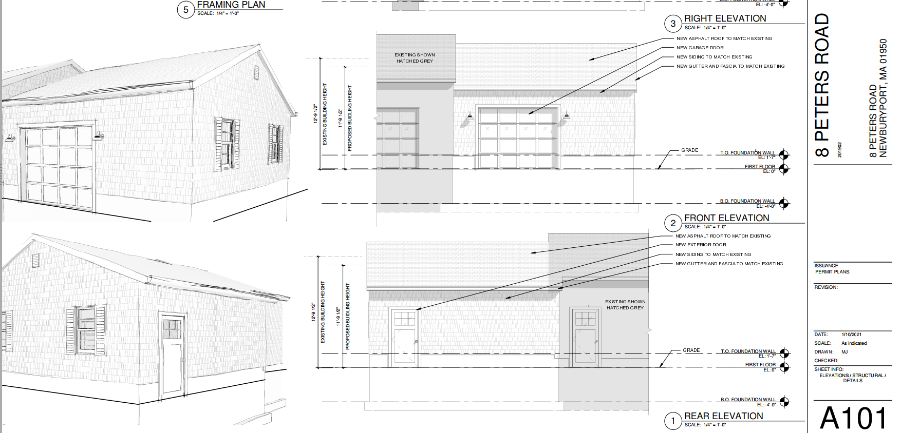

Slide 13
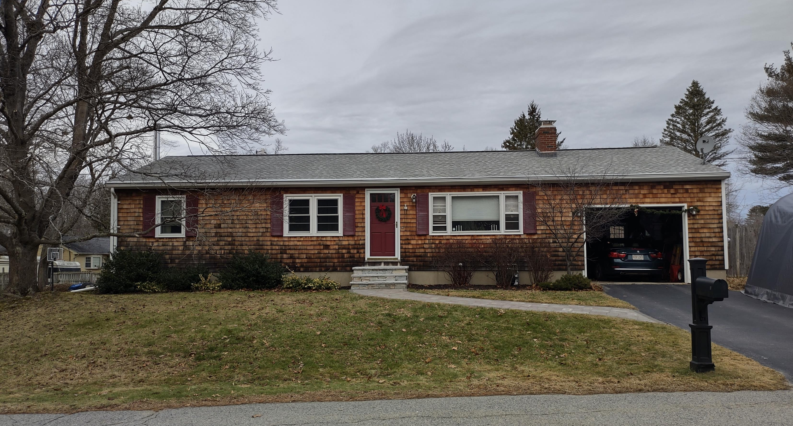

Slide 14
