Slide 1
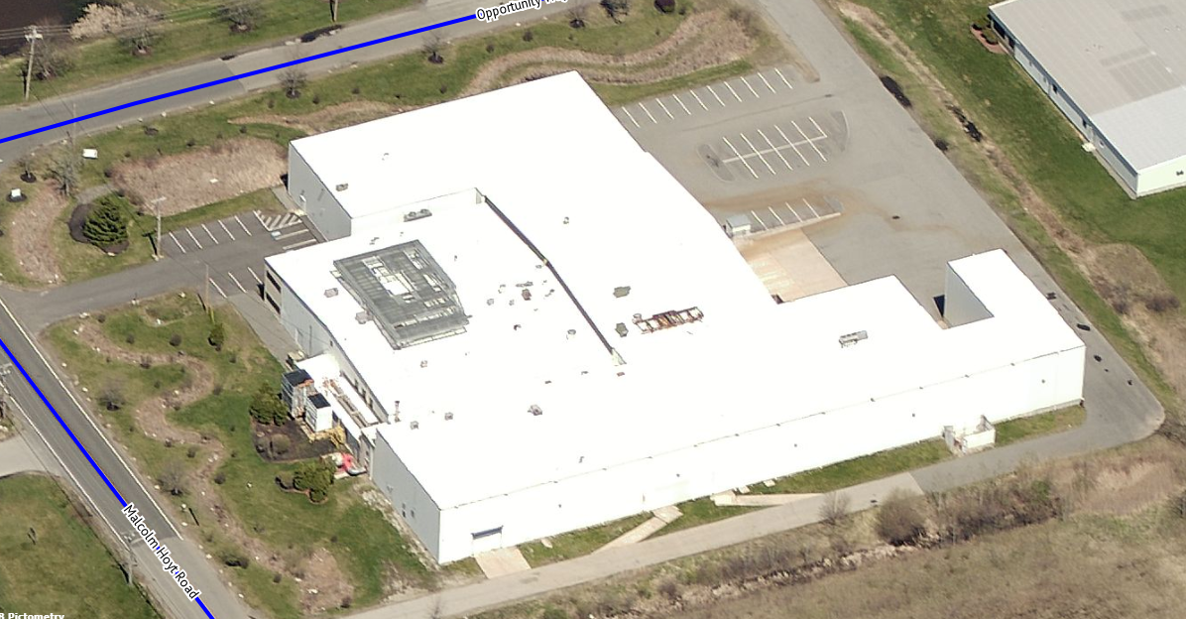
HVV Massachusetts, Inc.
Planning Board – Public Hearing
Newburyport, Massachusetts
July 18, 2018

Slide 2
Objectives:
Introduce HVV Massachusetts, Inc. (“HVV”) to Planning Board
Review process and progress to date
Review state-of-the-art, custom-designed marijuana cultivation facility
Introduce HVV’s team of experienced cannabis professionals in operations, compliance, cultivation and security
Review applicable legal standards

Slide 3
Happy Valley Ventures MA, Inc.
Team has a strong background in running non-profit organizations, private and public companies
COO/Founder – Eddie Lauth - Experienced entrepreneur. Founder of one public company and current board member of another.
CFO – Certified Public Accountant, Former CFO of 3,000 employee real estate and hospitality company.
CEO/Founder – Michael Reardon
Experienced real estate developer in multiple asset classes
Managing Partner of HVV Newburyport, LLC, formed in 2018 to purchase 2 Opportunity Way.
Team has specific experience in the cannabis industry
Holds several licenses from DPH; developing multiple sites
Cultivation facility in Gloucester currently under construction

Slide 4
Licensing Status of HVV across the Commonwealth
Provisionally licensed at the following locations:
East Boston – 220 William McClellan Hwy – retail shop / medical dispensary
Boston – 60 East Springfield Street (South End)– retail shop / medical dispensary license being transferred from Amherst.
Gloucester – 38 Great Republic Drive – cultivation and processing facility + retail shop / medical dispensary

Slide 5
HVV’s History with Newburyport
Approached City seeking to develop existing site into cultivation / processing facility
Site at 2 Opportunity Way presented to HVV as potential location
HVV entered into Purchase and Sale Agreement with current owner
Provided feedback to City during recent zoning amendment process.
Currently negotiating Host Community Agreement
Multiple meetings with Mayor and city staff
Notes:
-Meeting w/ Campanello – March 17, 2016
-Meeting w/ Gregg, Jim, and Chip – April 26, 2016
-Meeting w/ Gregg, Smith, McCarthy, PK, and Ryan – June 21, 2016

Slide 6
Benefits to Newburyport Community
HVV will develop and retrofit a vacant building that will remain fully taxable including equipment and fixtures.
HVV will use local subcontractors during construction whenever possible
HVV will be an active corporate member supporting local Newburyport charities and community organizations
HVV will employ approximately 70 full time employees at facility capacity
HVV will endeavor to hire local people, subject to CCC approval

Slide 7
Custom Retrofit Facility Designed for Newburyport
HVV’s facility will be a “purpose-built” marijuana cultivation and processing facility to ensure a state of the art, safe, and secure facility
Retrofit and renovation includes a secure garage for the discreet and protected delivery of product and pickup of supplies
Site has ample parking with great vehicular access for all employees, distributors, and suppliers, as well has handicap spaces and ramps
Facility will employ (and develop) leading-edge technology
Section of facility dedicated to genetic research on cannabis strains
Bringing “21st Century” jobs to Newburyport

Slide 8
Economic Benefits for Newburyport
Host Community Agreement
HVV proposing to contribute 3% of gross sales annually to City
Starting first full year of operation, minimum of $100,000.00 per year
3% is the maximum allowed by state law
Real Estate Development and Construction Investment
Projected construction cost: $12MM to $16MM
Employment/Jobs
70 Jobs (max. 42 per shift)

Slide 9
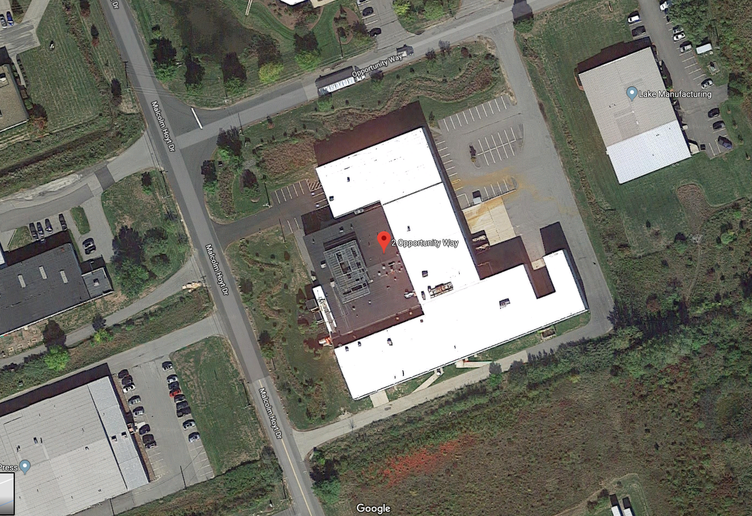
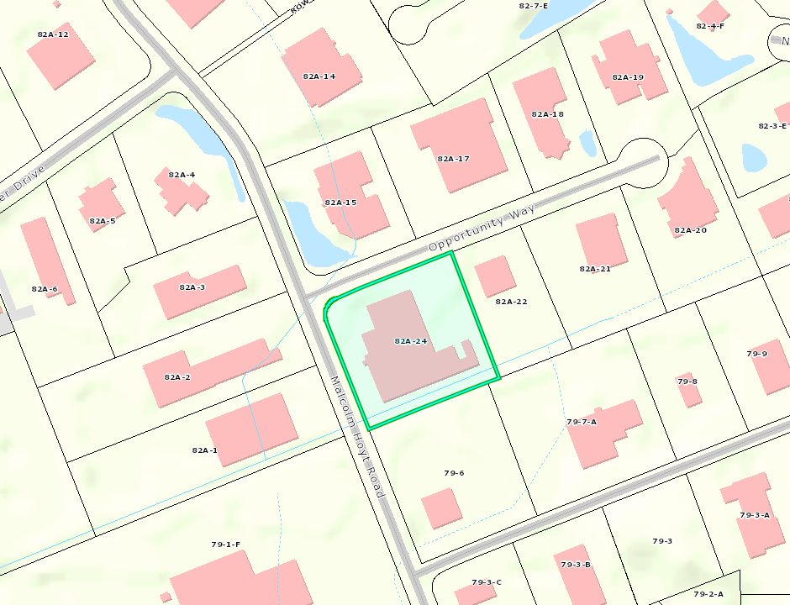
2 Opportunity Way– Existing Conditions

Slide 10
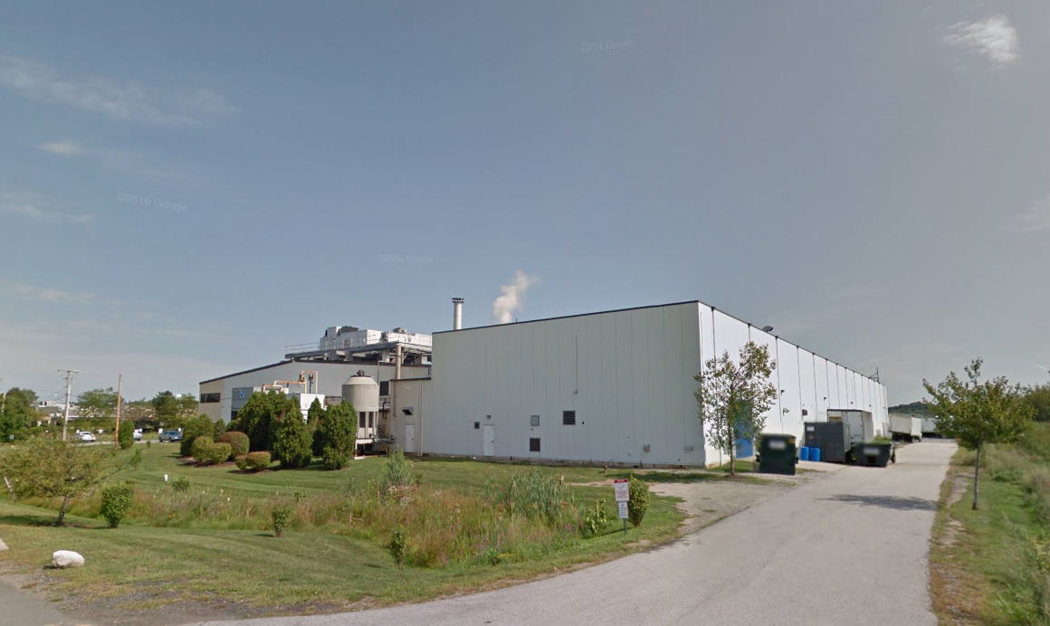
2 Opportunity Way– Existing Conditions

Slide 11
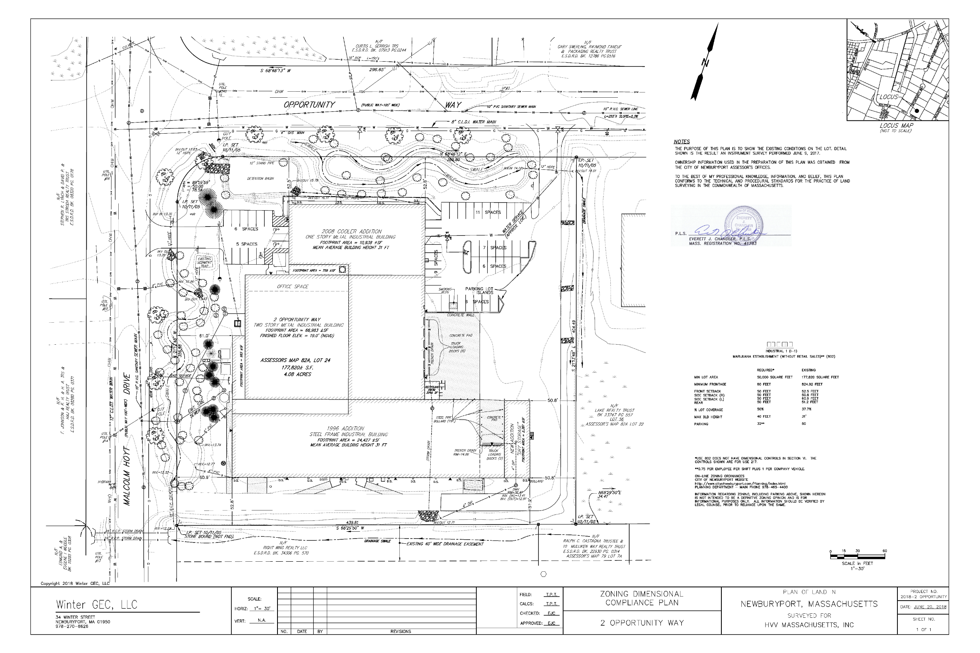
2 Opportunity Way – Existing Site

Slide 12
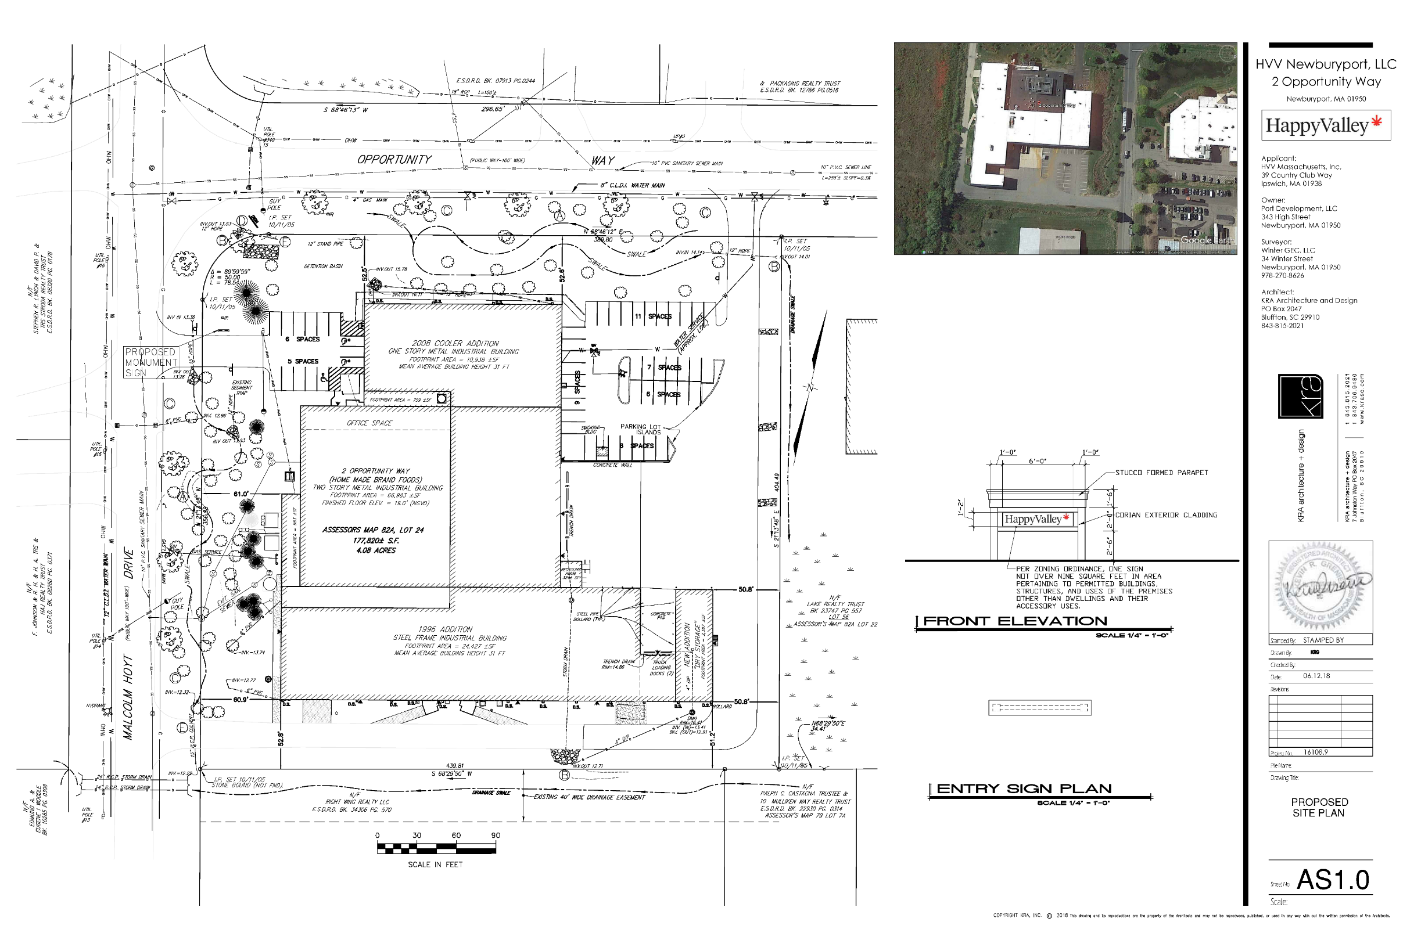
2 Opportunity Way – Proposed Site

Slide 13
2 Opportunity Way – Site Plan

Slide 14
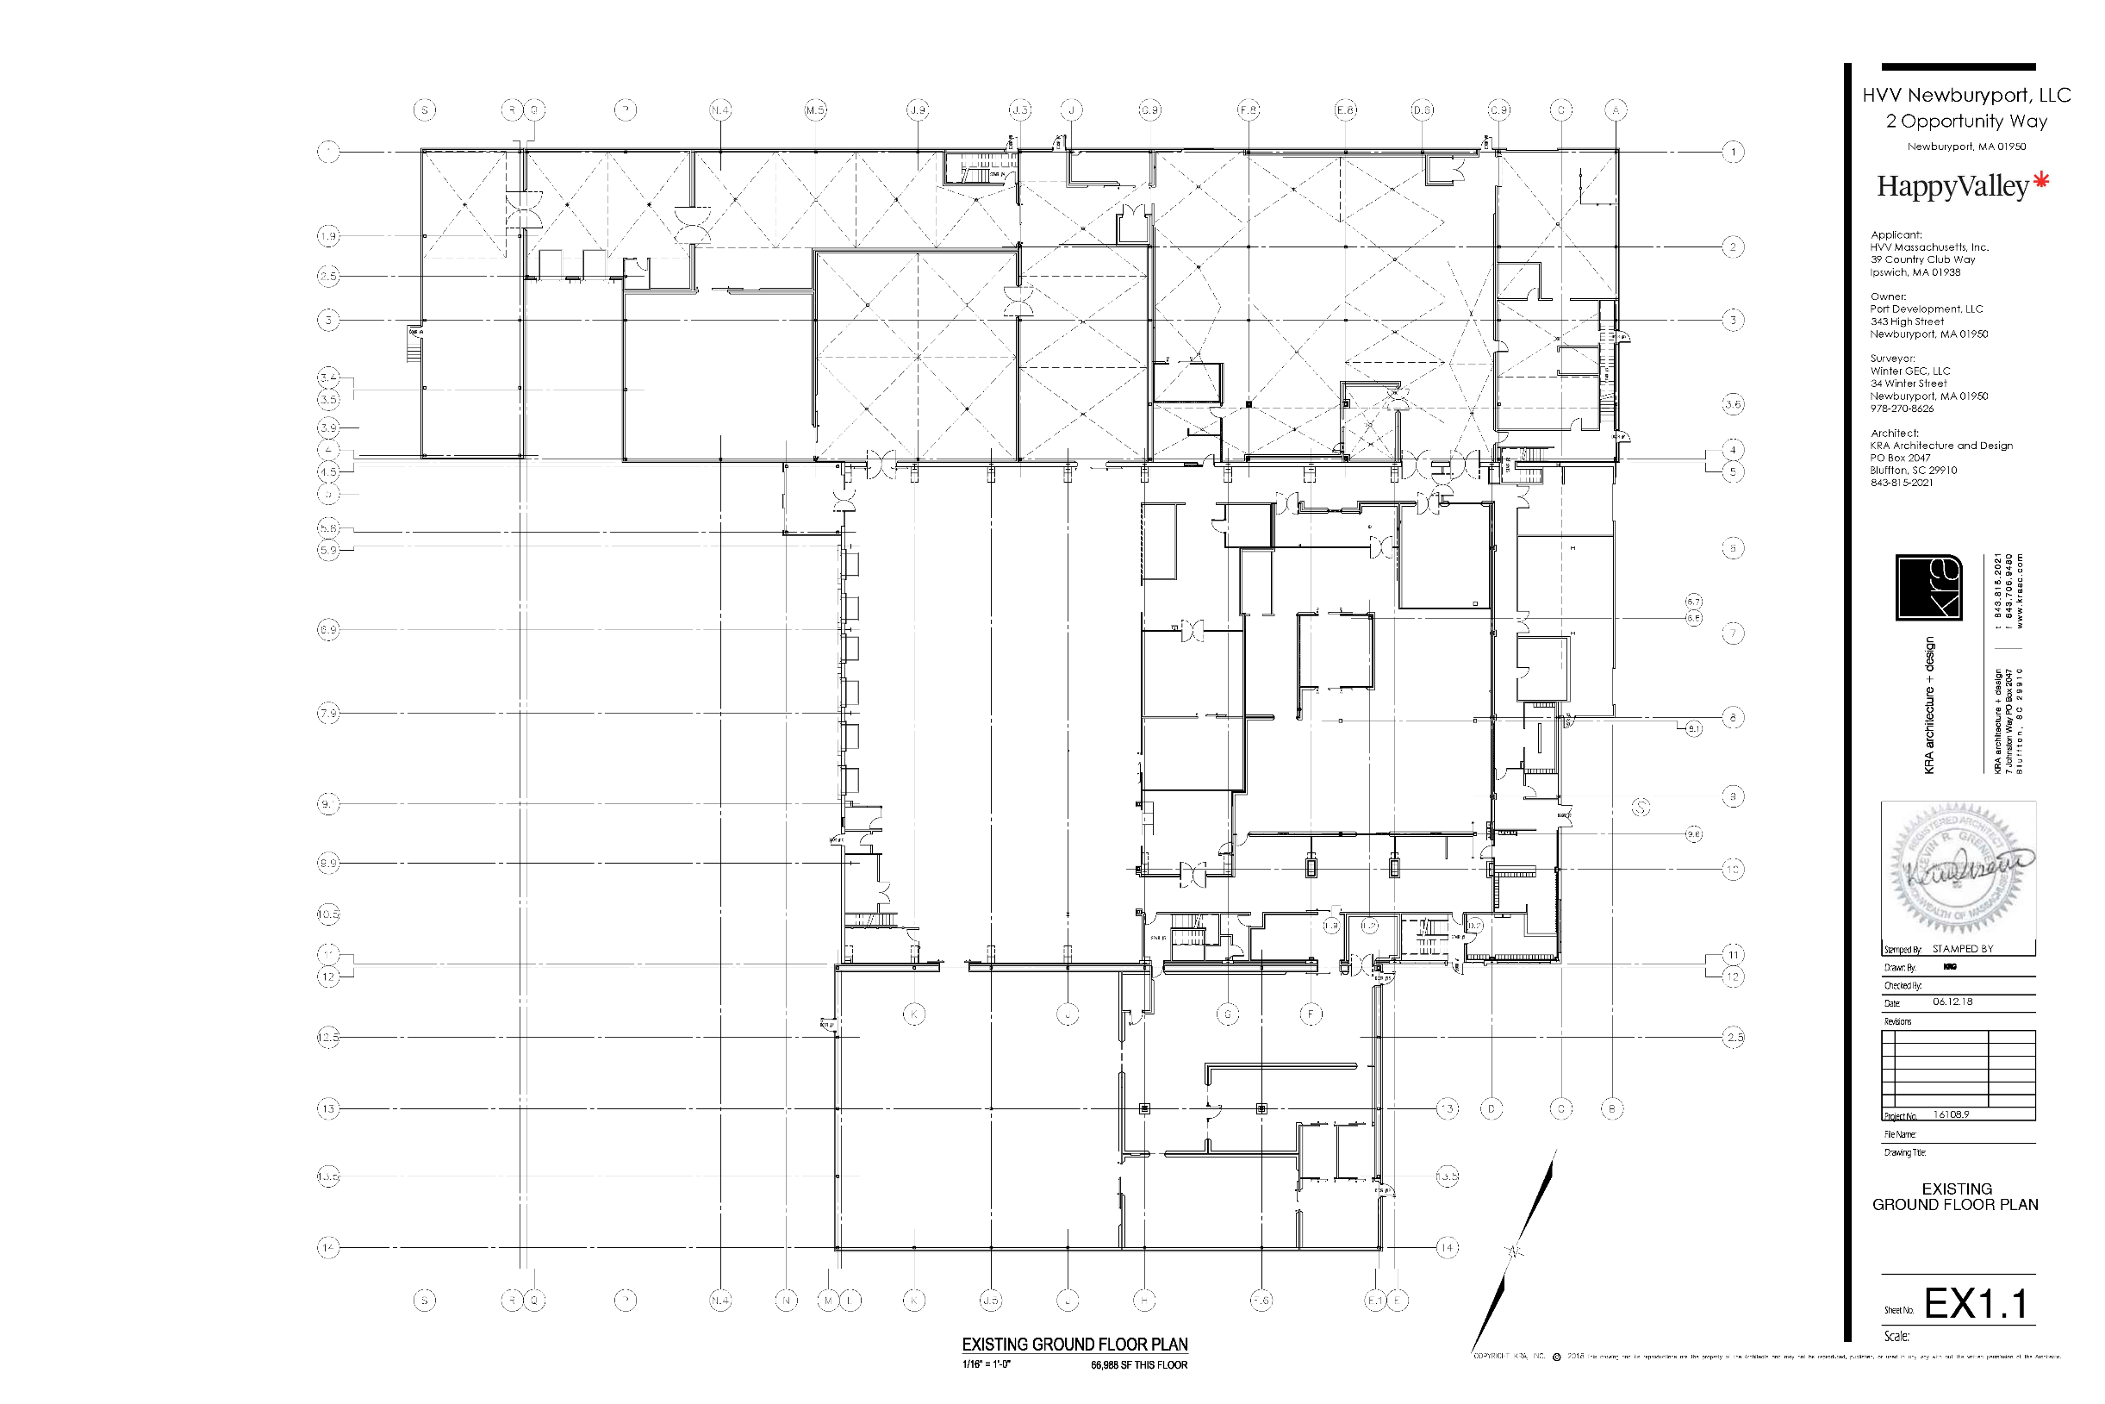
2 Opportunity Way – Existing Ground Floor

Slide 15
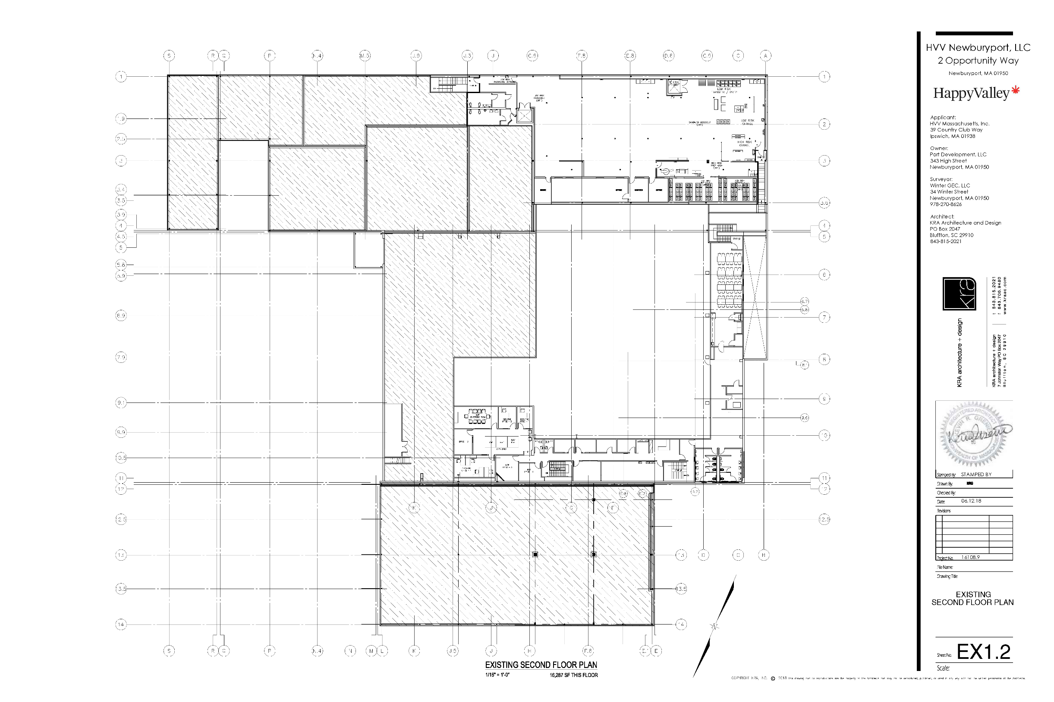
2 Opportunity Way – Existing Second Floor

Slide 16
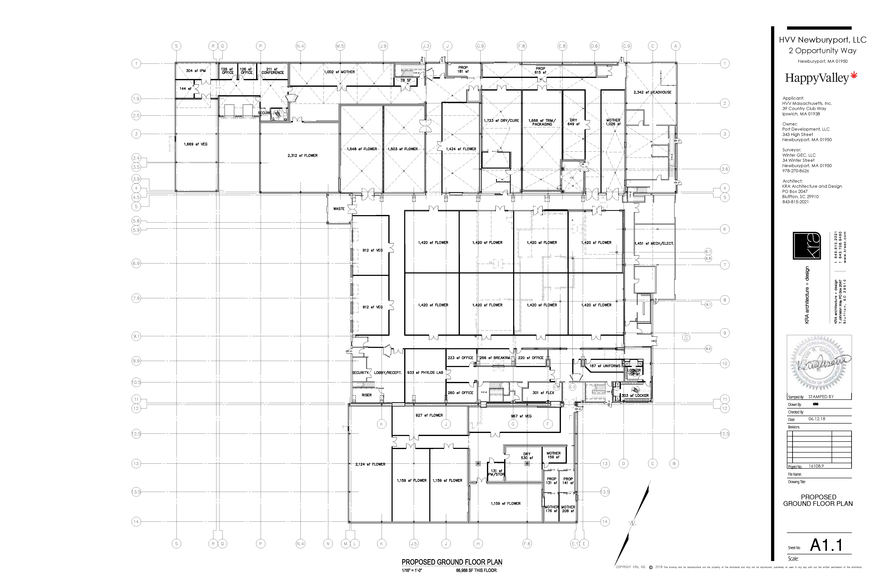
2 Opportunity Way – Proposed Ground Floor

Slide 17
2 Opportunity Way – Proposed Ground Floor

Slide 18
2 Opportunity Way – Proposed Ground Floor

Slide 19
HVV’s Team Consists of Industry Leaders
Providing HVV with comprehensive policies and procedures for the successful management of marijuana cultivation and processing.
Providing HVV with operational oversight and employee training to insure proper compliance with all state mandated regulations.
Notes:
HVV has entered into a 10 year consulting agreement with 4Front Advisors to help ensure our long-term viability.
4Front is a leading consulting firm with substantial expertise in operating and advising best-in-class medical marijuana dispensaries, enabling us to establish an organization dedicated to adhering to the highest operational standards.
4Front has developed the most comprehensive set of operating policies and procedures available by leveraging the best practices of leading dispensary operators. These solutions have been developed according to principles followed by some of the country's most successful retail chains and tailored to the cannabis industry.

Slide 20
Employee Hiring Practices
Verified Staffing
Annual “Agent” Registration
Applies to all agents, employees, managers and volunteers
Verifies that employees have a clean criminal history
Verifies that employees understand CCC regulations regarding transportation and wholesale distribution of marijuana
Verifies that employees understand CCC protocols regarding cultivating and storage

Slide 21
Operations
Compliance
Inventory tracking
Reporting practices to local agencies
Product testing
Staff licensing
Operations
Optimal facility design
Comprehensive staffing charts and job descriptions
Employee handbooks, operations manuals, and operations tools for each department
Notes:
As mentioned earlier, 4Front is a leader in the medical marijuana consulting industry. We have substantial expertise in establishing and advising professional, high-end, operationally compliant medical marijuana facilities. We seek to empower local owners who show the capacity to set a new standard for excellence in this industry, something we have found in Happy Valley Ventures and their impressive team.
4Front and our team have a successful track record of helping to establish some of the most respected retail dispensaries in California, Arizona, Rhode Island, Washington DC, Illinois and Nevada. We’ve assembled a talented team with expertise in best practice operations and protocol development from the medical cannabis, retail, and hospitality industries, and we’ve spent millions of dollars developing operational and training protocols, including a comprehensive set of operations manuals, in order to create the most professional medical dispensary model in the industry.
Compliance is the foundation of 4Front Advisors. We understand the importance of regulatory compliance within this strictly governed industry. As part of our relationship with HVV, we will provide policies and procedures designed to establish and maintain compliant operations in the following areas: inventory tracking; patient record keeping; reporting practices to local agencies; medicine testing; patient education; and staff licensing.

Slide 22
Cultivation and Processing
Grow Industries will consult on the design and construction of our cultivation facility by utilizing the most efficient technologies for the cultivation and processing of cannabis.
Grow Industries will quality control oversight on all aspects of our cannabis cultivation and harvest. These services are provided to us using proprietary Standard Operating Procedures and other Intellectual Property to maximize the efficiency of our cultivation operation.

Slide 23
Security
HVV has engaged BluLine to provide security design services for our operations.
BluLine Security Consulting, LLC is a security firm founded by experienced law enforcement officers, who drawing on experience, training, and education develop realistic, user friendly, and practical security plans, training and risk management programs.
BluLine has intimate knowledge of all facets of the day-to-day operations of a marijuana cultivation facility to adhere to all DPH and CCC regulations.
BluLine is also available as a resource for training local Law Enforcement officers, City Inspectors and Government Officials.

Slide 24
Security
Detailed Security Plan
HVV has engaged American Alarm of Arlington, MA for security design, installation, and monitoring services.
American Alarm has worked closely with DPH on multiple RMD locations throughout Massachusetts to insure that 105 CMR DPH guidelines are satisfied correctly.
All medicine and assets will be secured against external threats and properly monitored to prevent diversion.
Security System Features
HVV’s design is a fully integrated security system throughout the facility that includes the following features:
HD Video with IR for images in all lighting conditions
iClass technology access control devices
Dual Path Alarm Monitoring at our UL Central Station
Notes:
We are committed to implementing sufficient security measures to deter and prevent unauthorized entrance into areas containing marijuana and theft of marijuana at our facility. In consultation with a leading security providers Agoge and American Alarm, we have developed a security plan that details that all medicine and assets will be secured against external threats.
We will limit access to all areas where marijuana will be cultivated, processed and stored to authorized dispensary agents. We will control access to secure areas though the use of access control devices, including high security iClass card and keypad readers which will ensure that access is limited to only authorized personnel. All staff will visibly display a company-issued identification card at all times while on-site and when making deliveries.
Visitor access will be strictly controlled. All outside vendors, contractors, and visitors must obtain and wear a visitor identification badge prior to entering any limited access area. All visitors will be escorted by a security associate at all times inside the enclosed, locked facility where marijuana is stored and/or cultivated. All visitors must be logged in and out; that log will be available for inspection by DPH at all times. All badges must be returned to the RMD upon exit.
We will use a state of the art security system that features an alarm system on all perimeter entry points and windows, including glass breaks for each window, door contacts for each perimeter door, and cameras with built-in motion detection in order to prevent and detect diversion, theft, or loss of marijuana, as well as unauthorized intrusion. Our electronic monitoring system includes a failure notification system with constant system health checks that provide an audio and visual notification should a failure in the system occur.
Video cameras will be directed at all safes, vaults, sales areas, and areas where marijuana is cultivated, harvested, processed, prepared, stored, handled, or dispensed. In addition, exterior cameras will ensure monitoring of the property and surrounding area for suspicious behavior. We also have designed a secure approach to the delivery/receipt of medicine at our facilities.
All security personnel will be trained prior to deployment in industry standards and crime prevention. Security personnel will ensure that only eligible patients who comply with Our Code of Conduct and other dispensary policies are served and will patrol the area to ensure non-diversion and prevent use of medicine in public areas.

Slide 25
Legal Standards – Zoning Ord. § XXXI
Section XXXI replaces former section V-G
Approved May 29, 2018, on a 10-to-1 vote in favor
XXXI-C – Requires Special Permit from Planning Board for use
- Follows Zoning Ord. § X-H(7)
XXXI-D – Sets limitations as to size, location, and use
XXXI-E – Parking requirements
XXXI-F – Buffer Zones; additional location restrictions
XXXI-G and H – Outlines Special Permit procedure

Slide 26
Legal Standards – Zoning Ord. § XXXI
Section XXXI replaces former section V-G
Approved May 29, 2018, on a 10-to-1 vote in favor
XXXI-C – Requires Special Permit from Planning Board for use
- Follows Zoning Ord. § X-H(7)
XXXI-D – Sets limitations as to size, location, and use
XXXI-E – Parking requirements
XXXI-F – Buffer Zones; additional location restrictions
XXXI-G and H – Outlines Special Permit procedure

Slide 27
Legal Standards – Zoning Ord. § X-H(7)
“Before granting an application for a special permit, the SPGA, with due regard to the nature and condition of all adjacent structures and uses, and the district within which the same is located, shall find all of the following general conditions to be fulfilled”
The use requested is listed in the table of use regulations or elsewhere as in the ordinances requiring a special permit in the district for which application is made or is similar in character to permitted uses in a particular district but is not specifically mentioned
Specifically designated as use #802 in Zoning Ord. § V-D
The requested use is essential and/or desirable to the public convenience or welfare
Provides local jobs
Greatly increases tax revenue derived from the parcel
HCA to include annual charitable contribution
Upgrades to the Business Park
The requested use will not create undue traffic congestion, or unduly impair pedestrian safety
Located in existing Business Park at previously developed site
No retail component – employees, deliveries, and outgoing shipments only

Slide 28
Legal Standards – Zoning Ord. § X-H(7)
“Before granting an application for a special permit, the SPGA, with due regard to the nature and condition of all adjacent structures and uses, and the district within which the same is located, shall find all of the following general conditions to be fulfilled”
The requested use will not overload any public water, drainage or sewer system or any other municipal system to such an extent that the requested use or any developed use in the immediate area or in any other area of the city will be unduly subjected to hazards affecting health, safety or the general welfare
Demand on municipal systems no greater than average industrial use of this size
No discharge into municipal systems without rigorous treatment – heavily regulated by state
Any special regulations for the use, set forth in the special permit table are fulfilled
Totally compliant with all regulations in Zoning Ord. § XXXI
The requested use will not impair the integrity or character of the district or adjoining districts, nor be detrimental to the health or welfare
Use is specifically designated for this district
Nearest residential district over 2300’ away
A/C District ~ 1500’ away

Slide 29
Legal Standards – Zoning Ord. § X-H(7)
“Before granting an application for a special permit, the SPGA, with due regard to the nature and condition of all adjacent structures and uses, and the district within which the same is located, shall find all of the following general conditions to be fulfilled”
The requested use will not, by its addition to a neighborhood, cause an excess of that particular use that could be detrimental to the character of said neighborhood
Zoning Ord. § XXXI-D(5) – limits total square footage to 10% of entire Business Park
Roughly 80,000 SF proposed – would be roughly 2.7% of entire Business Park
The proposed use is in harmony with the purpose and intent of this ordinance
Meets all 7 purposes outlined in Zoning Ord. § I-C
Particular note: 2. To conserve the value of property, with due consideration for the character of the zones and their peculiar suitability for particular uses
Commercial / industrial facility located in a commercial / industrial Business Park
Meets all objectives of “Purpose” clauses in Zoning Ord. § XXXI-A

Slide 30
Legal Standards – Zoning Ord. § X-H(7)
“Before granting an application for a special permit, the SPGA, with due regard to the nature and condition of all adjacent structures and uses, and the district within which the same is located, shall find all of the following general conditions to be fulfilled”
The proposed use shall not be conducted in a manner so as to emit any dangerous, noxious, injurious or otherwise objectionable fire, explosion, radioactive or other hazard, noise or vibration, smoke, dust, odor or other form of environmental pollution
No dangerous chemicals used
All equipment—including all HVAC—housed within building
All deliveries of supplies and outgoing shipments loaded / unloaded indoors

Slide 31
Legal Standards – Zoning Ord. § XXX-D
Marijuana Businesses shall be properly licensed by the Commonwealth of Massachusetts Cannabis Control Commission (CCC) or Department of Public Health (DPH), as applicable, pursuant to regulations promulgated therefore.
HVV is properly licensed through DPH and will be filing an application to CCC once application requirements are met with City of Newburyport.
No Marijuana Business shall be permitted for, or otherwise allow, on-premises social consumption.
HVV proposes making this a condition of the Special Permit (would be part of the facility’s operational protocol regardless)
No Marijuana Business shall be permitted to operate outside of an enclosed building or structure.
All work shall take place within the confines of the building
Including all receipt of deliveries and loading of outgoing shipments

Slide 32
Legal Standards – Zoning Ord. § XXX-D
No Marijuana Business located with the Business and Industrial Park zoning districts (I-1 and I-1B) shall be permitted to conduct in-person retail sales to consumers on premises. This restriction shall not be construed to prohibit the transfer or delivery of marijuana-related products to other locations where in-person retail sales of marijuana-related products are permitted.
HVV proposes making this a condition of the Special Permit
Facility has no capacity for retail function
Facility’s license from CCC will not be for retail use
The total cumulative square footage of all Marijuana Cultivators permitted within the Business and Industrial park zoning districts (I-1 and I-1B) shall be limited to 100,000 square feet.
Approximately 80,000SF proposed; is about 2.7% of total SF in Business Park

Slide 33
Legal Standards – Zoning Ord. § XXX-E
Parking Required: 0.75 spaces per employee in maximum shift plus 1 per company vehicle (same for Cultivator, Establishment, Product Manufacturer, Transporter, and Research Facility).
Total number of expected employees on max shift: 42
X 0.75 = 31.5
Total number of company vehicles: 2
Total parking spaces required: 34
Total parking spaces provided: 50 (with room for expansion as necessary)

Slide 34
Conclusion
HVV employs best-in-class protocols
Developed in concert with with top consultants in the cannabis industry
HVV utilizes latest technology and highest-quality equipment
Leading edge research in efficient and effective breeding and growth techniques
HVV is highly regulated on state level through CCC and DPH
Annual reports to state can be shared with local authorities as well
Newburyport Zoning Ordinance also provides rigorous controls
Application to CCC requires 100% compliance with all city regulations

Slide 35
Conclusion
HVV will bring substantial revenue to City of Newburyport
Increase in taxable value of vacant property in Business Park
Revenue sharing via Host Community Agreement
HVV will bring jobs to Newburyport
“21st Century” jobs
Livable wages

Slide 36
Contact Information
Chairman and Founder:
Michael D. Reardon
HVV Massachusetts, Inc.
(843) 819-0866
Counsel:
Seaside Legal Solutions, P.C.
PO Box 1172
Gloucester, MA 01931
978-627-4500
contact@seasidelegal.com

