Slide 1
10 BRIGGS AVENUE Newburyport, Ma 01950
Special Permit for Non Conformities
Upward Extension / Front Yard Setback
Braden Monaco
&
Chris Ferrant
Presented By:

Slide 2
REQUESTS
Written Memo Addressing Special Permit for Non-Conformities.
The existing use of the land is a single-family residence, the proposed use is also a single-family residence.
The existing property does not currently conform to the front yard setback. The current home sits 20.4 feet from the property line and roughly 31 feet from the street. All other setbacks are conforming.
The proposed extension does slightly reduce the front yard set back to the street. Current set back is 20.4 feet along Briggs Ave, proposed cantilevered second floor will be set 18.4 feet.
The proposed set back at 18.4 feet still falls at the average of the neighborhood (see included neighborhood plot plan). Thus, not being detrimental to the neighborhood. The upward extension does increase the size of the property, but still roughly at same height as 11 Briggs Ave. The neighboring home (see included image) Is taller than our proposed addition. Thus, not creating any detrimental height to the neighborhood.

Slide 3
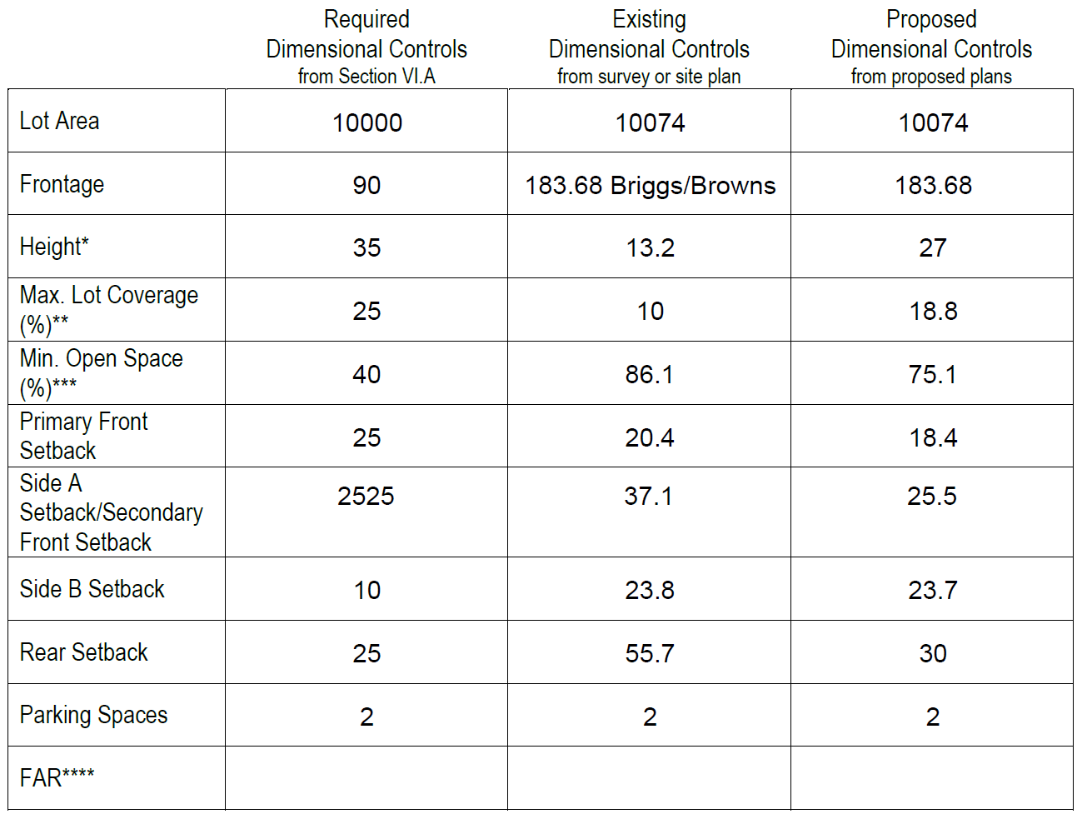
Required Existing Proposed Dimensional Controls

Slide 4
EXISTING HOME

Slide 5
PROPOSED NEW HOME

Slide 6
PROPOSED NEW HOME WITH BUILDING HEIGHTS

Slide 7
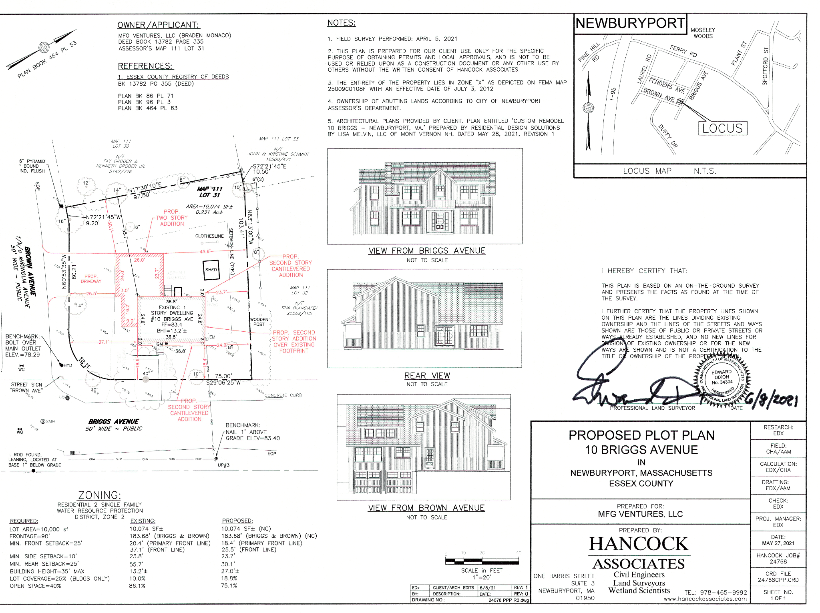
PROPOSED PLOT PLAN

Slide 8
SURROUNDING HOME SETBACKS

Slide 9
11 BRIGGS HEIGHT COMPARISON

Slide 10
ROW PERMIT

