Slide 1
NYS Needs and Numbers

Slide 2
Why do we need it?
How did we design it?
How will it be used?

Slide 3
Recreation and enrichment programs seasonally for children and families, community events
Youth Center memberships, programs, trips, clubs and groups for 6th-12th graders
Positive youth development initiatives, community partnerships, parent supports, substance abuse prevention, social work and supports (City and regional)

Slide 4
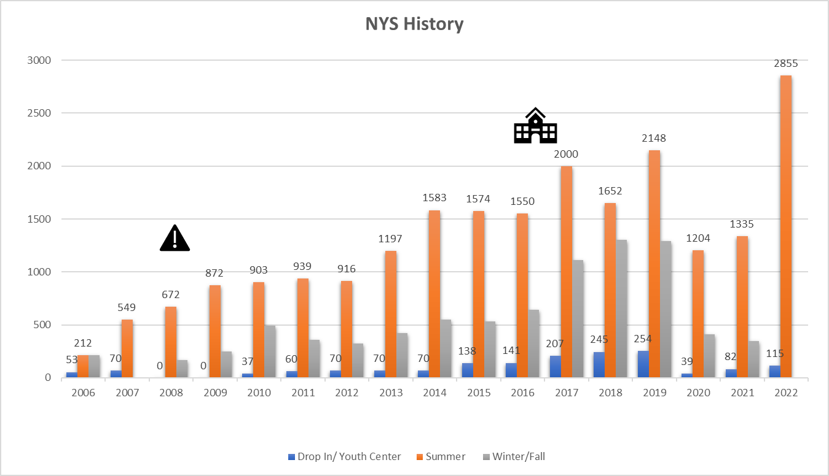
1st Summer post covid regs
Moved to the Brown
Moved to the Kelley
COVID
Brown Closed
Lost Drop-In Space

Slide 5
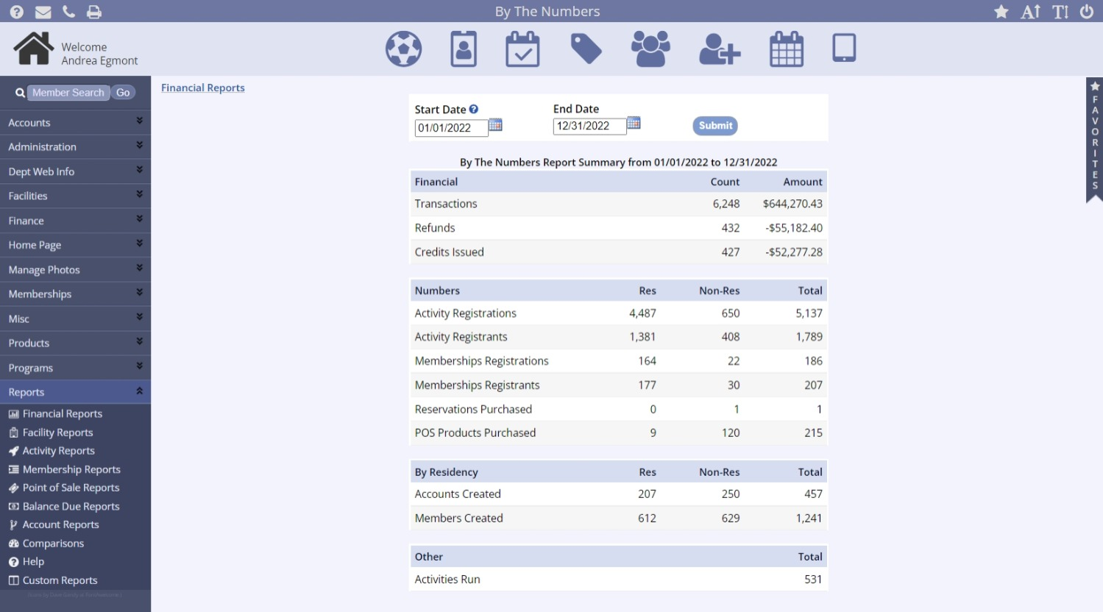
Total # of transactions and revenue through registration software
Refunds are given when a program is cancelled or a participant is removed for certain reasons
Credits are given when a participant cancels within 2 weeks
531 Activities Ran. That means 531 different sessions of programs- For example we had 8 weeks of Clipper Kids for 3 age groups. So that counts as 24 sessions.

Slide 6
Total # of registrations in My Rec (does not include events that don’t require sign up)
# of unique individuals registered
Individual or Unique # of Members
# of membership registrations. Memberships include the Family Club Memberships, Rec Center Memberships and Therapeutic Rec. There may be duplications of families between memberships– but individuals are on the next line.
This refers to the # of members added to our registration system in this time frame. 207 accounts were added with 612 individuals in them.
We currently have 6,819 individuals in our system.

Slide 7
Annual 2022-23 began in September of this year. The previous Annual were from memberships purchased at the end of last school year. There are currently 145 Active Members grades 6-12.

Slide 8
Non-Residents have made up on average 10-13% of Registrations annually since we began
Non-Residents pay a $10 non-resident fee per program (with a few exceptions)
Non-Residents are made up of school choice students, students at River Valley and the IC, grandchildren of residents , and children of individuals who work in the City
Non-Residents
Registrations Unique Non Res
FY2018 4,274 2,091 10-13% varied by season
FY2019 4,928 2,409
FY2020 4,476 2,179
FY2021 3,580 1,467 10% of registrations were non-residents
FY2022 5,116 1,722 12% of registrations were non-residents
Calendar Year 2022 Res 5,538 Non Res 825 Total Reg 6,363
Revenue Res $567,818.50 Non-Res $87,934.00 Total Revenue $655,752.5

Slide 9
Community Goals
Provide high-quality public services that serve children and families with educational and youth programming
Invest in medium to long-term capital assets
Support our youth and the Department
Attract a diverse population of residents
Support economic development initiatives by supporting young families that bring a diverse, skilled labor force

Slide 10
NYS NEEDS
 |  |  |  |  |  |  |  |  |  |  |  |  |  | (matchline)
 |  |  | First Floor-Part A
 |  |  |  |  |  |  |  |  |  |  |  |  |  |  |  |  |  |  |  |  |  | Boiler
 |  |  |  |  |  |  |  |  |  |  |  |  |  |  |  |  |  |  |  |  |  | Room |  |  |  |  |  |  |  |  |  |  |  |  |  |  |  |  |  |  |  |  | Girl's
 |  |  |  |  |  |  |  |  |  |  |  |  |  |  |  |  |  |  |  |  |  |  |  |  |  |  |  |  |  |  |  |  |  |  |  |  |  | Up |  |  |  |  | Room
 |  |  |  |  |  |  |  |  |  |  |  |  |  |  |  |  |  |  |  |  |  |  |  |  |  |  |  |  | Ping Pong/ Music
 |  |  |  |  |  |  |  | Entrance #4
 |  |  |  |  |  |  |  | Up
 | Girl's |  |  |  | Boy's |  |  |  |  |  |  |  |  |  |  |  |  |  |  |  |  |  |  |  | Storage |  |  |  |  |  |  |  |  |  |  |  |  |  |  | Up |  |  | Art Room
 | Room |  |  |  | Room
 | ADA |  |  |  | ADA |  |  |  |  |  |  |  |  |  |  |  |  |  |  |  |  | Down To |  |  |  |  |  |  | Homework Room |  |  |  |  |  |  |  |  |  |  |  |  |  |  |  | (13 kids)
 |  |  |  |  |  |  |  |  |  |  |  |  |  | Multi Purpose Classroon |  |  |  |  |  |  |  |  |  |  |  |  |  |  |  | (10 kids)
Entrance |  |  |  |  |  |  |  |  |  | Up
#3 |  |  |  |  |  |  |  |  |  |  |  |  |  |  |  |  |  |  |  |  |  |  | Custodian |  |  |  |  |  |  |  |  |  |  |  |  |  |  | Up
 |  |  |  |  |  |  |  |  |  |  |  |  |  |  |  | (30 kids) |  |  |  |  |  |  |  | &
 |  |  |  |  |  |  |  |  |  |  |  |  |  |  |  |  |  |  |  |  |  |  | Electrical |  |  |  |  |  |  |  | conference
 |  |  |  |  |  |  |  |  |  |  |  |  |  |  |  |  |  |  |  |  |  |  | Room |  |  |  | Storage
 | Early Ed Classroom Space |  |  |  |  |  |  |  |  |  |  |  |  |  |  |  |  |  |  |  |  |  |  |  |  |  |  |  |  |  |  |  |  |  |  |  |  |  |  |  |  |  | Games Room
 |  |  |  |  |  |  |  |  |  |  |  |  |  |  |  |  |  |  |  |  |  |  |  |  |  |  |  |  |  |  |  |  |  |  |  |  |  | Elevator
 |  |  |  |  |  |  |  |  |  |  |  |  |  |  | Waiting |  |  |  | Resource |  |  |  |  |  |  |  |  |  |  |  |  |  |  |  |  |  |  |  |  |  |  |  |  |  |  | (23 kids)
 |  |  | (23 Kids) |  |  |  |  |  |  |  |  |  |  |  | Area |  |  |  | Center
 |  |  |  |  |  |  |  |  |  |  |  |  |  |  |  |  |  |  |  |  |  |  |  |  | Staff |  |  | Staff Bath |  |  |  |  |  |  |  |  |  | Machine
 |  |  |  |  |  |  |  |  |  |  |  |  |  |  |  |  |  |  |  |  |  |  |  |  |  |  |  |  |  |  |  |  |  |  |  |  |  |  | Room
 |  |  |  |  |  |  |  |  |  |  |  | Reception |  |  |  |  | Office |  |  |  |  |  |  |  |  |  |  |  | Office
 |  |  |  |  |  |  |  |  |  |  |  |  |  |  |  |  |  |  |  |  |  |  |  |  | Storage |  |  |  | Room
 |  |  |  |  |  |  |  |  |  |  |  |  |  |  |  |  |  |  |  |  |  |  |  |  |  |  |  |  | (Ktchenett)
 |  |  |  |  |  |  |  |  |  |  |  |  |  |  |  |  |  |  |  |  |  |  |  |  |  | Tech and office supplies
 |  |  |  |  |  |  |  | Entrance #2 |  |  |  |  |  |  |  |  |  |  |  |  |  |  |  |  |  |  |  |  |  |  |  |  |  |  |  |  |  | Entrance #1
 |  |  |  |  |  |  |  |  |  |  |  |  |  |  |  |  |  |  |  |  |  |  |  |  |  |  |  |  |  |  |  |  |  |  |  |  |  |  |  |  |  |  |  | Not To Scale
 |  |  |  |  |  |  |  |  |  |  |  |  |  |  |  |  |  |  |  |  |  |  |  |  |  |  |  |  |  |  |  |  |  |  |  |  |  |  |  |  |  |  |  |  | 99 Participants
Based on existing and past programs
Pulled from all 3 feasibility studies and past possible designs
Based on future growth and community needs
Based on keeping it flexible

Slide 11
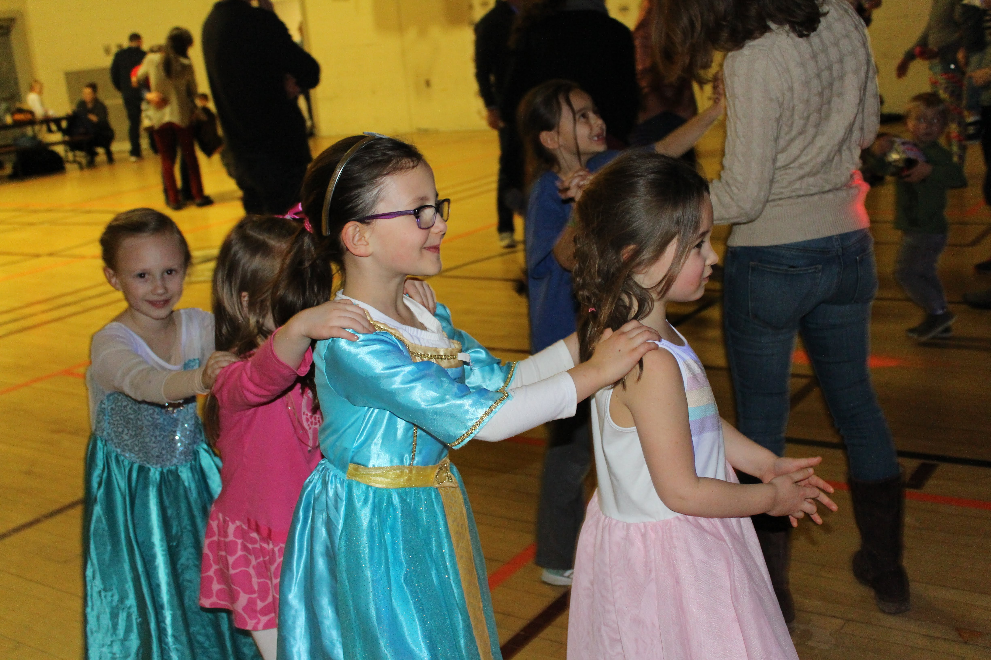
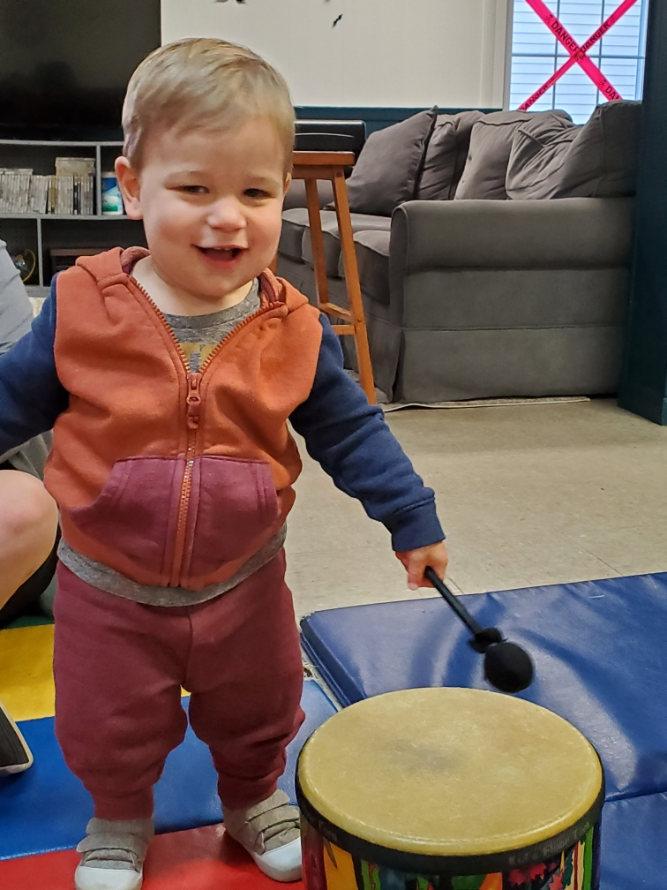
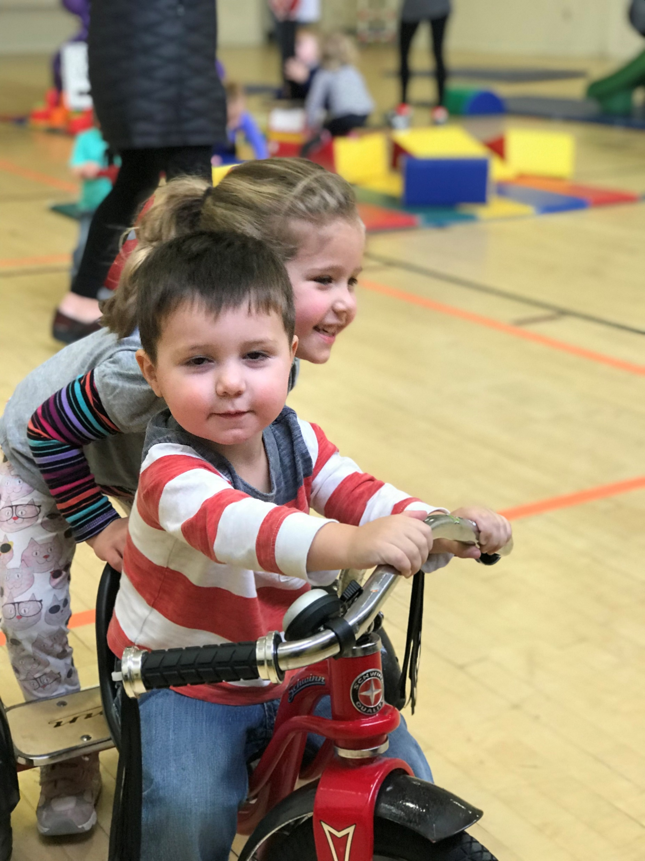
Morning Hours
Classrooms
Gymnasium
NYS Office hours
New Parent Meet Ups
Age specific play groups
Early Literacy groups
Art classes for children under 5
Music & movement classes for children under 5
Tea Parties
Holiday special events
Little Aces- summer program (4-6 year olds)
Summer Classes
Community Meetings
Social Worker Hours
Open Gym Pre-school
Open Gym- Toddlers
Parent & Child group exercise
Dads, Dudes & Donuts
Learn to Play Sports Programs (>6)
Vacation Week Programs
Community gym use: pickleball, tai chi, play groups
Blue Blocks Groups (Imagination Playground)
Kids movement, dance and exercise classes
Half day programming
Summer Rain Day Gym

Slide 12
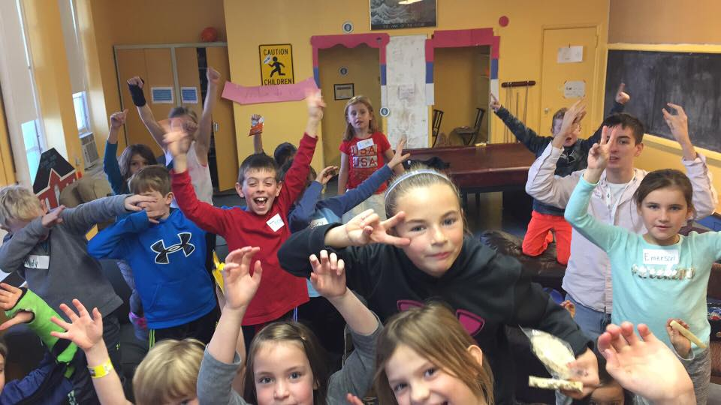
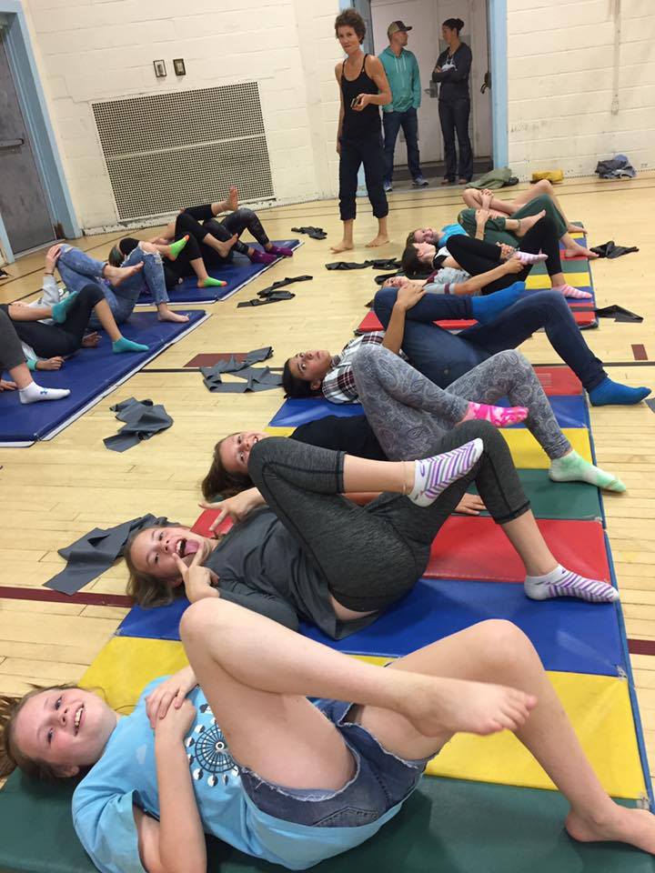
Afternoon Hours
Classrooms
Gymnasium
Clubs (D&D, Chess, Gaming, Art, Cooking)
Jr Youth Council meetings
Coalition Meetings (prevention)
Rentals: Scouts, theater
Lego league and Destination Imagination teams
Play Groups
Youth Center hours
Enrichment classes
Art classes (school age)
Youth Center Middle School Gym Hours
Pick up sports
Ninja Nerfers
Parkour
Club Sports
Recreation classes
Birthday/ private rentals

Slide 13
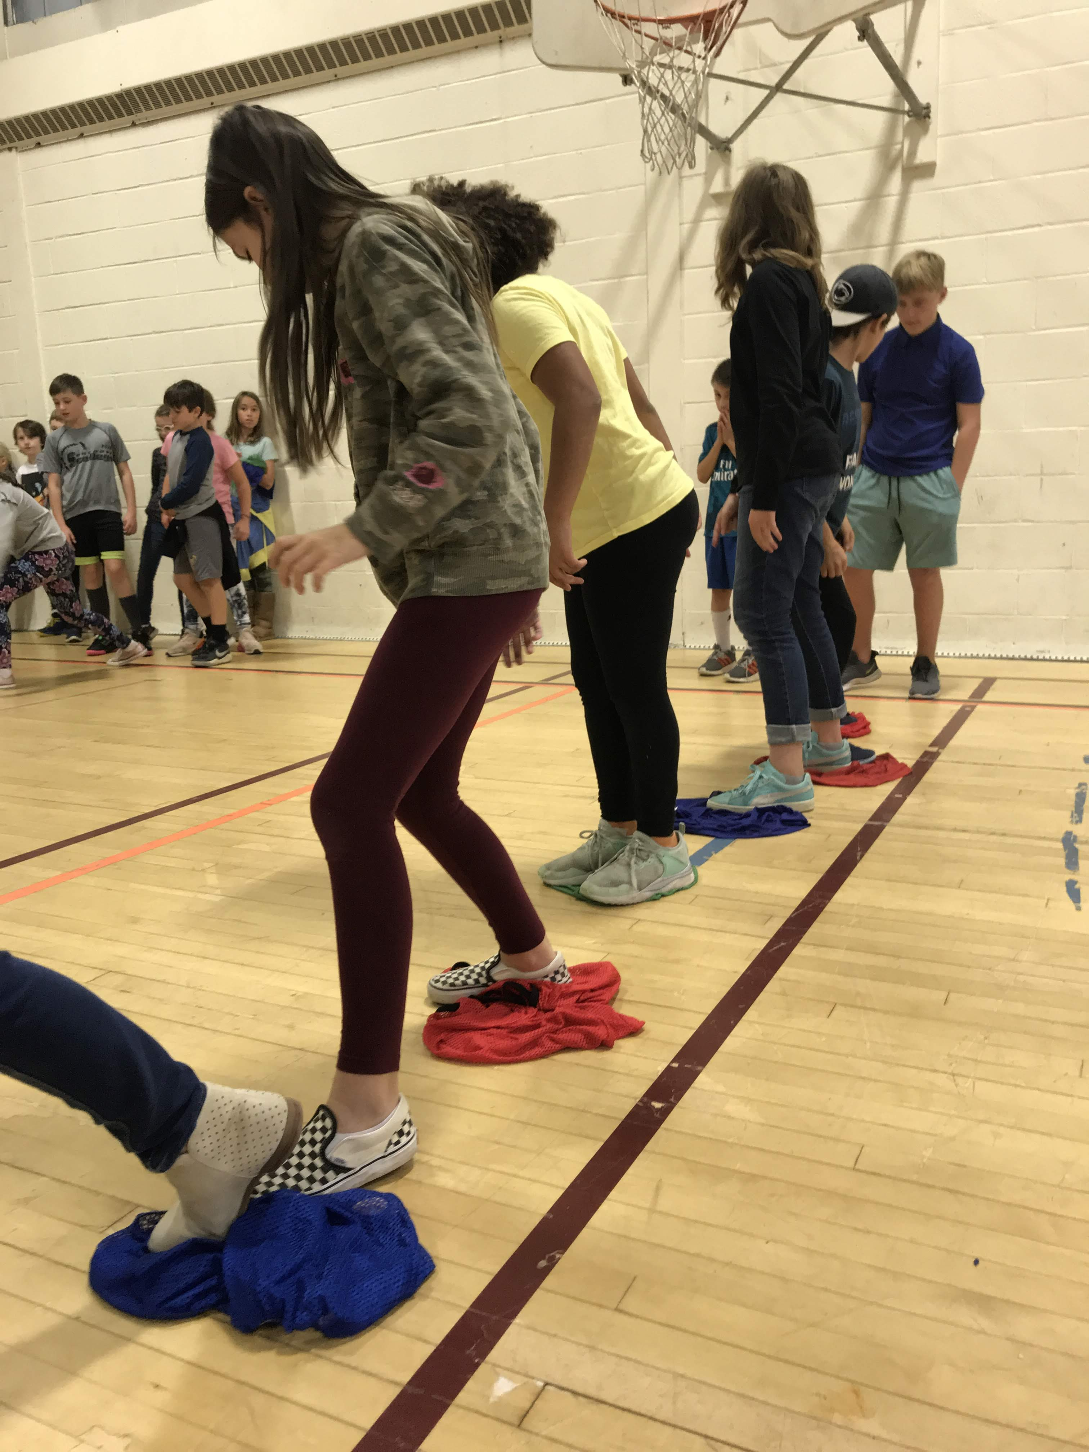
Evening and Weekend Hours
Classrooms
Gymnasium
Youth Council meetings
High School hours
Certificate courses
Community meetings
Recreation and Enrichment classes
Lego League teams
E-Sports teams
Birthday/ private rentals
Youth Center High School Gym Hours
NBBA/ NGBA rentals
Rec Programs (soccer, softball, misc. clinics)
Men's Basketball
Parent Speaker Series
Community events: movie nights, tournaments, dances

