Slide 1
EVERGREEN COMMONS
22 ACRES OF PUBLIC OPEN SPACE
EXSTENSIVE PUBLIC TRAIL NETWORK
TOT LOT PLAYGROUND
PUBLIC GATHERING AREA
OUTDOOR SKATING POND
TRAIL CONNECTION TO THE RTE. 95 MULTI-USE TRAIL

Slide 2
18 Boyd Drive Project
Newburyport, Massachusetts
Traffic impact and access study (TIAS)
September 21, 2016

Slide 3

Study Area

Slide 4
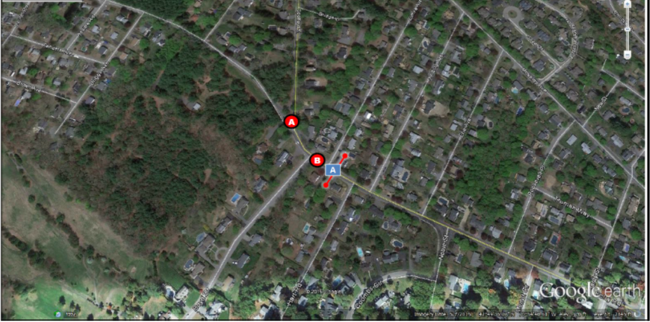
OVERVIEW
David Giangrande, M.S., P.E.
Traffic Impact Guidelines

Slide 5
Data Collection
Study Intersections:
Ferry Road and Elmira Avenue
Ferry Road and Boyd Drive
Ferry Road and Spofford Street
Ferry Road and Laurel Road
Collection Dates:
Automatic Traffic Recorder (ATR) placed on Boyd Drive east of Elmira Avenue from 6/7/2016 to 6/9/2016
Turning Movement Counts (TMCs) collected at Ferry Road/Elmira Avenue, Ferry Road/Boyd Drive, and Ferry Road/Spofford Street on 6/8/2016
TMCs collected at Ferry Road/Laurel Road on 8/25/2016

Slide 6
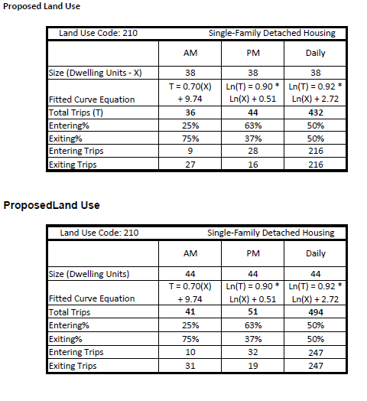
Trip Generation and Mode Split
A 38-Unit Subdivision is expected to generate 36 trips during the morning peak hour and 44 trips during the evening peak hour
A 44-Unit Subdivision is expected to generate 41 trips during the morning peak hour and 51 trips during the evening peak hour

Slide 7
Trip Generation and Mode Split
“Journey to Work” data was collected from Census Tract 2682 in Newburyport
A conservative 95% vehicle-usage percentage was used for this project
An Average Vehicle Occupancy (AVO) of 1.1 was used for this project

Slide 8
38-Unit Trip Distribution

Slide 9
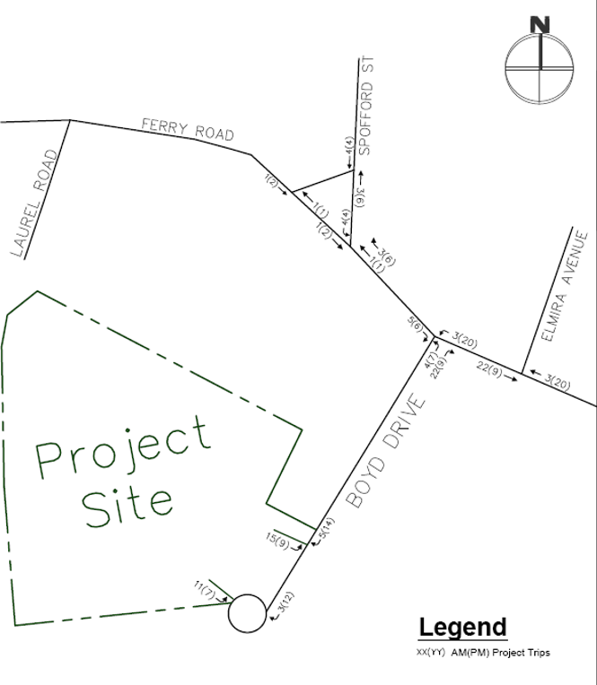
38-Unit Project Trips

Slide 10
44-Unit Trip Distribution

Slide 11
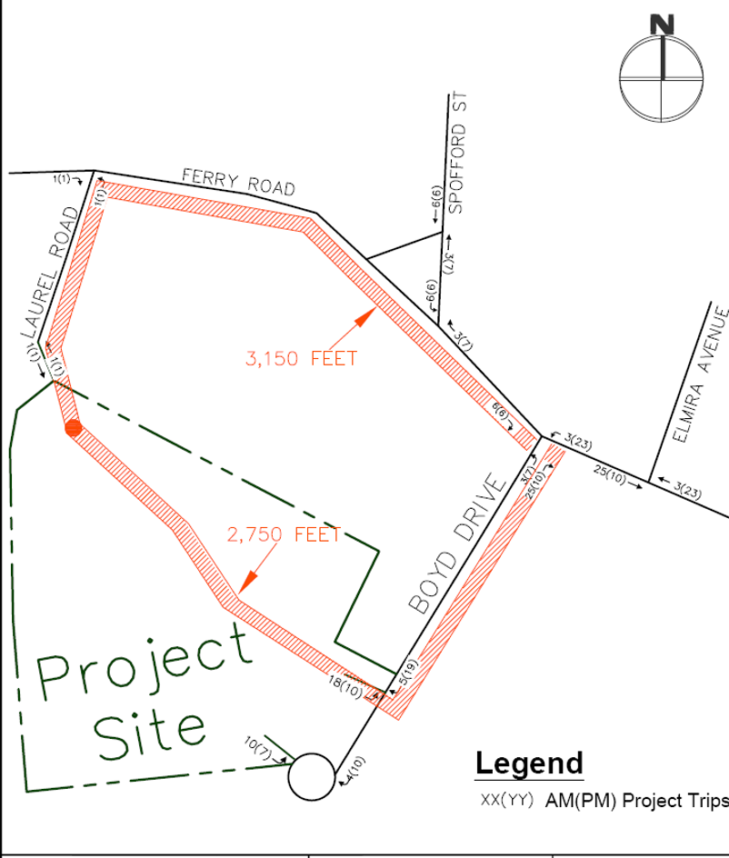
44-Unit Project Trips

Slide 12
Safety Analysis
2011-2014 MassDOT crash data reviewed (most recent years available)
Only one crash at the study intersections over the four year study period
The one crash resulted in property damage only

Slide 13
Stopping Sight Distance (SSD) and
Intersection Sight Distance (ISD)
Proposed Site Driveways on Boyd Drive
Ferry Road and Boyd Drive

Slide 14
Level of Service Summary
*Any improvements to No-Build Conditions are due to the MassDOT requirement of using a 0.92 Peak Hour Factor for future conditions.
Only minor changes in delay due to the project
Zero movements have LOS that decline after the project is built
Overall traffic impact due to the project will be minimal
*Any improvements to No-Build Conditions are due to the MassDOT requirement of using a 0.92 Peak Hour Factor for future conditions.

Slide 15
Conclusions
Level of Service:
Zero intersections have turning movement LOS that decline due to the project; this report was conservative in that there was zero trip reductions for bicycle, walking, or public transportation even though there are future plans for a direct multi-use path to the park and ride; additionally, there was zero trip reduction for the existing golf course use; both mode split reduction and existing land use reduction are standard practice.
Considering a Connection to Laurel Road:
Connecting to Laurel Road did not reduce trips on Boyd Drive or at the intersection of Boyd Drive and Ferry Road. Trips on Boyd Drive were not reduced due to the travel distance and the desired travel patterns.
Safety:
There was only one crash at the four study intersections over the four year period (2011 to 2014); sight distances for the proposed driveways on Boyd Drive are sufficient, as well as at the intersection of Boyd Drive and Ferry Road. It is always recommended to have a second means of egress for emergency response units. A gated emergency access egress from the subdivision to Laurel Road could provide public benefit to both Laurel Road and Boyd Drive.

Slide 16
QUESTIONS?

Slide 17
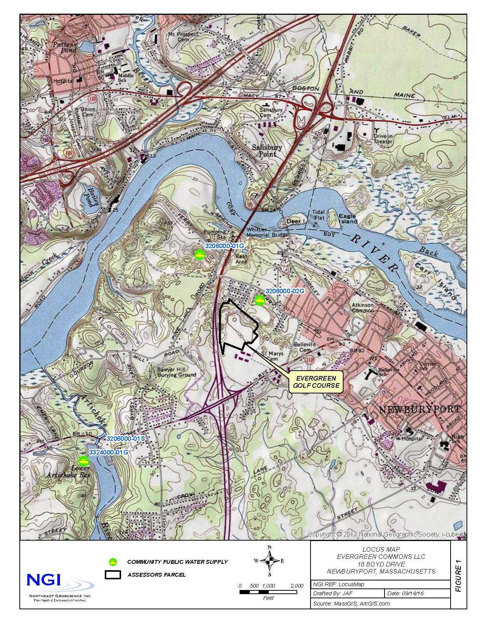
Evergreen Commons OSRD

Slide 18
Meetings and Literature Review
NGI met with representatives of Newburyport
  Director of Public Services
  Director of Planning
  City Engineer
  Water Superintendent
  Water Operators
  City Engineering Consultant
Literature Review
  United States Geological Survey Reports
  BSC Engineering Reports (1984)
  Lally Engineering Report (1985)
  TEEM Zone II Delineation Report (1999)
  Newburyport 2015 Annual Statistical Report
  Newburyport 2015 Consumer Confidence Report
  MA Department of Environmental Protection Water Quality Database
Field Investigation
  Installed 8 borings/7 Wells and collected soil samples
  Measured water levels in 6 existing monitoring wells on City property, 7 new wells, 2 irrigation wells and an existing monitoring well on the golf course property

Slide 19
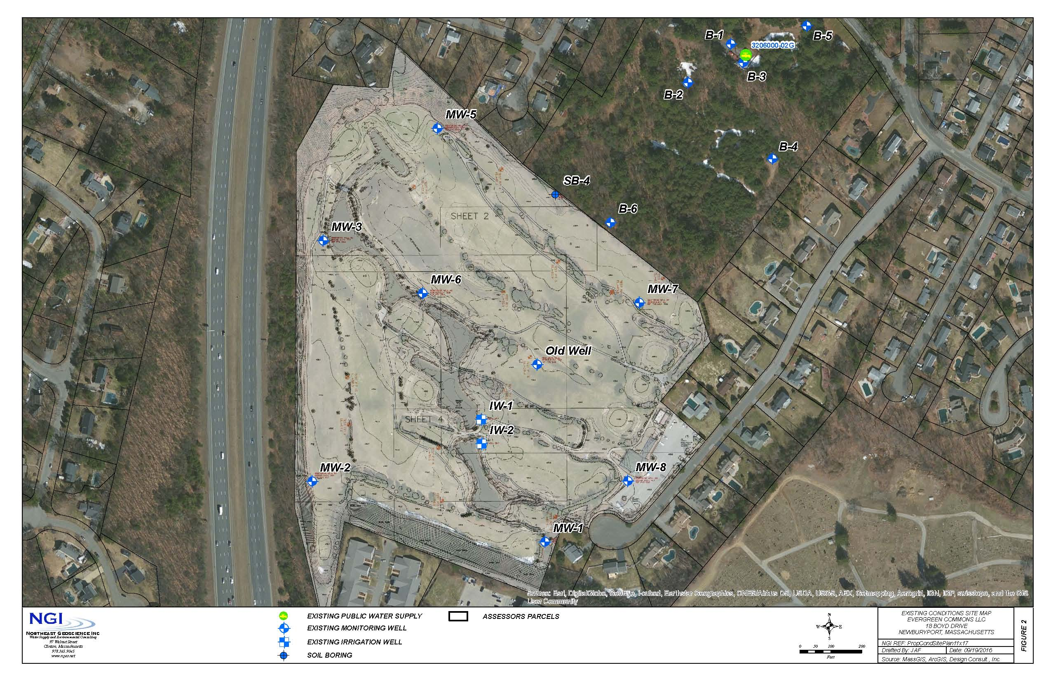
Existing Conditions

Slide 20
Summary of Findings
Site is 36.4 acres and is currently the site of a 9 hole public golf course
Proposed 38 lot OSRD served by City water and sewer
Newburyport Well No. 2 is located 758 feet northeast of the project
The site is within the Zone II Recharge Area of Well No. 2
Currently the water quality of Well No. 2 is good, no VOCs or SOCs detected
Yield of Well No. 2 is 408 gpm but it is operated at 225 gpm (0.324 MGD)
Subsurface investigation revealed the following information
  Site is underlain by deposits of sand and gravel of Pleistocene Age (Glacial Outwash)
  No evidence of a thick loam or clay layer on the surface of the site identified
  Average depth to water on site is 11.96 feet below ground surface
  Confirmed the presence of a bedrock high identified by BSC Engineering (1984)
Potential Sources of Contamination in Zone II
  Evergreen Valley Golf Course
  I-95
  St. Mary’s Cemetery
  Gravel pits off Ferry Road

Slide 21
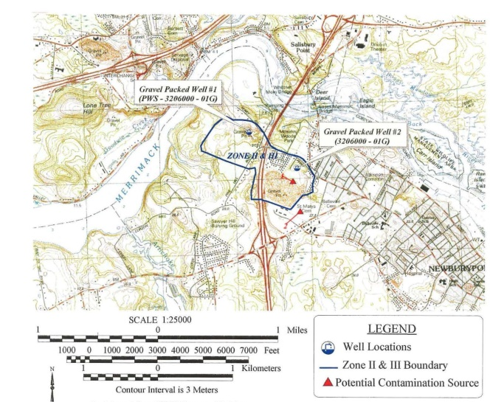
TEEM Zone II Recharge Area Delineation (1999)

Slide 22
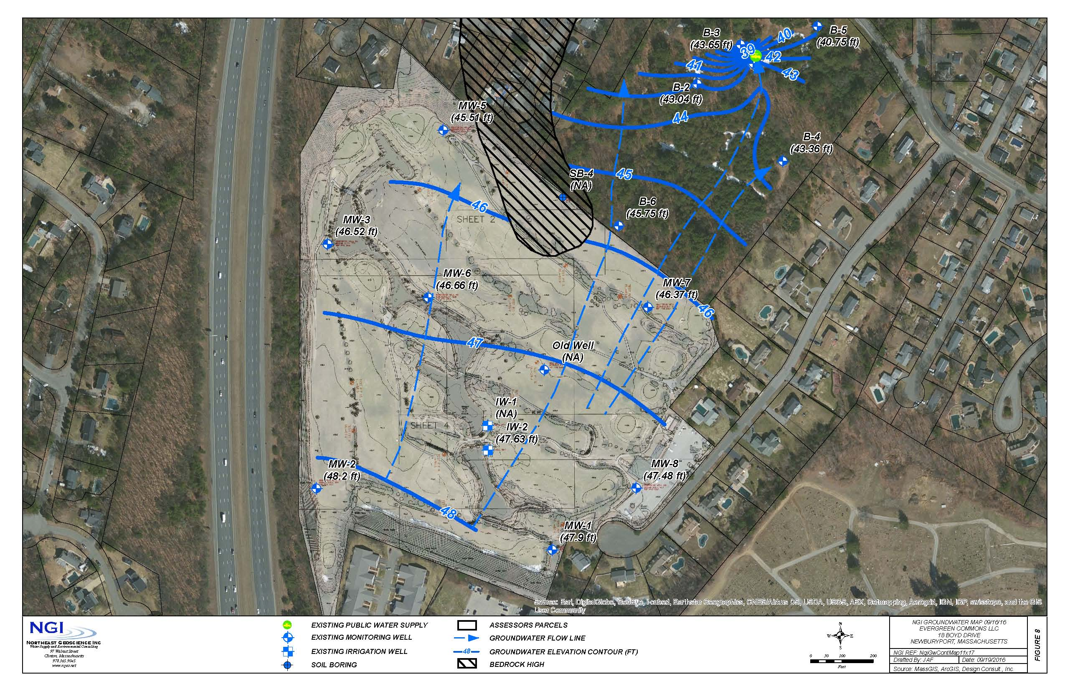
Groundwater Contour Map

Slide 23
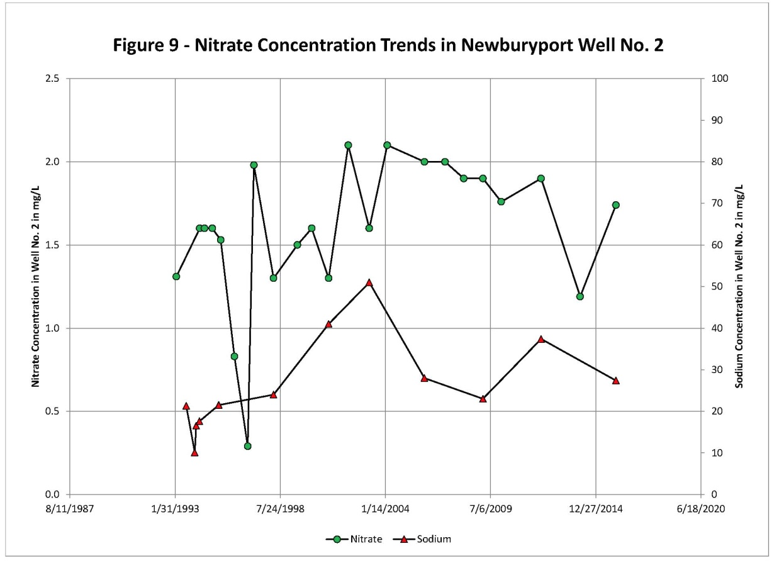
Current Water Quality

Slide 24
Wellhead Protection Measures
Zone II is protected by a Wellhead Protection Zoning Ordinance adopted in 1998
The Ordinance complies with 310 CMR 22.000 (water supply regulations)
The Ordinance prohibits land uses that potentially threaten water supplies
  No landfills, gas stations, truck terminals, bulk storage of petroleum products, junk yards, sludge landfills, septic systems greater than one acre density, and other uses
The project as proposed is allowed in the Wellhead Protection District
Well offsets
  758 feet from Well 2 to the site
  358 feet from Well 2 to Boyd Drive
  351 feet from Well 2 to Briggs Avenue
  280 feet from Well 2 to Ferry Road

Slide 25
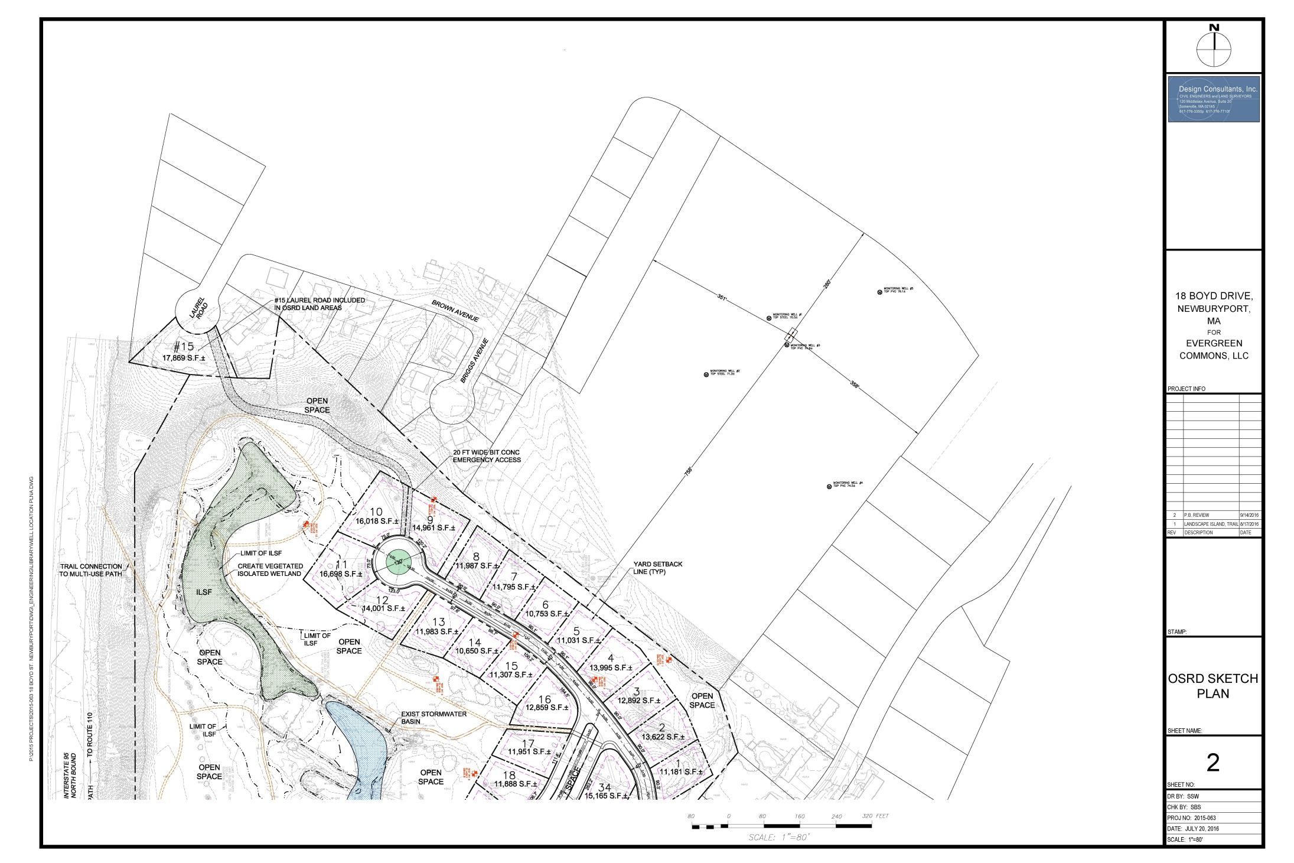

Slide 26
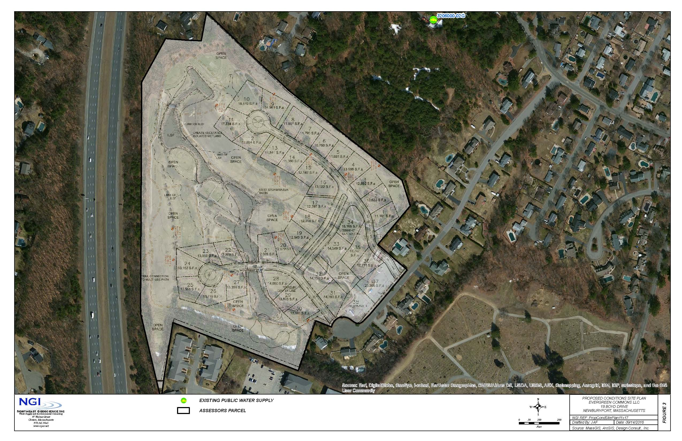
Proposed Site Conditions Plan

Slide 27
Projected Development Impacts
Elimination of an Identified Potential Source of Contamination in Zone II (Evergreen Valley Golf Course)
Addition of up to 9.1 acres of lawn (62% reduction in maintained turf)
Proposed use of a single professional lawn care contractor for all lawns
Addition of 1.4 acres of road (8% increase in roadway in Zone II East)
Stormwater management system in compliance with MADEP Standards for Zone II
Projected 8% increase in sodium in Well No. 2 from an average of 26.6 mg/L to 28.7 mg/L – still below standard of 250 mg/L
Elimination of two existing irrigation wells that pump 60,000 gpd during the irrigation season
The proposed development will not affect the ability of Newburyport to replace or expand Well No. 2
The proposed development complies with Wellhead Protection Ordinance

