Slide 1
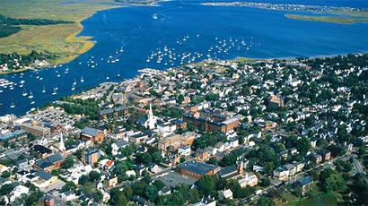
What is a Master Plan?
It is a policy guide and a framework
It tells us where we are and where we’re going
It provides a plan of action
It serves as a consistent point of reference

Slide 2
Why do we need a Master Plan?
We need direction
We need consistency
We need grant funding
We need to measure our progress

Slide 3
What Information is Found in a Master Plan?
2001 Master Plan
2014 Master Plan
Goals & Policies Statement
Land Use & Development
Housing
Economic Development
Natural and Cultural Resources
Open Space & Recreation
Public Services & Facilities
Circulation
Implementation Program
Goals & Policies Statement
Land Use & Development
Housing
Economic Development
Natural Resources, Open Space & Recreation
Cultural Resources
Public Services & Facilities
Transportation
Energy & Sustainability
Education
Implementation Program
Massachusetts State Law, Chapter 41, Section 81D mandates the elements that MUST be included in a Master Plan

Slide 4
Let’s Brainstorm

Slide 5
Project Timeline

Slide 6
Questions or Comments?
Visit
[website address]
for more information, including:
A link to the 2001 Master Plan
Project Schedules
Meeting Agendas
Committee Lists and Contact Information
Andy R. Port, AICP
Director of Planning
aport@cityofnewburyport.com
Kate Newhall-Smith
Staff Planner
ksmith@cityofnewburyport.com

