Slide 1
Master Plan 2014
Spotlighting the Master Plan Chapters
Cultural Resources
Transportation
Public Facilities & Services

Slide 2
City of Newburyport 2014 Master Plan
Cultural Resources Sub-Committee
June 11, 2014

Slide 3
Cultural Resources Sub-Committee: Purpose & Members
- Committee Purpose
- Members & Organizations
Lois Honegger
Mayor’s Office
Melissa Vokey, Massachusetts Audubon
Ghlee Woodworth, Clipper Heritage Trail
Elena Bachrach, Newburyport Art Association
Beth Falconer, Firehouse Center for the Arts
Patty St. John, Newburyport Chamber of Commerce
Lois Honegger, Mayor’s Office of Arts, Tourism & Cultural Affairs
Sarah White, Co-Chair

Slide 4
Cultural Resources Sub-Committee: Definitions & Categories
Lois Honegger
Mayor’s Office
- What are “cultural resources”?
Natural Resources + Historic Assets + The Arts
Goals
Objectives
Action Items
Residents
Tourists
Increased Revenue & Quality of Life

Slide 5
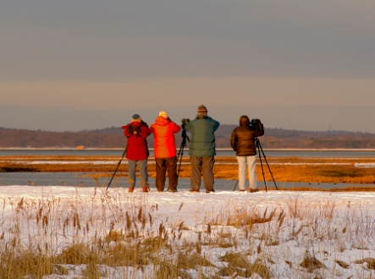
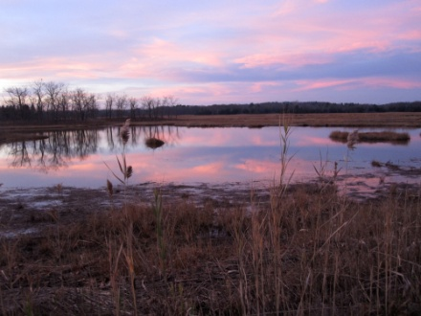
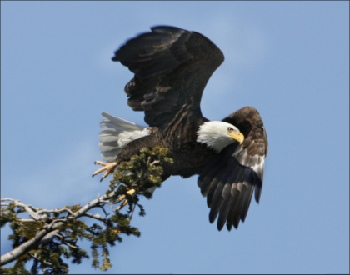
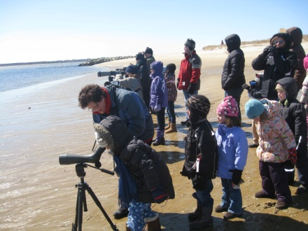
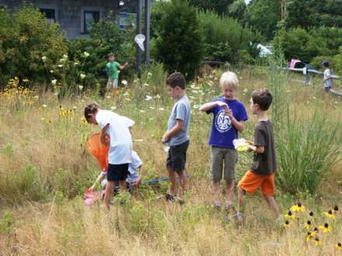
Cultural Resources Sub-Committee: Natural Resources
Melissa Vokey
MA Audubon Society
Goals, Objectives & Actions
- Develop outreach tools to promote Newburyport’s natural resources
- Identify & permanently protect natural habitats important wildlife corridors from development
- Identify & permanently protect lands buffering public waterways to meet wildlife needs
- Actively manage the City Forest and Common Pasture as wildlife habitat

Slide 6
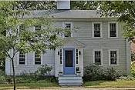
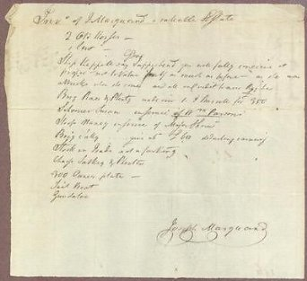
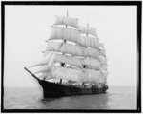
Cultural Resources Sub-Committee: Historic Assets
Ghlee Woodworth
Clipper Heritage Trail
Goals, Objectives & Actions
- Promote and protect historic architectural and archival resources
- Increase historic preservation through further zoning and/or local ordinances
- Create incentives for preservation and adaptive reuse of historic buildings
- Encourage and support local history outreach to residents and in the school curriculum
- Recognize and support the library Archival Center as the only openly-accessible repository of local historic documents, photos and other resources
- Develop collaborative relationships between historical resources and artistic, environmental and business sectors

Slide 7
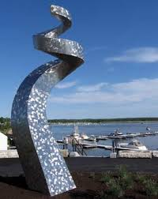
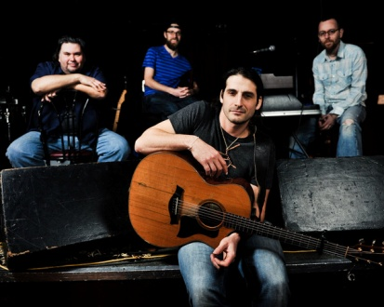
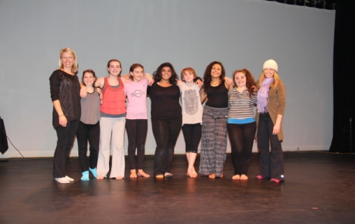
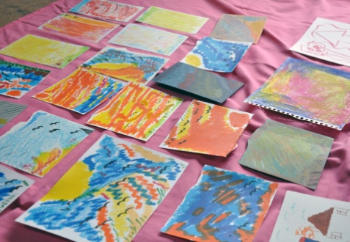
Cultural Resources Sub-Committee: The Arts
Elena Bachrach
Newburyort Art Association
Beth Falconer
Firehouse Center for the Arts
Goals, Objectives & Actions
- Grow existing arts education opportunities for school age children, adults, adults with special needs, and seniors across the visual and performing arts
- Create professional networks for artists and organizations across the art forms
- Encourage the creation of affordable live/work artist spaces
- Promote the preservation , appreciation, and use of our visual and performing arts assets for residents and visitors

Slide 8
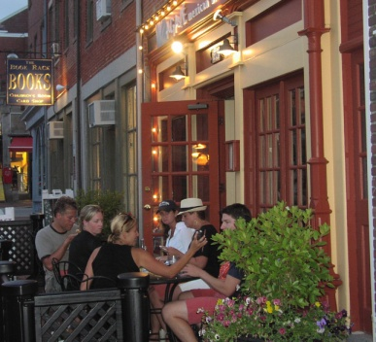
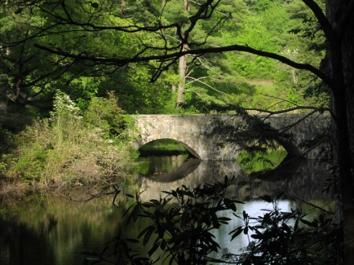
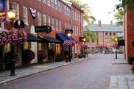
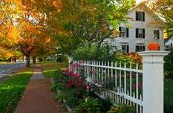
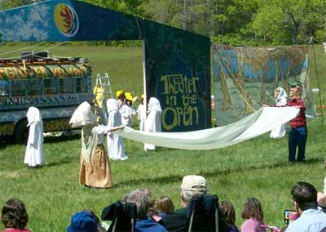
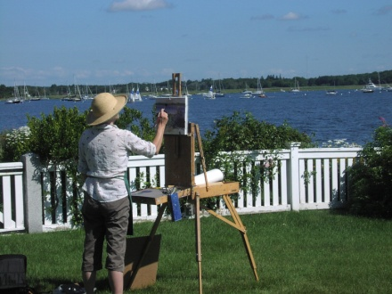
Cultural Resources Sub-Committee: Cultural Tourism
Patty St. John
Chamber of Commerce
Goals, Objectives & Actions
- Increase awareness and appreciation of Newburyport as a destination for arts, culture, natural and heritage tourism
- Support Newburyport’s cultural community and recognize its contributions to tourism by integrating arts and culture into the life of the city and ensure that Cultural Tourism remains a priority for Newburyport
- Develop a framework and infrastructure to collectively and efficiently support and sustain tourism efforts in Newburyport
- Secure funding resources to sustain the office of Arts, Tourism & Cultural Affairs

Slide 9
Cultural Resources Sub-Committee: Conclusions
Sarah White
Co-Chair
A Key Economic Driver
Government
Education
Business
Cultural Resources
Economic Health
Social Health
Strategic. Intentional. Measurable. Effective. Growth-oriented.
“More than any other social offering, availability of arts and cultural opportunities make people love where they live.”

Slide 10
Transportation
2014 MASTER PLAN UPDATE

Slide 11
Improve roadway infrastructure & enhance vehicular circulation throughout City
GOAL #1

Slide 12
Goal #1: Improve roadway infrastructure & enhance vehicular circulation throughout City
Increase annual budgets and dedicated funding streams for road maintenance
Explore feasibility of bonding to support substantial expansion of road work
Improve local planning, communication and coordination of transportation issues
Improve safety and responsiveness to citizens through interdepartmental Transportation Safety Advisory Committee (TSAC)
Improve regional planning, communication and coordination of transportation issues
Improve representation and coordination with the Merrimack Valley Planning Commission and Metropolitan Planning Organization in regard to the Transportation Improvement Program and Regional Transportation Plan
Reduce impact on residential neighborhoods of commercial truck access to the industrial park
Improve local signage and implementation/enforcement of truck bans

Slide 13
Goal #1: Improve roadway infrastructure & enhance vehicular circulation throughout City
Continue to evaluate and improve efficiency of overall downtown circulation
Seek funding and conduct comprehensive analysis of downtown circulation
Incorporate “Complete Streets” approach for all roadways
Adopt model ordinance of Complete Streets design criteria
Improve safety, appearance, and functionality of key intersections
Work with local, regional and state agencies to improve intersections, including Merrimac Street & Route 1, Three Roads, and Route 1 rotary
Investigate improved land use policies to enhance and preserve efficiency of the City’s transportation network
Work with stakeholders to explore promoting appropriate Transportation Oriented Development (TOD) projects
Improve winter parking ban policies and snow and ice removal management
Identify streets that limit public safety vehicle access and create policies to alleviate issue

Slide 14
Improve public parking facilities and management
GOAL #2

Slide 15
Goal #2: Improve public parking facilities and management
Establish structured parking facilities to support the downtown commercial district and allow for increased removal of “interim” waterfront parking
Continue to seek funding and site control for a downtown structured garage at Titcomb and Merrimac Streets
Investigate public-private partnerships to increase capacity of public parking
Develop both short- and long-term plans for central waterfront parking
Pursue long-term reduction in waterfront parking to allow for waterfront park expansion and redevelopment of lots currently owned by the Newburyport Redevelopment Authority while retaining appropriate parking for public access to the river

Slide 16
Goal #2: Improve public parking facilities and management
Maintain and improve downtown paid parking system
Consider mechanisms to create higher turnover of on-street parking downtown
Explore and implement smart technologies to improve system and user interface (sensors, wireless communication, mobile apps)
Improve management of parking around significant events as well as the busy summer season
Research feasibility of satellite parking lots and frequent shuttle service, e.g., mandatory shuttle service for events

Slide 17
Promote walkability and pedestrian safety throughout the City
GOAL #3

Slide 18
Goal #3: Promote walkability and pedestrian safety throughout the City
Improve City’s system of sidewalks
Make the City’s comprehensive 5-year sidewalk plan more transparent, web-based, and accessible for citizens
Investigate better marking of primary pedestrian routes through installation of way-finding signage
Improve pedestrian routes to schools for children
Develop and adopt a Safe Routes to Schools policy, and expand the local Safe Routes to Schools program (Walking and Wheeling Newburyport) and network
Improve and prioritize pedestrian routes for seniors
Improve and re-open pedestrian connection between North Atkinson Street and neighborhood and the new Senior Center
Extend off-road pathways and trails for pedestrians
Construct and fund maintenance of Phase II of the multi-use Clipper City Rail Trail
Work with the Town of Newbury to extend Phase III of the Clipper City Rail Trail to the MBTA commuter rail station

Slide 19
Goal #3: Promote walkability and pedestrian safety throughout the City
Conduct comprehensive analysis and create a City-wide pedestrian improvement plan
Prioritize and implement universal access upgrades
Install Accessible Pedestrian Signals at prioritized signalized intersections
Adopt “Complete Streets” approach to promote improved pedestrian facilities in all transportation corridors
Require all new developments to study the full transportation impacts with mitigation to include construction of pedestrian facilities to nearby destinations
Research best practices in traffic calming and implement measures in priority areas
Pursue a “Walk Friendly” community designation to promote pedestrian facilities and market Newburyport as a walkable destination

Slide 20
Promote bicycle use throughout the City as a viable alternative transportation mode
GOAL #4

Slide 21
Goal #4: Promote bicycle use throughout the City as a viable alternative transportation mode
Extend off-road pathways and trails for bicyclists
Work with neighboring communities and regional and state partners to physically connect trails to other municipalities
Work with NRA, WFT, and other stakeholders to construct a dedicated, safe and appropriate bicycle path across the central waterfront
Improve on-street bicycle facilities
Review, prioritize, fund, and construct a more comprehensive system of bicycle lanes on major roads with adequate width
Explore other systems, infrastructure and approaches to promote bicycle use
Explore feasibility and implement as appropriate an appropriately scaled bicycle sharing system
Pursue a “Bicycle Friendly” community designation to promote bicycle facilities and market Newburyport as a bikable destination

Slide 22
Goal #4: Promote bicycle use throughout the City as a viable alternative transportation mode
Develop a comprehensive bicycle master plan
Adopt “Complete Streets” approach to promote improved bicycle facilities in all transportation corridors
Improve bicycle routes to schools for children
Improve bicycle facilities along the Low Street corridor to schools

Slide 23
Improve public transportation services
GOAL #5

Slide 24
Goal #5: Improve public transportation services
Continue to refine regional MVRTA public bus service
Promote smart phone technology capacity and public awareness regarding timing and availability of buses
Explore feasibility of water-based transit to Salisbury and beyond
Explore feasibility, and implement as appropriate, shuttle services
Explore feasibility of local shuttle service with frequent stops during the busy warm-weather season, as well as potentially year-round
Work more closely with the MBTA and MassDOT/C&J to refine policies regarding existing train and bus public transportation
Better capture and use data on tourists using public transportation to travel to Newburyport
Improve paratransit door-to-door transport service options for people with disabilities who are not able to ride fixed-route public transportation
Improve marketing of the MVRTA “ring and ride” 24-hour service

Slide 25
Adapt City’s transportation system to address climate change and sustainability
GOAL #6

Slide 26
Goal #6: Adapt City’s transportation system to address climate change and sustainability
Review critical infrastructure and establish prioritized plan to modify portions of transportation network at risk from increased flooding and sea level rise
Prepare a Climate Change Resiliency Plan including review of roadways, drainage systems, etc. in critical locations
Improve energy efficiency of municipal fleet of vehicles
Implement “Green Communities” vehicle replacement policy
Promote residential and municipal use of electric and hybrid vehicles
Establish electric charging stations in public lots and at municipal facilities

Slide 27
Goal #6: Adapt City’s transportation system to address climate change and sustainability
Explore facilitation of car-pooling and car-sharing services
Explore feasibility of hiring a Transportation Planner to bring focus and energy to the implementation of comprehensive and sustainable transportation improvements
Explore viability of increased use of permeable pavement
Update land use policies to incorporate promotion of sustainability (e.g., solar panels) in private parking lots

Slide 28
PUBLIC FACILITIES AND SERVICES
2014 MASTER PLAN UPDATE

Slide 29
Maintain all public facilities and provide adequate funding to protect their long-term value
GOAL #1

Slide 30
Goal #1: Maintain all public facilities and provide funding to protect their long-term value
Continue to implement and refine Capital Improvement Program (CIP)
Update the CIP on an annual basis and use resource as a guide to inform decision making around use of Free Cash and Supplemental Budget funding
Incorporate adequate funding in annual operating budget to cover planned capital expenditures
Provide adequate funding to ensure long-term maintenance of facilities
Conduct cost/benefit analysis of staff arrangements, including: hiring additional in-house staff based on demand/need, consolidating School/City maintenance staff, and privatizing custodial services
Incorporate Total Cost of Ownership analysis into CIP and use data to inform funding decisions
Develop comprehensive preventative maintenance plan
Coordinate service contracts across the City to ensure improved consistency and cost savings
Evaluate existing facilities for alignment with City’s needs and consider adaptive reuse or disposal of surplus properties as appropriate
Address existing facilities at Kelley School, Brown School, and 115 Water Street adjacent to new wastewater treatment plant

Slide 31
Manage municipal facilities and services to fit the needs of residents
GOAL #2

Slide 32
Goal #2: Manage municipal facilities and services to fit the needs of residents
Maximize use of all municipal facilities, regardless of the management entity
Consider centralizing scheduling function of field spaces and municipal facilities and implementation of a public calendar, supported by appropriate scheduling software
Evaluate fee structure and policies for municipal facility rental
Continue to support and encourage a diverse range of cultural facilities in the City, such as the Firehouse Center for the Arts and Custom House
Continue to work with all relevant stakeholders on details of a Welcome Center and Transient Boater / Harbormaster facility located along the Central Waterfront
Establish level of service standards and use metrics to track performance
Forecast demand for services and identify appropriate goals and objectives on an annual basis as part of the operating budget building process

Slide 33
Provide adequate water supply capacity to account for average and peak demand levels and public safety needs
GOAL #3

Slide 34
Goal #3: Provide adequate water supply capacity to account for average and peak demand levels and public safety needs
Update the Water System Master Plan on a regular basis to coincide with Master Plan Update process and continue to implement recommendations
Continue to post water quality test results online and in hard copy to residents
Continue to include adequate funding in annual operating budget for maintenance of new water treatment plant

Slide 35
Conserve water supplies and implement policies that promote continued conservation
GOAL #4

Slide 36
Goal #4: Conserve water supplies and implement policies that promote continued conservation
Continue to promote water conservation by consumers
Continue to recommend against installation of second “deduct” meters
Continue to explore alternative rate structures (ie. peak demand) in order to encourage conservation
Continue to plan to move from quarterly to monthly billing cycle
Continue to include adequate funding in annual operating budget for long-term capital replacement of monitoring equipment to automated radio read technology
Continue to encourage residents to install water savings technologies/devices (ie. rain barrels) and to implement water saving techniques in all municipal facilities

Slide 37
Provide wastewater collection and treatment facilities that are adequate to serve existing and projected development and to protect the environment
GOAL #5

Slide 38
Goal #5: Provide ADEQUATE wastewater collection and treatment facilities
Update the Wastewater System Master Plan on a regular basis to coincide with Master Plan Update process and continue to implement recommendations
Continue to monitor capacity of existing sewer system as new developments come online
Continue to include adequate funding in annual operating budget for infiltration/inflow ongoing capital investment in system
Continue to include adequate funding in annual operating budget for maintenance of new wastewater treatment facility and pump stations

Slide 39
Ensure continued adherence to Stormwater regulations and prepare for significant policy changes
GOAL #6

Slide 40
Goal #6: Ensure continued adherence to Stormwater regulations and prepare for significant policy changes
Update the Stormwater Master Plan on a regular basis and continue to implement recommendations
Enforce the relevant City ordinance and related rules and regulations in coordination with the Stormwater Advisory Committee
Continue to plan for implementation of more stringent federal standards and evaluate funding mechanisms

Slide 41
Provide a high quality of public safety services throughout the City
GOAL #7

Slide 42
Goal #7: Provide a high quality of public safety services throughout the City
Continue to facilitate communication with all members of public safety leadership team
Implement the all hazards response model, including public health
Evaluate feasibility of centralizing public safety dispatch and implement accordingly
Continue to plan for and transition to a Fire-based Emergency Medical Service model
Maintain ISO rating and Police Department Accreditation

Slide 43
Ensure that all public facilities are accessible to disabled persons
GOAL #8

Slide 44
Goal #8: Ensure that all public facilities are accessible to disabled persons
Undertake a comprehensive rewrite of the existing ADA Transition Plan and ensure that this document is updated annually to reflect current conditions
Continue to support the work of the Commission on Disabilities with adequate staffing resources and a baseline level of funding in the operating budget
Seek input from Commission on Disabilities on priority projects and incorporate recommendations into CIP and Sidewalk Master Plan
Support the Commission on Disabilities on an improved outreach and education campaign around ADA issues

Slide 45
Continue to invest in and leverage Information Technology
GOAL #9

Slide 46
Goal #9: Continue to invest in and leverage Information Technology
Conduct regular outreach to the community using various communication platforms
Continue to refine use of City’s content-management website
Implement social media policy and use social media platforms to reach broader and more diverse resident and visitor audience
Complete contract renewal negotiations with Comcast
Secure best value for community, including increased PEG funding and potential fiber network
Continue to account for technology upgrades in CIP
Explore feasibility of Town-wide public wireless network to provide universal access to internet
Implement CMMS Asset Management and Work Order System
Enable residents to report and track complaints/issues in more transparent manner
Increase staff’s ability to integrate use of mobile technologies in managing daily operations

Slide 47
Continue to develop and implement City’s commitment to sustainability
GOAL #10

Slide 48
Goal #10: Continue to develop and implement City’s commitment to sustainability
Continue to identify areas where efficiencies can be gained in terms of energy consumption and move forward with energy efficiency projects in line with Green Communities designation
Apply for grant funding to support continued investment in upgrades
Design and implement energy efficiency upgrades to municipal buildings and equipment including lighting, HVAC, streetlights, etc.
Review critical infrastructure and establish prioritized plan to facilities that are at risk from increased flooding and sea level rise
Prepare a Climate Change Resiliency Plan including review of properties and buildings in critical locations

Slide 49
Public Comment
Comments?
Questions?
Suggestions?

Slide 50
Next Steps
Summer 2014
Community Meeting – Education and Economic Development Chapters, date TBD
Drafting of Plan – Planning Office with Subcommittees
Fall 2014
Community Meeting – Presentation of Draft Plan in its entirety
Public Comment Period
Winter 2014-2015
Local Adoption Process: Planning Board and City Council
State Adoption Process: Submission to Department of Housing and Community Development

Slide 51
Questions or Comments?
Visit
http://www.cityofnewburyport.com/master-plan-steering-committee
for more information, including:
A link to the 2001 Master Plan
Project Schedules
Meeting Agendas and Notes
Presentations
Committee Lists and Contact Information
Andy R. Port, AICP
Director of Planning
aport@cityofnewburyport.com
Kate Newhall-Smith
Staff Planner
ksmith@cityofnewburyport.com

