Slide 1
Master Plan 2014
Spotlighting the Master Plan Chapters
Housing
Energy & Sustainability

Slide 2
Housing in Newburyport
We need to:
Increase the variety of housing options
Achieve 10% affordability
Ensure that new residential development complements
Respect our natural and cultural resources as development occurs
Promote energy efficiency and conservation

Slide 3
Goal 1: Increase Variety
Zoning Regulations – modify to allow a variety of housing types by-right within certain districts or geographic areas of the City.
Creative Housing Development – Promote creative ways to address the needs of the entire community such as accessory apartments, live/work options, accessible apartments for disabled individuals.
Mixed-Use Developments – Support the business community while meeting the City’s housing goals through Smart Growth developments and the relaxing of dimensional regulations.

Slide 4
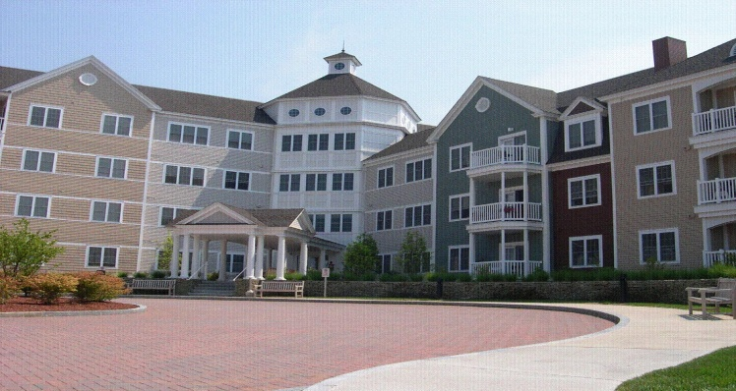
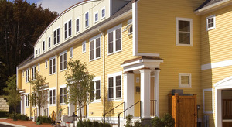
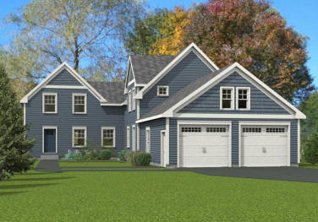
Goal 2: Affordability
Revise Zoning Regulations – Allow for the creation of affordable units through incentives, modifications to current regulations and adopting Inclusionary Zoning
Encourage Deed-Restricted Rental Units – Density bonuses, dimensional relief, partnerships with local organizations and the selling of surplus public land
Fund the Affordable Housing Trust – Ensure “local match” funding, create partnerships, support existing programs and allow for creation of new ones
End Homelessness – Increase supply of supportive housing, explore SRO housing, educate the community

Slide 5
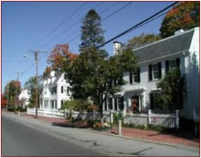
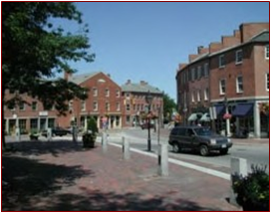
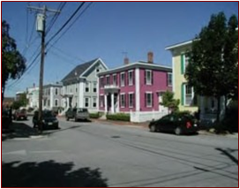
Goal 3: Development Complements
Preserve Neighborhoods’ Historic Character – Determine characteristics that make each neighborhood historically significant, create an inventory of these characteristics
Design Review of Residential Development – Establish guidelines to allow for development and redevelopment that respects the surrounding properties and neighborhood as a whole.

Slide 6
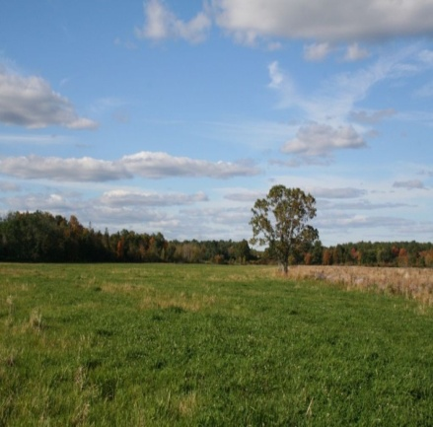
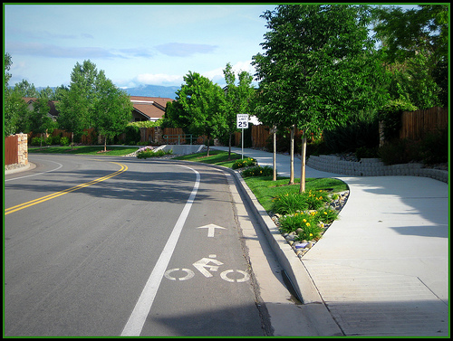
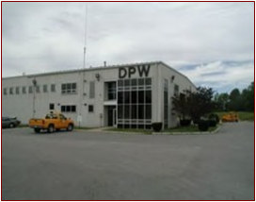
Goal 4: Respect our Resources
Protect Open Spaces – Cluster zoning for new subdivisions, inter-departmental communication to further open space goals/priorities, update subdivision rules and regulations
Promote Efficient and Safe Vehicular and Pedestrian Movement – create connecting streets (vs dead-ends and cul-de-sacs), carefully consider requests to waive sidewalk requirements
Evaluate Adequacy of City Infrastructure and Public Services – examine current capacity of City utilities, determine future capacity, conduct build-out analysis, determine growth impacts on budget, school system and provision of City resources.

Slide 7
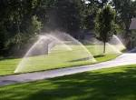
Goal 5: Energy Efficiency and Conservation
Utilize Sustainable Design Techniques – Incorporation of LID techniques, explore using gray water systems, implement high standards for weatherization through the Building Code, require “McMansions” to be LEED certified and/or to offset energy consumption
Community Education – Promote various financing options to incorporate energy conservation and generation efforts for residential properties
Allow Renewable Energy Generation – Relax zoning regulations for residential incorporation of renewable energy, create minor review process for design and installation of systems, collaborate with financial institutions for incentive programs

Slide 8
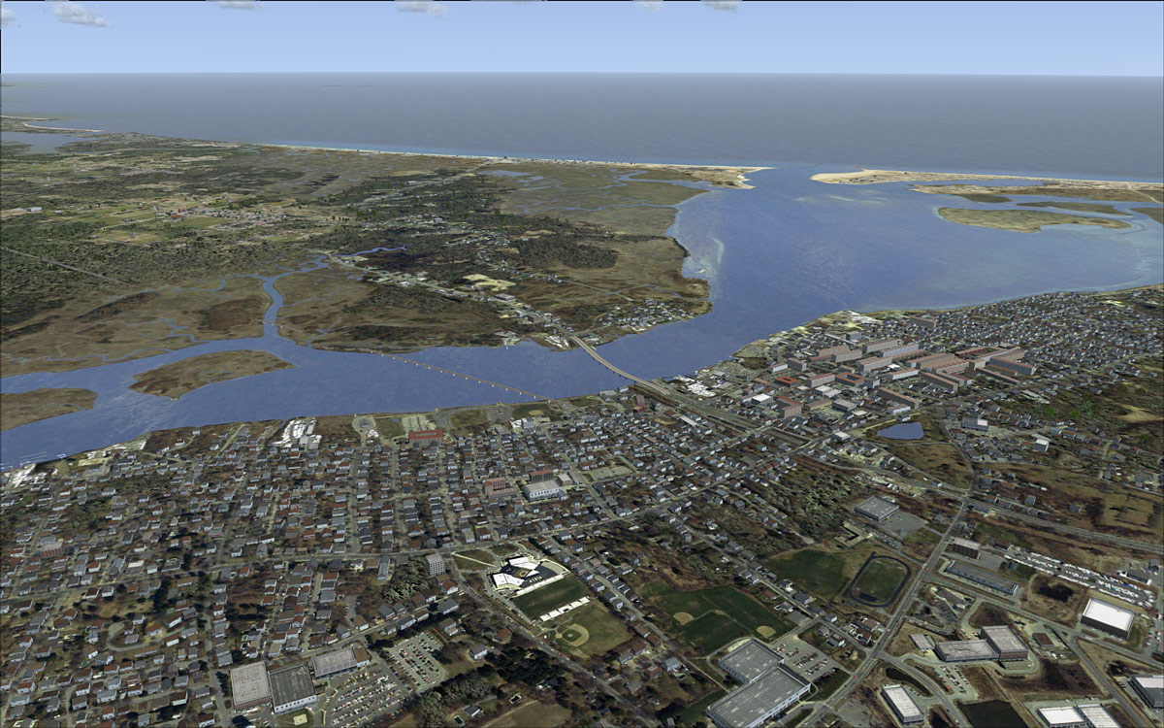
Master Plan 2014
Energy and Sustainability
Subcommittee Report
May 28, 2014

Slide 9
What is sustainability?
The traditional definition of sustainability calls for policies and strategies that ensure we are “meeting society’s present needs without compromising the ability of future generations to meet their own needs.”
To be sustainable, a city must have clean energy sources, sufficient clean water, clean air, sufficient food, biological diversity to support natural systems, and safe disposal or reuse of its wastes

Slide 10
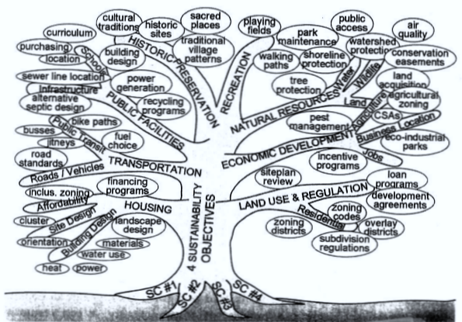
Vision of a Sustainable Community

Slide 11
Challenges and Opportunities
Human impacts from climate change, storm surge, ocean acidification, reduction of fisheries, loss of wetlands, accumulation of waste, and loss of critical habitat for plants and animals.
Opportunities exist to incorporate sustainability and clean energy goals in order to strengthen the local economy, enhance quality of life for all City residents.
Integrate energy and sustainability goals across city departments (and non-city entities)

Slide 12
Energy
Newburyport signed U. S. Mayor’s Climate Protection Agreement (2005)
EAC established by City Council (2007) to support reducing GHGs
Identifying policies and cost savings around energy
Installed 500kW solar PV on middle municipal buildings (2009)
Green Communities Act designation (2010)
20yr agreement for net metering 4.2MW of local Solar (2012)
Solarize Newburyport( 2012) installed over 400kw solar on private property
Clean Energy Strategies Grant and Planning (2013-2014)

Slide 13
Clean Energy and Energy Efficiency
Goal ES-1: Work toward becoming a net zero energy community and support local development of renewable energy and energy efficiency initiatives.

Slide 14
Clean Energy Objectives
Objective ES-1.1: Create a community-wide electricity aggregation and clean energy purchase program.
Objective ES-1.2: Produce energy from renewable resources.
Objective ES-1.3: Develop a “one-stop shop” for clean energy planning for the community and implement customer aggregation and third party financing programs for clean energy, including solar PV.
Objective ES-1.4: Procure solar to reduce municipal energy costs.

Slide 15
Energy Efficiency Objectives
Objective ES-1.5: Launch grassroots energy efficiency (“EE”) outreach campaign.
Objective ES-1.6: Educate those stakeholders on energy savings benefits from tree shading to reduce building energy use and greenhouse gas emissions.

Slide 16
Waste
Goal ES-2: Work toward net zero waste by: reducing solid and hazardous waste and toxic substances, increasing recycling, and organic waste diversion.

Slide 17
Waste Objectives
Objective ES-2.1: Reduce per capita waste generation.
Objective ES-2.2: Increase recycling.
Objective ES-2.3: Divert organics from the waste stream.
Objective ES-2.4: Greatly reduce litter and illegal dumping.
Objective ES-2.5: Reduce use of pesticides, herbicides and toxic chemicals.

Slide 18
Water
Goal ES-3: Protect and conserve the City’s water quality and supply. Integrate sustainability goals in water and sewer department planning.

Slide 19
Water Objectives
Objective ES-3.1: Protect the Artichoke Reservoir and other water supply sources.
Objective ES-3.2: Maximize water conservation and minimize water use and waste.
Objective ES-3.3: Manage rivers, streams, creeks, and ponds for high water quality and habitat.

Slide 20
Food
Goal ES-4: Increase and support local food production to begin to meet needs of residents.

Slide 21
Objective ES-4.1: Encourage use of vacant land, backyards, rooftops and schools for food production and community gardens and support Farmers’ Markets and CSAs.
Actions
Create database of neighborhood sustainable agricultural resources and consider supporting with tax reductions on sales or property taxes, or other tax incentives for businesses and homeowners growing food.
Consider a community service program where participants receive food in exchange for work on community agriculture.
Assist land trusts and actively seek funding to preserve agricultural land.
Modify city regulations to require edible garden space in all new development and amend zoning to support agricultural production.
Update city laws and regulations to allow for small-scale animal production.
Identify appropriate locations and promote bee keeping.
Support community gardens and encourage urban and surrounding farms.

Slide 22
Air
Goal ES-5: Achieve and maintain clean air quality for public health.

Slide 23
Objective ES-5.1: Air quality exceeds federal and state standards on an on-going basis.
Actions
Publish on the City’s website (HD) reportable emissions from point sources in the City and from the Newburyport air quality monitoring station.
Research effective policies to improve air quality and apply locally.
Develop policies to increase alternative or clean fuel vehicles in the City and decrease individual miles traveled.
Establish auto free zones.
Support expanded bike and pedestrian paths and interconnections.

Slide 24
Biodiversity
Goal ES-6: Minimize habitat destruction and maximize habitat value to preserve biological diversity, protect natural systems and enhance quality of life.

Slide 25
Biodiversity Objectives
Objective ES-6.1: Develop a “Significant Natural Resources Management Plan” integrated with an “Open Space and Recreation Management Plan” with the goal of maximizing habitat value.
Objective ES-6.2: Integrate sustainability goals, including biodiversity, watershed protection, and increased local food production, with land use and development planning and decisions.
Objective ES-6.3: Collect, organize, develop and utilize current and historic information on habitats and biodiversity.

Slide 26
Environmental Resilience
Goal ES-7: Work with local, regional, state and federal partners to protect against and adapt to effects of climate change.

Slide 27
Environmental Resilience Objectives
Objective ES-7.1 Flood and storm surge mitigation
Objective ES-7.2 Prepare for extreme weather including storm surge, high wind events, flooding, heat and drought
Objective ES-7.3 Educate public on climate change and urgency of CO2 reduction
Objective ES-7.4 Create underground utility corridors including utility for areas of city that have overhead utility poles

Slide 28
Public Comment
Comments?
Questions?
Suggestions?

Slide 29
Master Plan Update Project
Wednesday, June 11, 2014 at 6:30 p.m.
in the City Hall Auditorium
Spotlighting the Master Plan Chapters:
Transportation
Cultural Resources
Public Facilities and Services
Please join City officials, staff and volunteers as we continue to discuss specific chapters of the Master Plan.
This is your opportunity to be a part of the process, to influence change, and to collaborate with your friends and neighbors to create a comprehensive vision and plan for Newburyport.

Slide 30
Questions or Comments?
Visit
http://www.cityofnewburyport.com/master-plan-steering-committee
for more information, including:
A link to the 2001 Master Plan
Project Schedules
Meeting Agendas and Notes
Presentations
Committee Lists and Contact Information
Andy R. Port, AICP
Director of Planning
aport@cityofnewburyport.com
Kate Newhall-Smith
Staff Planner
ksmith@cityofnewburyport.com

