Slide 1
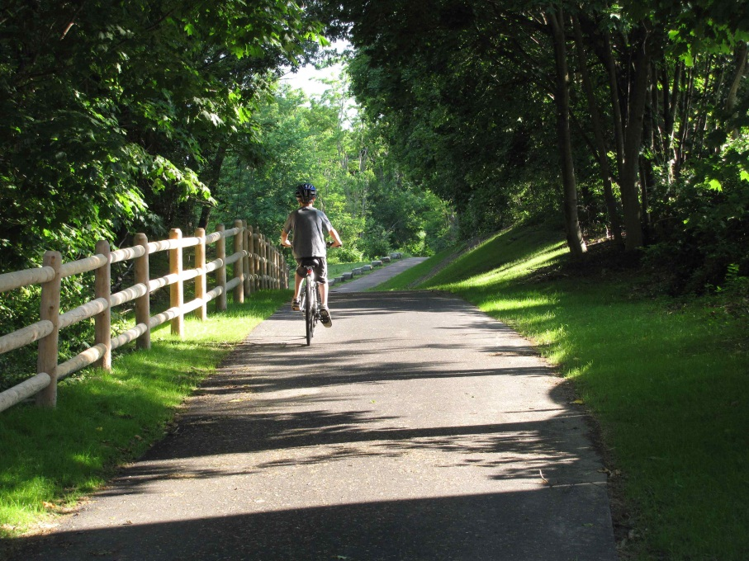
Master Plan 2014
Natural Resources,
Open Space and Recreation

Slide 2
GOAL 1
Protect and enhance Lands of Public Conservation and Recreational interest, including the City’s defining scenic heritage landscapes and areas that support essential wildlife habitat and ecosystems, water protection, flood management, and a variety of recreational interests.

Slide 3
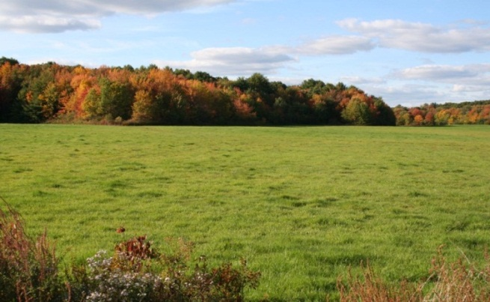
Objective 1.1
Protect pastoral character and scenic views and support natural resources including: agricultural uses; a wide range of bird and marine and estuarine life for migrating, native, endangered and threatened species; and a largely un‐fragmented habitat corridor including bald eagle habitat.
Action -1.1:1 – Protect and preserve scenic vistas and working farms, water systems, vernal pools and priority habitats, Great Marsh ecosystem and other marshlands, and scenic trail systems in the Common Pasture, Little River and Parker River Watershed areas, Merrimack River waterfront, Curzon Mill/Artichoke River area, and land along Old Ferry Road
Action -1.1:2 – Protect scenic byways and roadways
Action -1.1:3 – Encourage and support private land conservation measures
Action -1.1.4 - Encourage and support volunteer stewardship groups who care for public open space
Action -1.1.5 – Support active farming use of land

Slide 4
Objective 1.2
Support opportunities to expand and enhance open space and recreational areas and facilities
Action -1.2:2 – Identify and act on opportunities for adding new neighborhood parks to provide access within walking distance of all residents
Action -1.2:3 – Identify and secure funding for land acquisition and protection
Action -1.2:4 – Evaluate active or passive recreational use potential for Crow Lane areas associated with landfill and former compost facility
Action -1.2:5 – Continue to identify and act on opportunities for creating new athletic fields
Action -1.2:6 – Revitalize of underutilized parks such as Atwood Park, 270 Water Street, and Cushing Park
Action -1.2.7 – Preserve and enhance public access to and enjoyment of the Central Waterfront and its vistas
Action -1.2.8 – Support community gardening efforts
Action -1.2:1 – Incorporate provision of public open space and/or recreation areas in any major commercial and mixed use development projects and major redevelopment projects, including the area around the MBTA station, the Storey Avenue commercial area, Route 1 traffic circle and the Central Waterfront

Slide 5
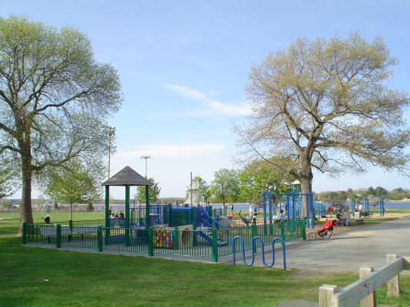
Objective 1.3
Enhance management of open spaces and recreational areas
Action -1.3:1 – Continue to maintain an updated list of lands of recreation and conservation interest
Action -1.3:2 – Support actions of Open Space Committee and enhance engagement with city staff
Action -1.3:3 – Consider coordination of a periodic review of city-owned land to identify potential changes of management and/or use
Action -1.3:4 – Encourage partnership between City Hall and schools to maximize use of athletic facilities through coordination of scheduling and usage fees

Slide 6
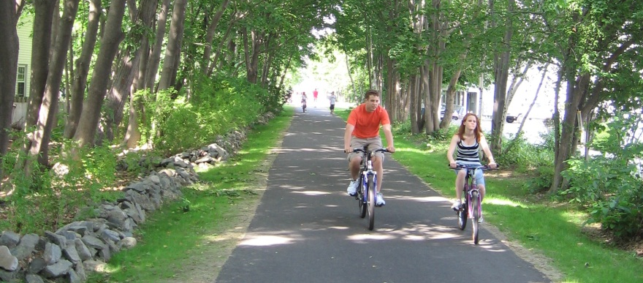
GOAL 2
Maintain a high quality of parks, recreation areas, trails and other open spaces that are safe, attractive, preserve historic resources, and provide a range of active and passive recrea-tional opportunities for all residents and visitors.

Slide 7
Objective 2.1
Provide high level of maintenance of park and recreation facilities
Action -2.1:1 –Increase number of dedicated park staff
Action -2.1:2 – Expand budget capacity for parks and recreational facilities management
Action -2.1:3 – Optimize use of existing athletic facilities by improving field conditions and maintenance practices
Action -2.1:4 – Continue to formalize and encourage volunteerism through volunteer events, programs, and “friends of park” groups
Action -2.1:5 – Identify reliable and consistent revenue stream for parks and open space maintenance for the future; continue to build public-private partnerships; continue to grow the Newburyport Parks Conservancy
Action -2.1.6 – Maintain walking trails throughout the city

Slide 8
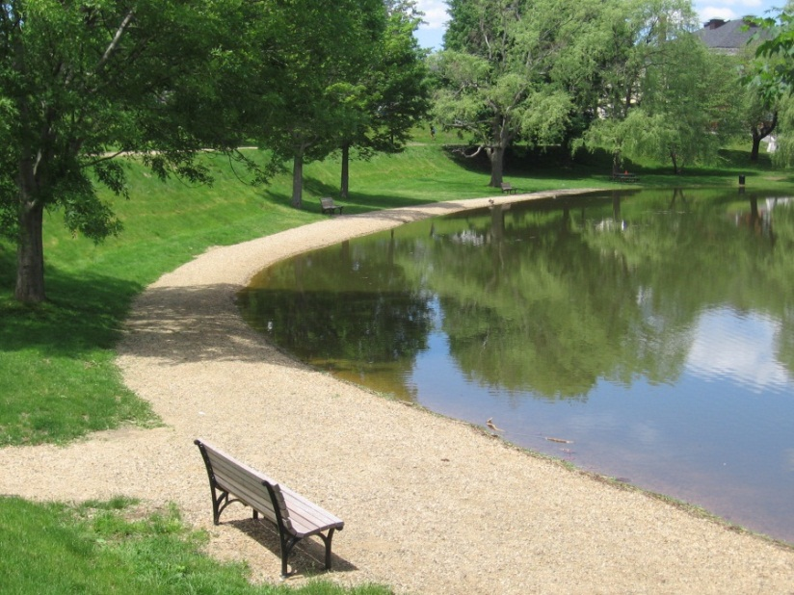
Objective 2.2
Improve declining parks and recreation facilities
Action -2.2:1 – Continue to plan for, budget for, and execute renovations to existing parks and facilities to create safe, accessible, and enjoyable parks and facilities
Action -2.2:2 – Identify reliable and consistent revenue stream for parks and open space capital improvements; continue to build public-private partnerships; continue to grow the Newburyport Parks Conservancy; and seek grant funding for improvement projects
Action -2.2:3 – Build new athletic fields to meet demand and reduce over use of existing fields
Action -2.2.4 – Improve walking trails in City Forest

Slide 9
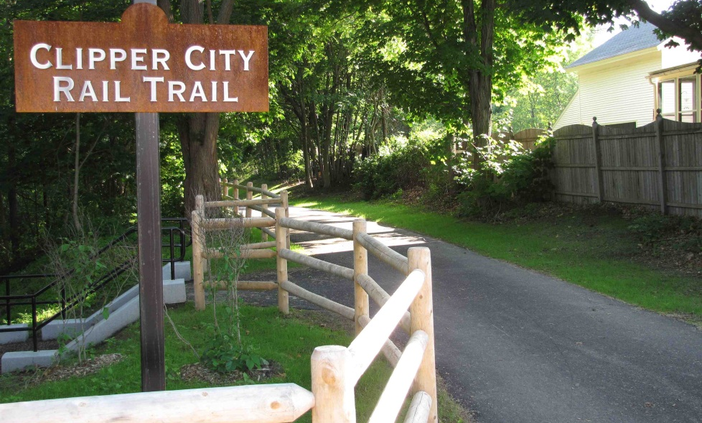
GOAL 3
Improve access to, connections between, awareness and use of public open space and recreation areas

Slide 10
Objective 3.1
Improve public awareness of, public access to, and use of the City’s open space and recreation areas
Action -3.1:4 –Create a guide for recreation areas and paths and including profiles of the historic farms of Newburyport.
Action -3.1:5 –Explore additional locations for interpretive panels and other signage at historic and natural sites in public open space and recreation areas.
Action -3.1:6 – Identify additional locations for adding “ways to the water” markers as recommended in the Strategic Waterfront Plan.
Action -3.1:7 – Regularly assess and provide for recreation needs and interests of residents of all ages, incomes, and abilities and adapt recreational and cultural activity offerings to address evolving needs including formal and informal, active and passive recreation in our parks and open spaces.
Action -3.1:8 – Preserve and enhance public access to and enjoyment of the Central Waterfront and its vistas
Action -3.1:9 – Investigate parking solutions for use of City Forest and other nature trails
Action -3.1:1 –Collaborate with conservation and education organizations to provide natural history and educational programming at City open space properties.
Action -3.1:2 –Increase public awareness of recommendations of the Heritage Landscape Inventory report.
Action -3.1:3 – Expand city web site to provide more complete and efficient access to information on parks, fields, programming open spaces and conservation lands.

Slide 11
Objective 3.2
Improve and create new connections between existing open space areas wherever possible
Action -3.2:1 –Continue to explore trail extension from Maudslay State Park to Moseley Woods Park via trail route beneath I-95 Whittier Bridge.
Action -3.2:2 –Explore opportunities to utilize unpaved public rights of way for habitat sensitive recreational trails including Old Ferry Road beyond Arrowhead Farm and Crow Lane between the city compost center and Route 95.
Action -3.2:3 – Support implementation/completion of Clipper City Rail Trail and Merrimack River Trail.
Action -3.2:4 – Work with developers in the Route 1 Traffic Circle area and along the Clipper City Rail trail to maintain existing open space connections and create and/or complete new connections between open space and trail systems.

Slide 12
Objective 3.3
Improve bike and pedestrian access throughout the City
Action -3.3:3 – Improve bike and pedestrian access and safety across Route 1 traffic circle.
Action -3.3:4 –Improve bike and pedestrian access and safety to travel along (east to west) and across (north to south) Storey Ave with particular focus at high traffic locations between Belleville Cemetery and Daniel Lucy Way.
Action -3.3:5 –Consider use of additional boardwalks for pedestrian access in environmentally sensitive areas, such as Plum Island and other wetland resource areas.
Action -3.3:6 –Consider establishment of multimodal access amenities such as a bike share program
Action -3.3:7 – Support implementation/completion of Clipper City Rail Trail and Merrimack River Trail.
Action -3.3:1 –Improve bike safety along High Street and along Hale Street, including vegetative management to improve sight lines and undertake regular street cleaning to clear obstructions.
Action -3.3:2 –Schedule and fund annual re-striping of Plum Island Turnpike Bike Lanes and High Street Bike Lanes.

Slide 13
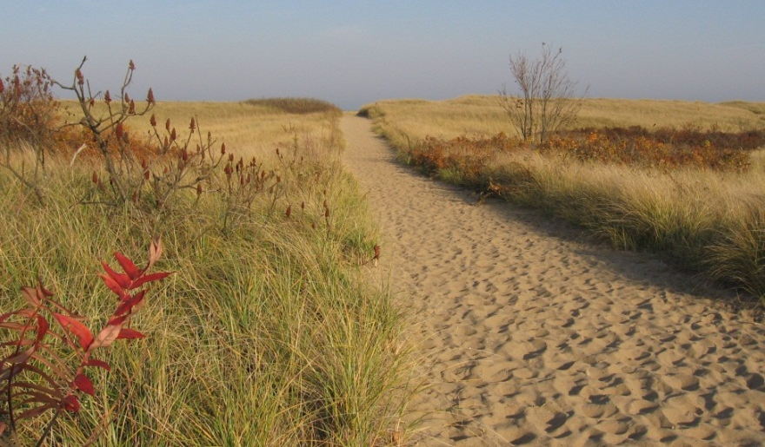
GOAL 4
Improve management of the City’s natural resources, including water bodies, forested areas, wetlands and the coastal dunes and barrier beach

Slide 14
Objective 4.1
Encourage the use of Low Impact Design (LID) techniques and stormwater best management practices in new developments and redevelopments throughout the City, especially the Business Park and other environmentally sensitive areas.
Action -4.1:3 –Maintain position of Conservation Administrator to oversee wetland permitting and coordinate with other city staff, boards and commissions on natural resource management issues.
Action -4.1:4 –.Work with conservation partners to educate local landowners about reducing and eliminating invasive plant species and incorporating native plant species into landscape designs.
Action -4.1:5 – Educate landowners about stormwater management techniques, including maintenance of new and existing stormwater management features, such as swales, detention basins, rain gardens, etc.
Action -4.1:6 –.Continue to administer and enforce the Newburyport Wetlands Protection Ordinance and Regulations as they relate to inland wetland resources.
Action -4.1:7 - Identify trees and urban forest as natural resources to be protected and enhanced; act to promote tree health and replacement on public and private land; and ensure enforcement of city’s tree ordinance.
Action -4.1:1 –Create a Stormwater Management Utility
Action -4.1:2 –Encourage Boards and Commissions to request that applicants proposing new or redevelopment projects incorporate LID techniques into their designs.

Slide 15
Objective 4.2
Improve protection of the coastal environment on and around Plum Island.
Action -4.2:1 –.Continue to administer and enforce the Newburyport Wetlands Protection Ordinance and Regulations as they relate to the Plum Island Coastal Dunes.
Action -4.2:2 – Continue to research and pilot test new environmentally sensitive methods for capturing sand and building dune volume and stability (e.g., biomimicry, sand fencing, beach grass planting, etc.)
Action -4.2:3 –.Continue to update and implement the recommendations of the Newburyport Beach Management Plan.
Action -4.2:4 –.Continue to participate in the Merrimack River Beach Alliance and other local groups working to protect the coastal environment.

Slide 16
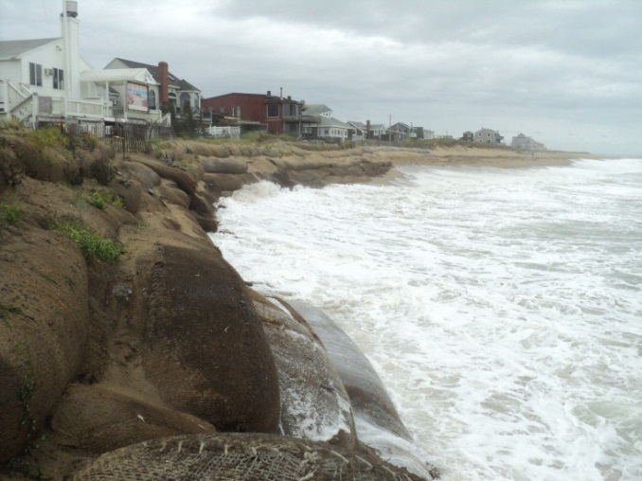
Objective 4.3
Protect the City’s natural resources and public open space and recreation areas from the damaging effects of projected sea level rise (SLR) and associated storm surges through comprehensive “coastal resiliency” planning.
Action -4.3:1 –.Undertake a comprehensive city-wide SLR risk assessment and vulnerability analysis.
Action -4.3:2 –Develop a strategic Coastal Resiliency Master Plan, including recommendations for protection of public infrastructure and open space.

Slide 17
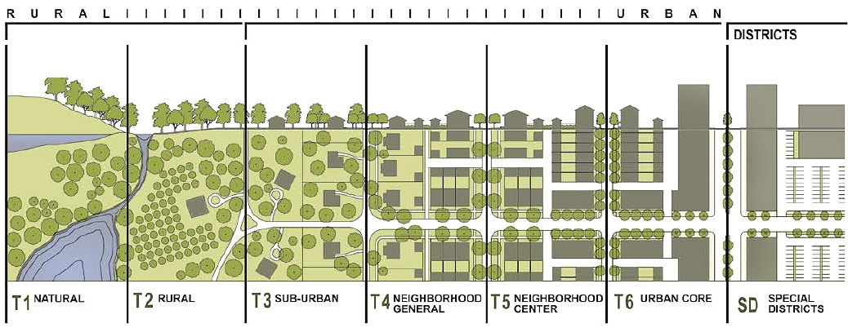
Master Plan 2014
Land Use & Development

Slide 18
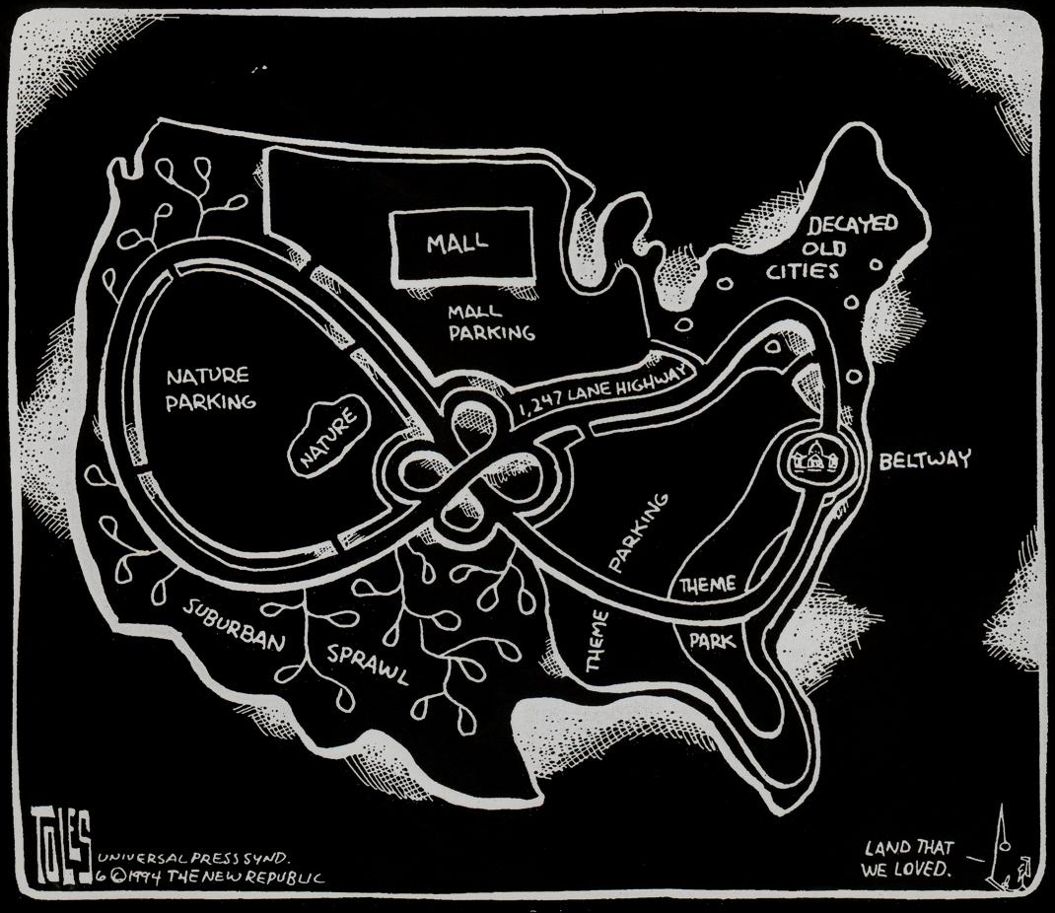
Smart Growth
Sustainability
Guiding Principles

Slide 19
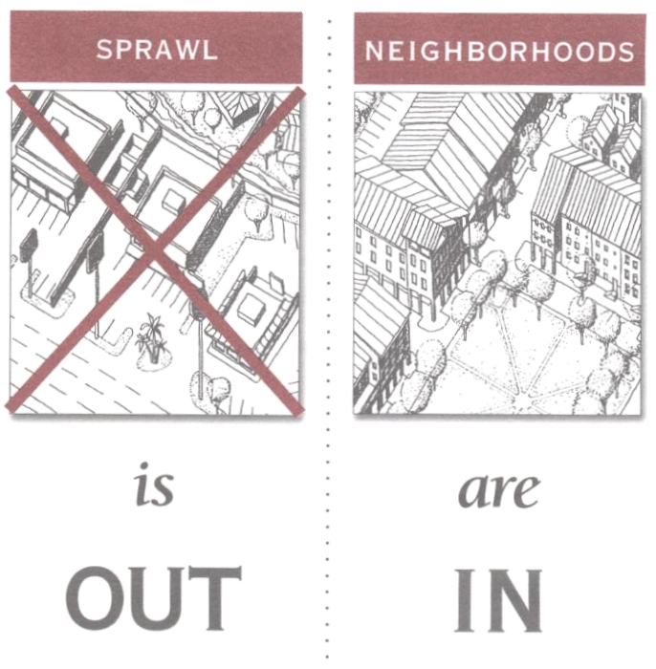
Smart Growth
Sustainability
Guiding Principles

Slide 20
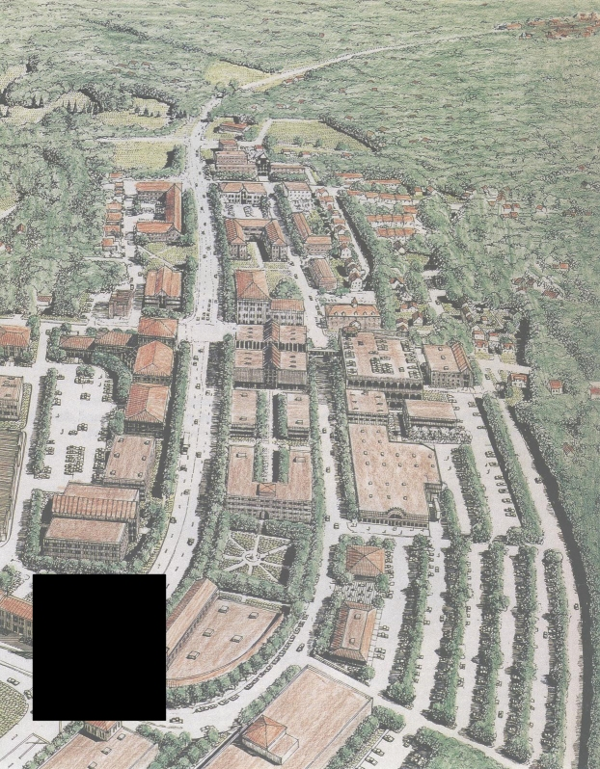
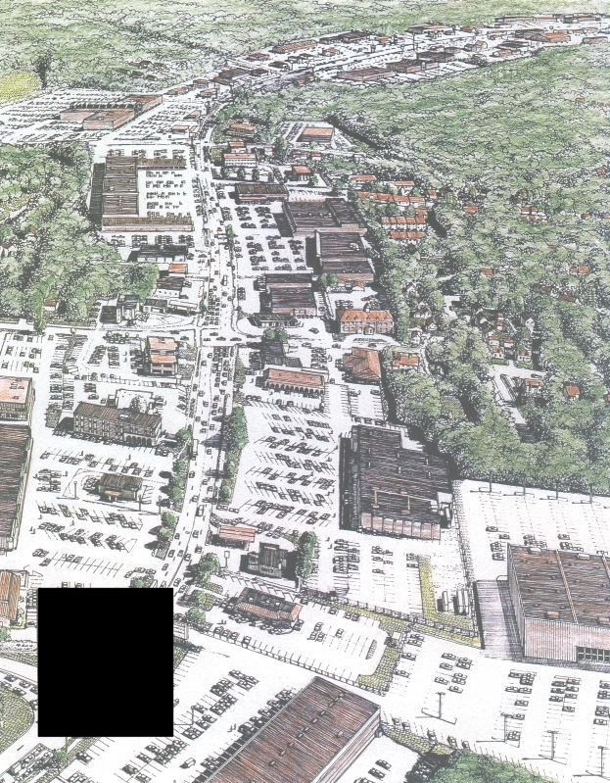
A
B

Slide 21
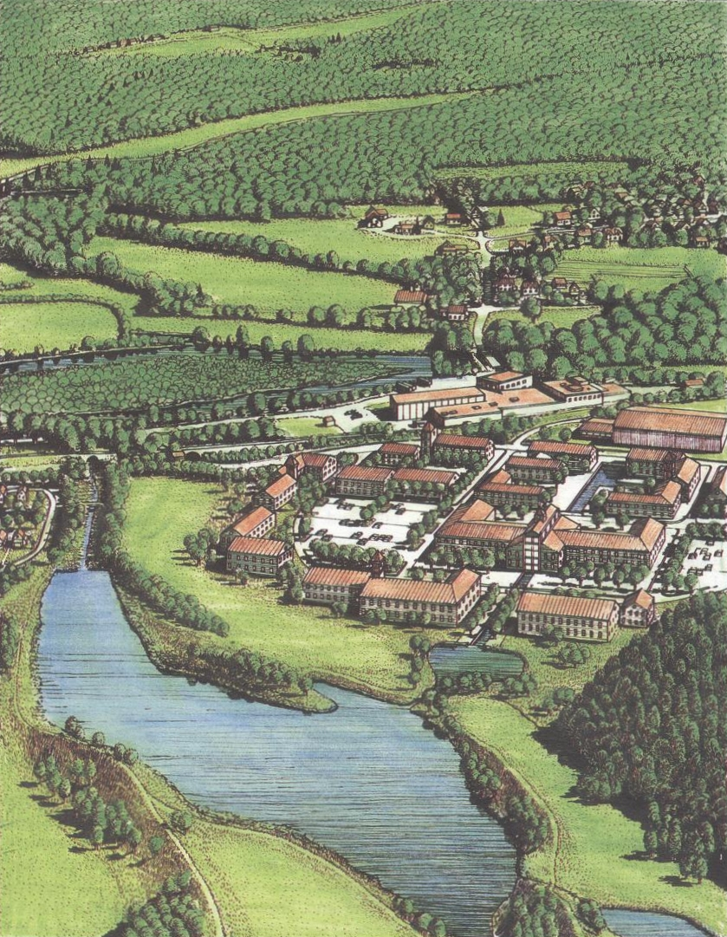
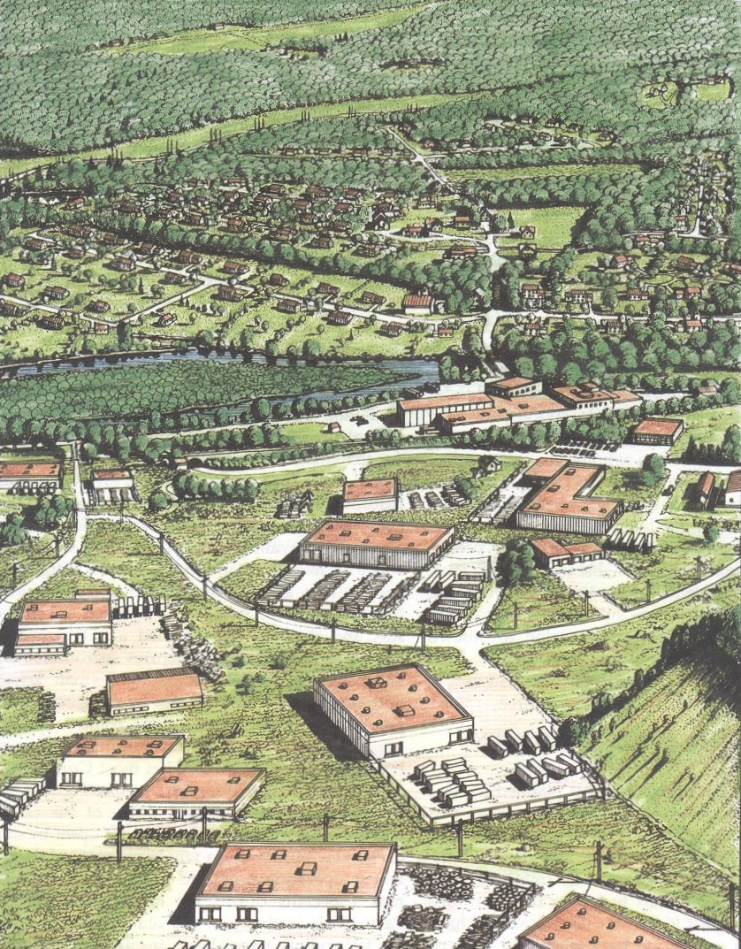
A
B

Slide 22
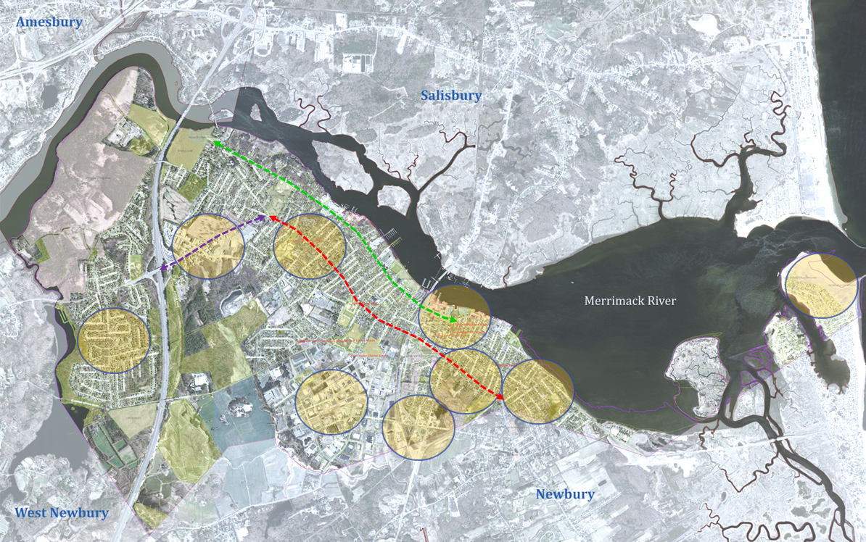
Key Areas & Corridors

Slide 23
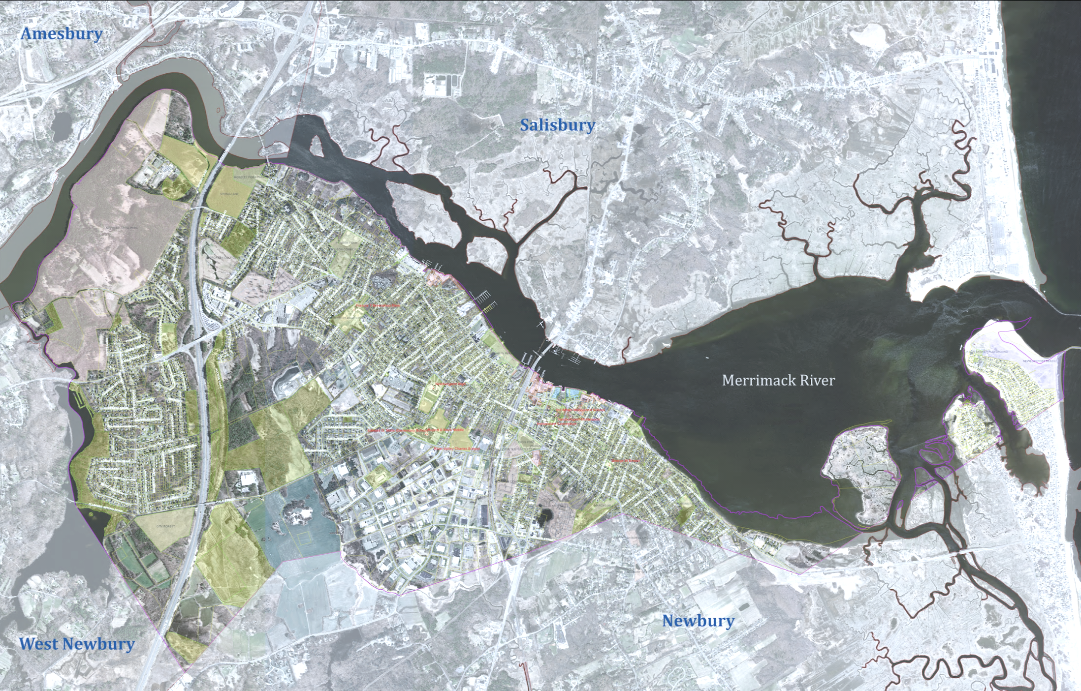
= Commercial / Mixed Use
= Residential
= Industrial
= Open Space / Agriculture
= Priority Development Area (PDA)
Maudslay
= Priority Preservation Area (PPA)
Storey Ave
Port Plaza
North End
Plum Island
Common
Pasture
Downtown
West End
Business
& Industry
Park
Back Bay
South End
Myette
Farm
Route 1
MBTA
Station
City Forest

Slide 24
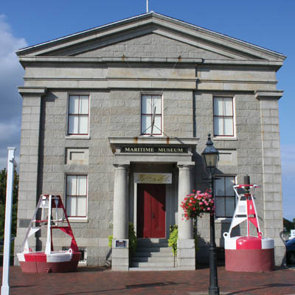
Downtown
Maintain and enhance the downtown's role as the City's civic, cultural, service and commercial center, and as a regional commerce center for surrounding towns by encouraging compatible redevelopment and infill development.

Slide 25
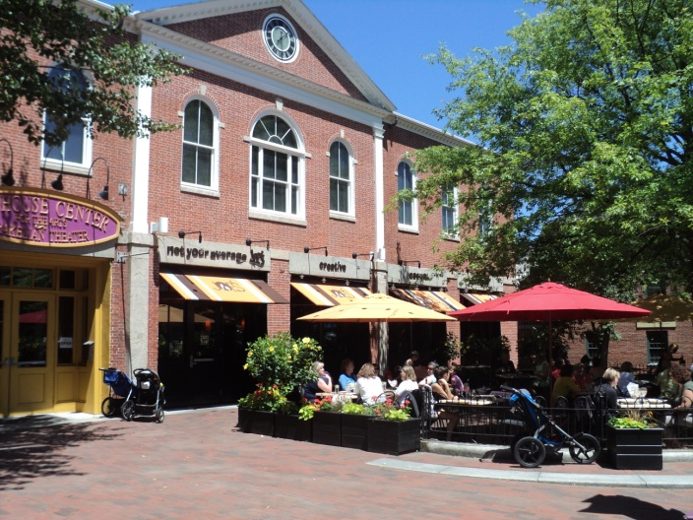
Downtown
Expand the central waterfront park, reducing the “footprint” of parking lots on NRA lands, creating a new harbormaster facility to encourage boating activities and tourism, and establishing a permanent visitor center with public restrooms.

Slide 26
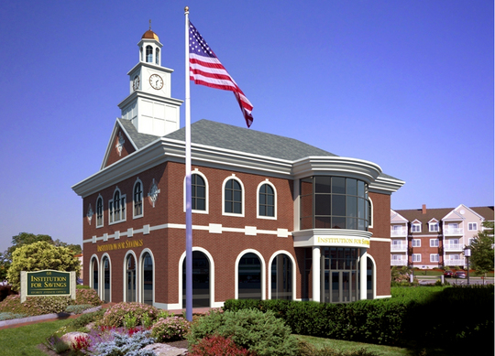
Storey Ave
Transform the Storey Ave gateway from a generic commercial strip-mall into a mixed-use village center more characteristic of Newburyport and subject to more stringent architectural design review.

Slide 27
Route 1 Traffic Circle & Commuter Rail Station
Transform the Route 1 Traffic Circle and the MBTA Commuter Rail Station area into a Mixed Use Transit Oriented Development (TOD) with pedestrian-friendly streetscapes and additional residential development with ancillary amenities.

Slide 28
Business & Industry Park
Encourage private investment and economic development opportunities within the Newburyport Business & Industry Park without exacerbating potential flood damages by encouraging vertical expansions and the conversion of underutilized parking areas into usable building space.

Slide 29
South End
Preserve the character of the High Street and Water Street corridors, ensure the compatibility of infill development, encourage 2 and 3-family residential use, consider allowing by-right accessory units and adapt to climate change and natural hazards near the Merrimack River.

Slide 30
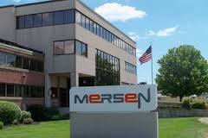
North End
Preserve the character of the High Street and Merrimac Street corridors, encourage commercial, mixed-use or institutional (higher education) uses at the Mersen site, ensure the continued success of Anna Jaques Hospital and yacht/boating club uses, adopt neighborhood design guidelines, encourage 2 and 3-family residential use, consider allowing by-right accessory units.

Slide 31
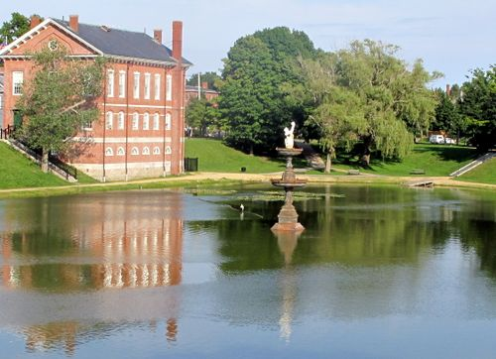
Back Bay
Encourage one and two-family use, but not three-family use, protect the "CVS" commercial node, adopt architectural standards for redevelopment of this site and properties around the Bartlett Mall.

Slide 32
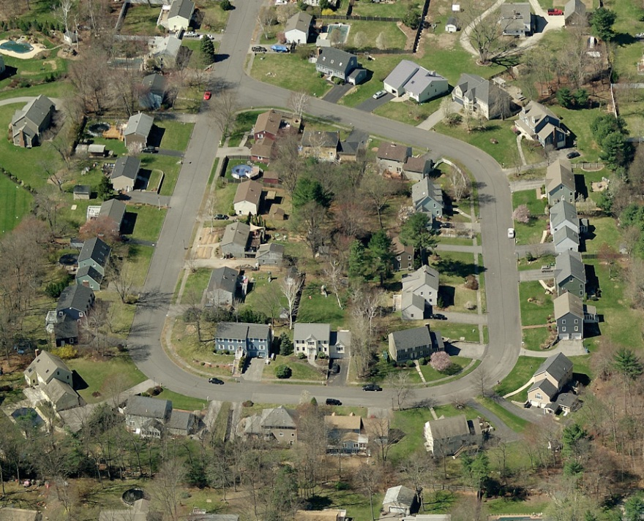
West End
Discourage truck traffic in residential neighborhoods, preserve and protect the character of existing residential neighborhoods.

Slide 33
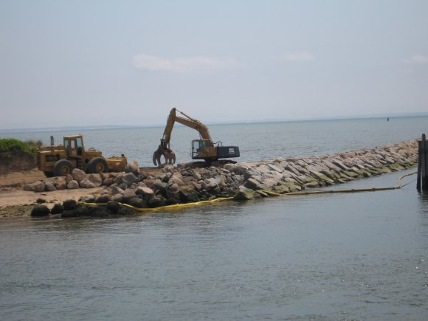
Plum Island
Continue to prohibit future growth and development on the island while promoting the modification of existing homes in order to minimize public and private loss from natural hazards, and to adapt to ongoing climate change.

Slide 34
Open Space & Agricultural Lands
Ensure "Priority Preservation Areas" remain undeveloped.
Direct new investment, infrastructure, development, redevelopment and infill development into "Priority Development Areas."

Slide 35
Primary Tools
Zoning Ordinance Amendments
(Comprehensive Zoning Review & Rewrite)
Architectural Design Review
(Comprehensive Zoning Review & Rewrite)
Site Plan Review
Targeted Investment in Public Infrastructure
Acquisition of Land or Conservation Restrictions

Slide 36
Public Comment
Comments?
Questions?
Suggestions?

Slide 38
Questions or Comments?
Visit
http://www.cityofnewburyport.com/master-plan-steering-committee
for more information, including:
A link to the 2001 Master Plan
Project Schedules
Meeting Agendas
Committee Lists and Contact Information
Andy R. Port, AICP
Director of Planning
aport@cityofnewburyport.com
Kate Newhall-Smith
Staff Planner
ksmith@cityofnewburyport.com

